Slide 1
OPEN Global Independent Research Initiative
ENERGY SYSTEM MODELS
USER AND DEVELOPER COMMUNITY
SOLVER
DATA
01.03.2022
Notes:
OPEN:
- To avoid information asymetries industry and policy
TOGETHER means:
1 model to cover the world
1 modular architecture to allow parallel work and improvement
BENEFITS OF WORKING TOGETHER:
- Faster development
- Improvements have global impact
- Less documentation per person
Everyone can earn maintainership

Slide 2
Fabian Neumann and Tom Brown. PyPSA: Free Sofware for Investment Planning in Sector-Coupled Energy Systems
https://www.neumann.fyi/files/pesgm2020.pdf

Slide 3
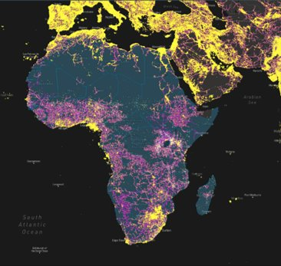
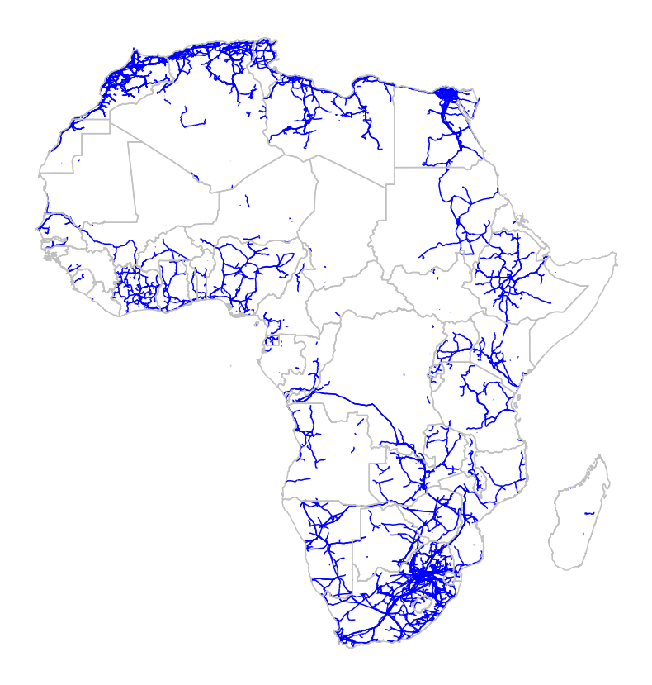
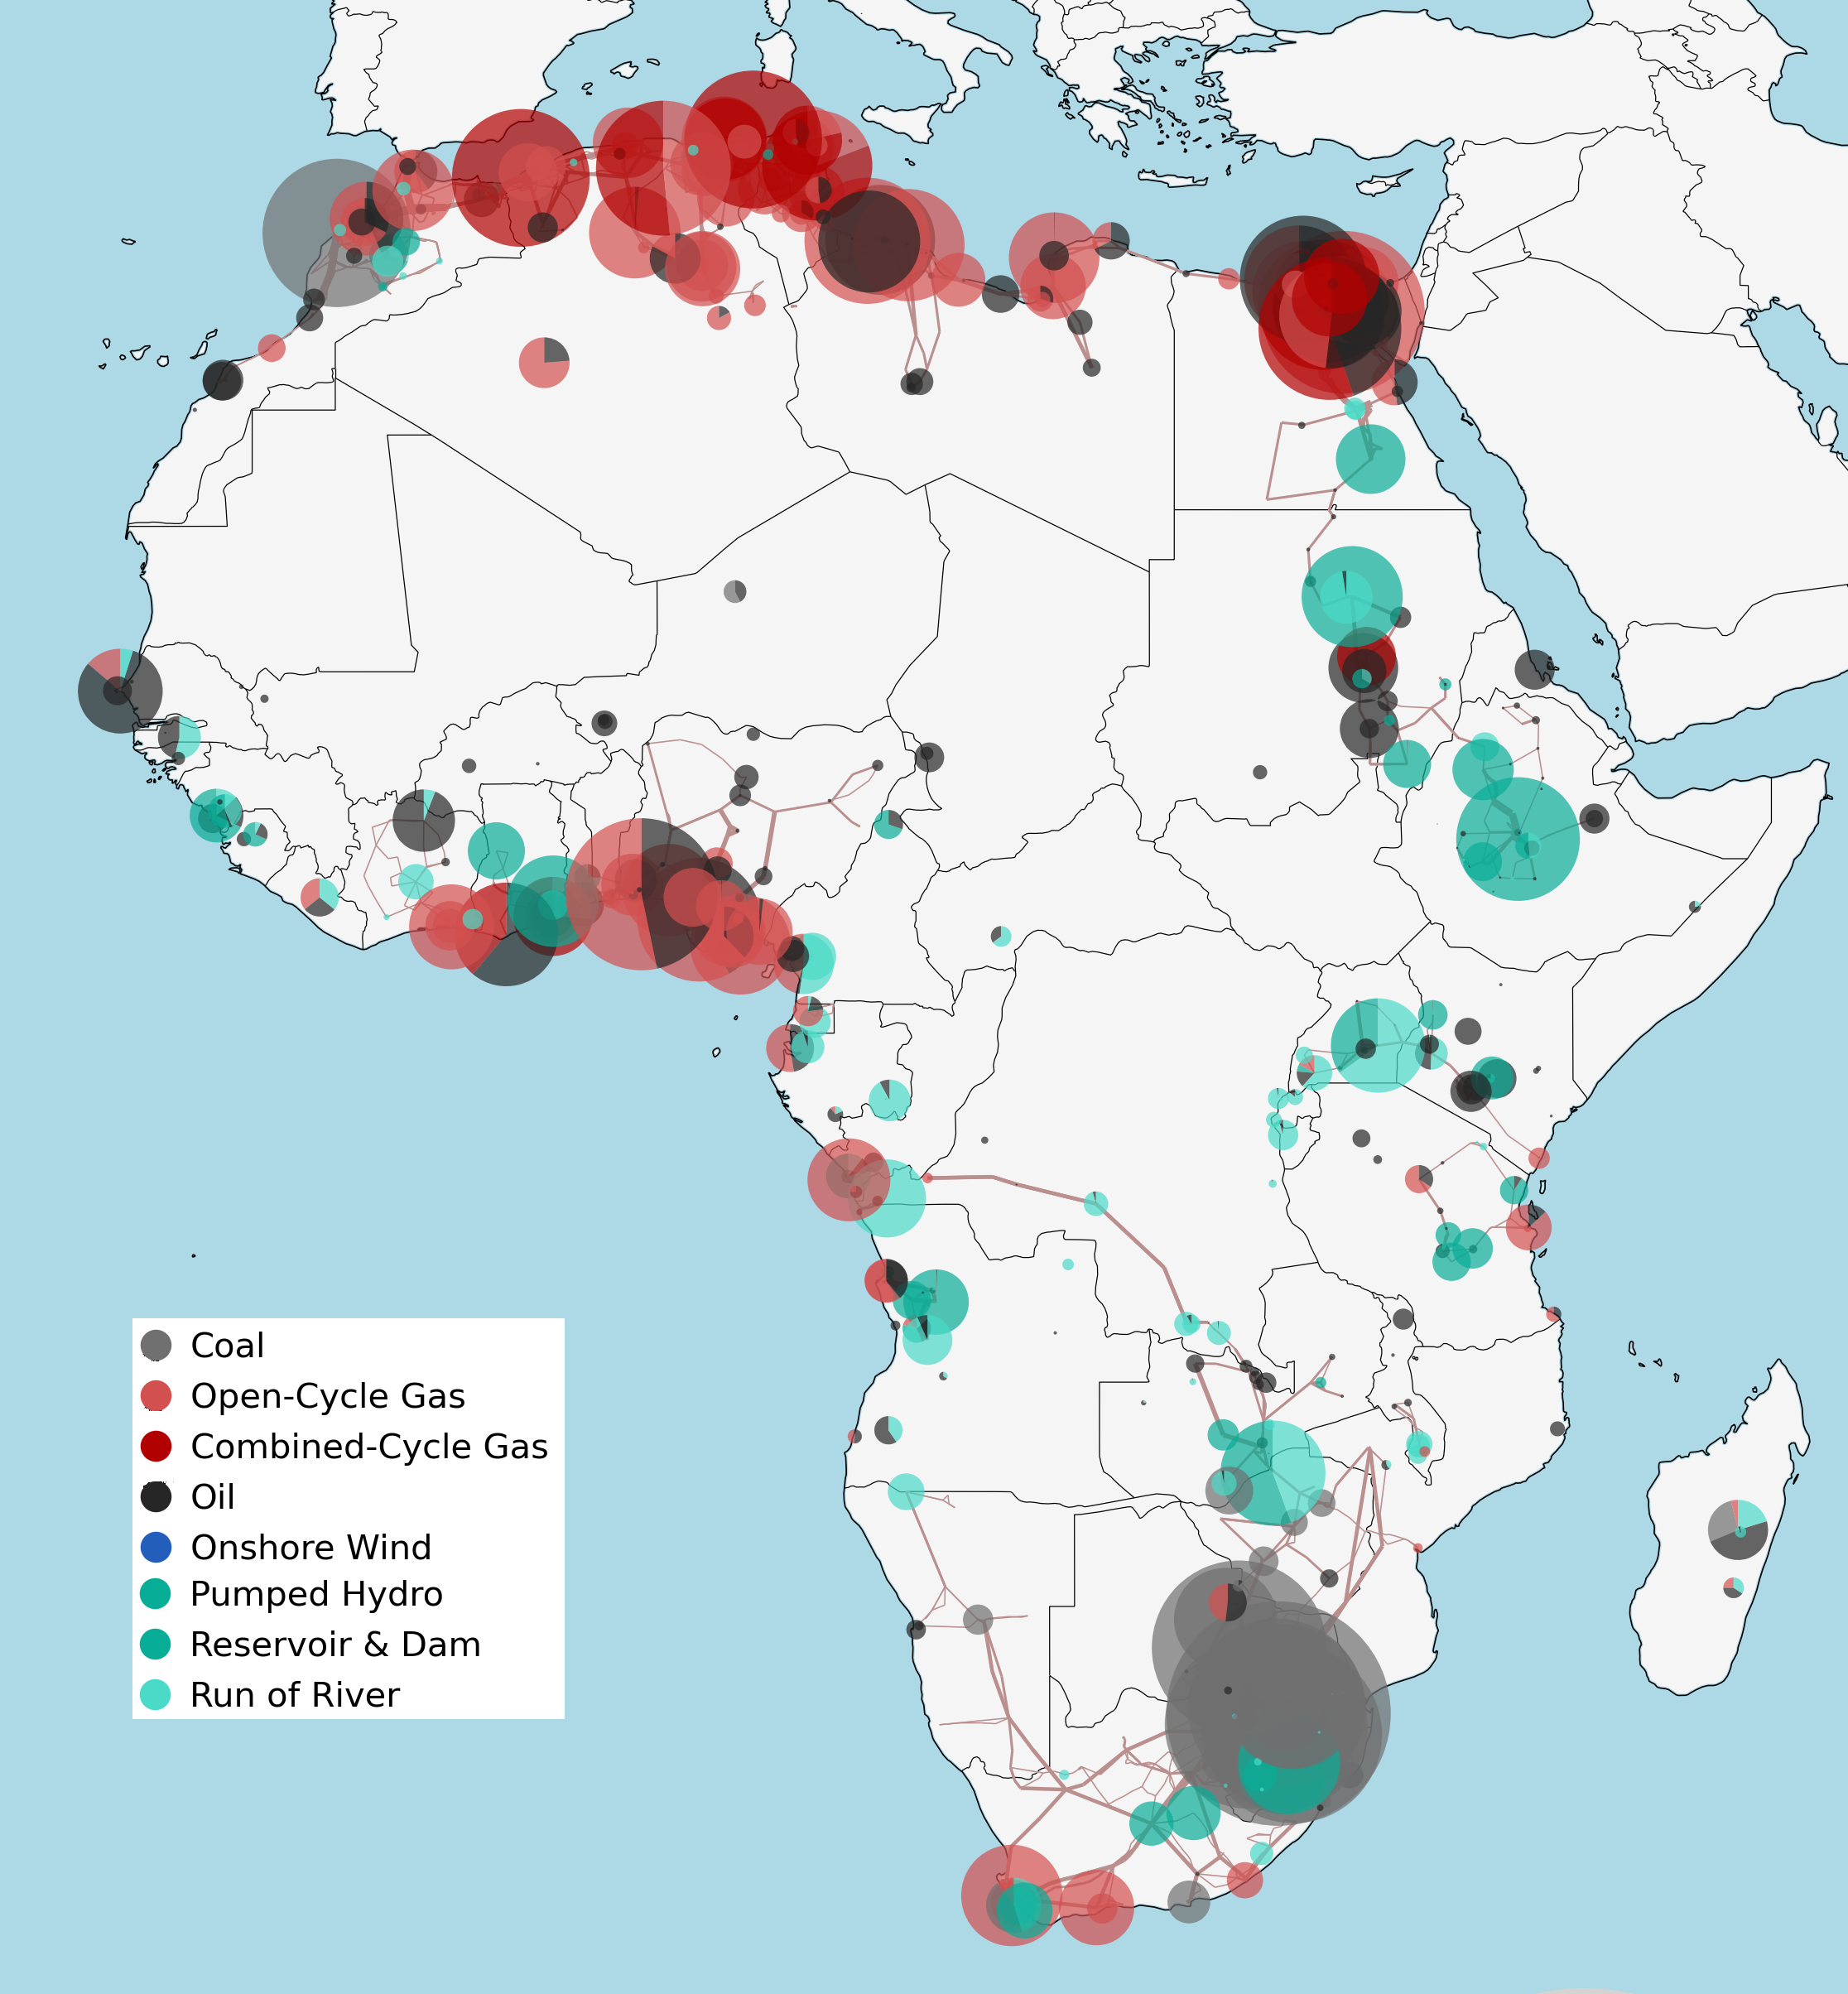
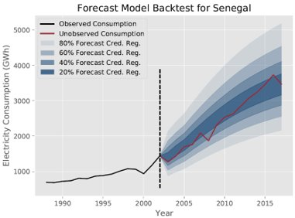
USE EXISTING DATA TO PLAN THE FUTURE
DEMAND
SUPPLY
NETWORK

Slide 4
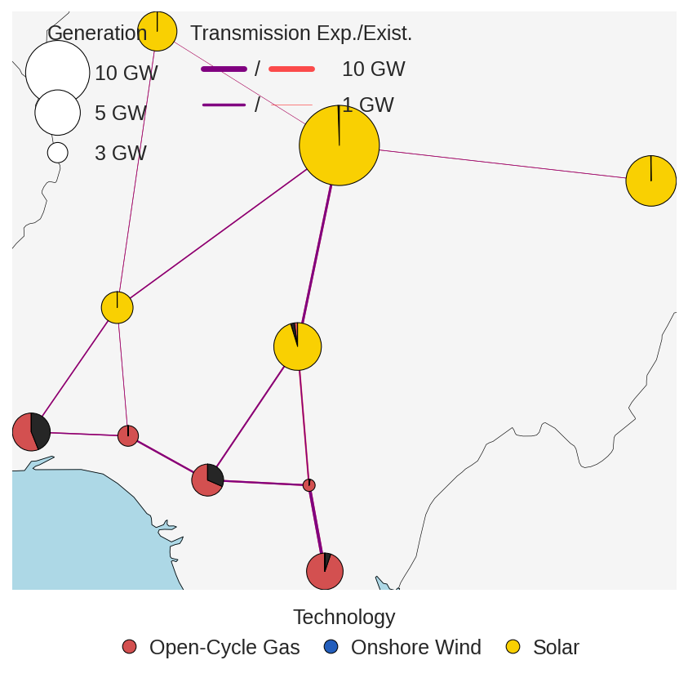
195 TOOLKITS VS 1 TOOLKIT
- Divided community
- 195 documentations
- Tons of duplications
- Poor performance
- Low standard
- Slow innovation
+ One community
+ One documentation
+ Limited duplications
+ Good performance
+ High standard
+ Fast innovation

Slide 5
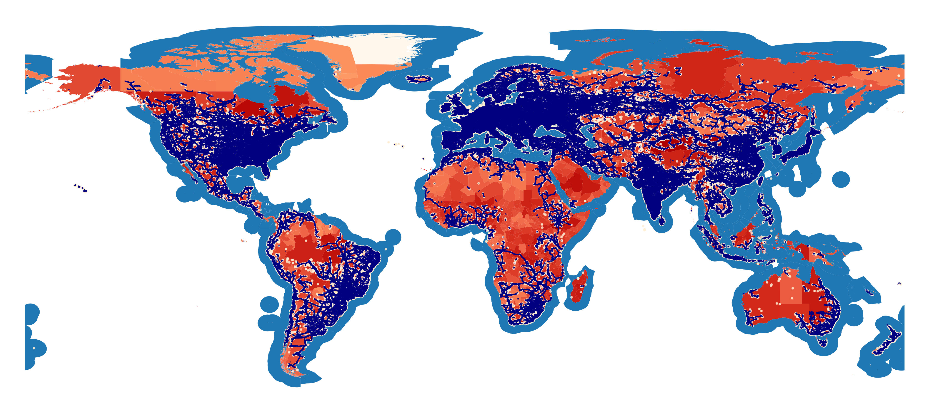
GLOBAL DATA BY DEFAULT
WIKIPEDIA
OF APPLIED
DATASTREAMS

Slide 6
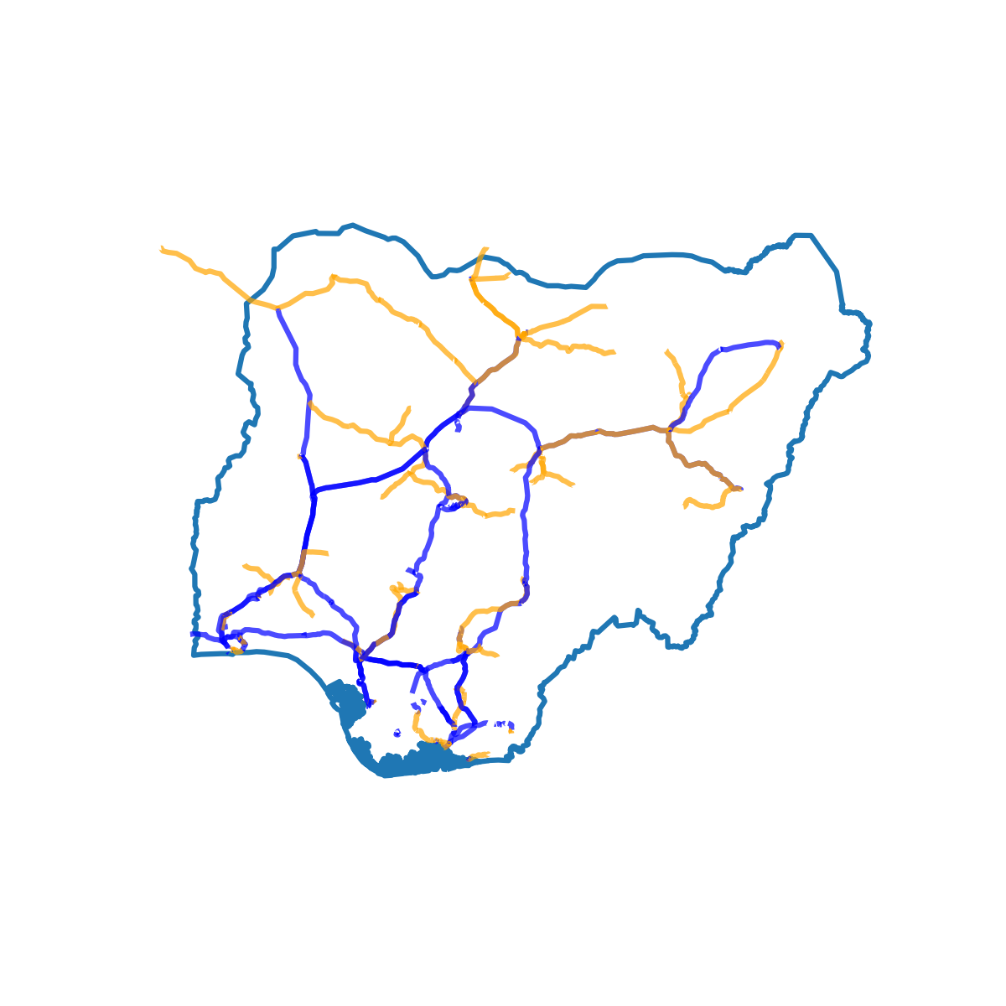
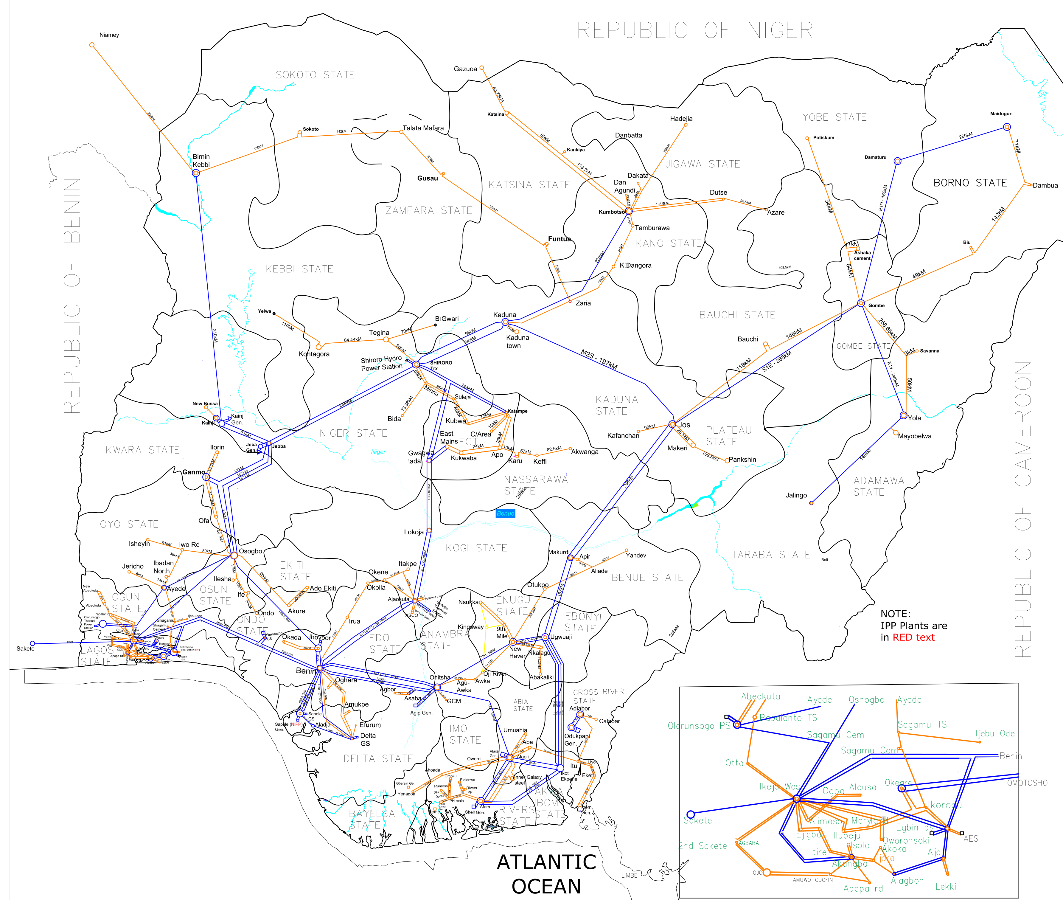
IMPLEMENT YOUR COUNTRY DATA IN THE EARTH FRAMEWORK
Open Street Map. Nigeria

Slide 7
WHAT IF YOU ARE MISSING DATA?

Slide 8
I.
INFRASTRUCTURE
DETECTION
II.
DEMAND PREDICTION

Slide 9
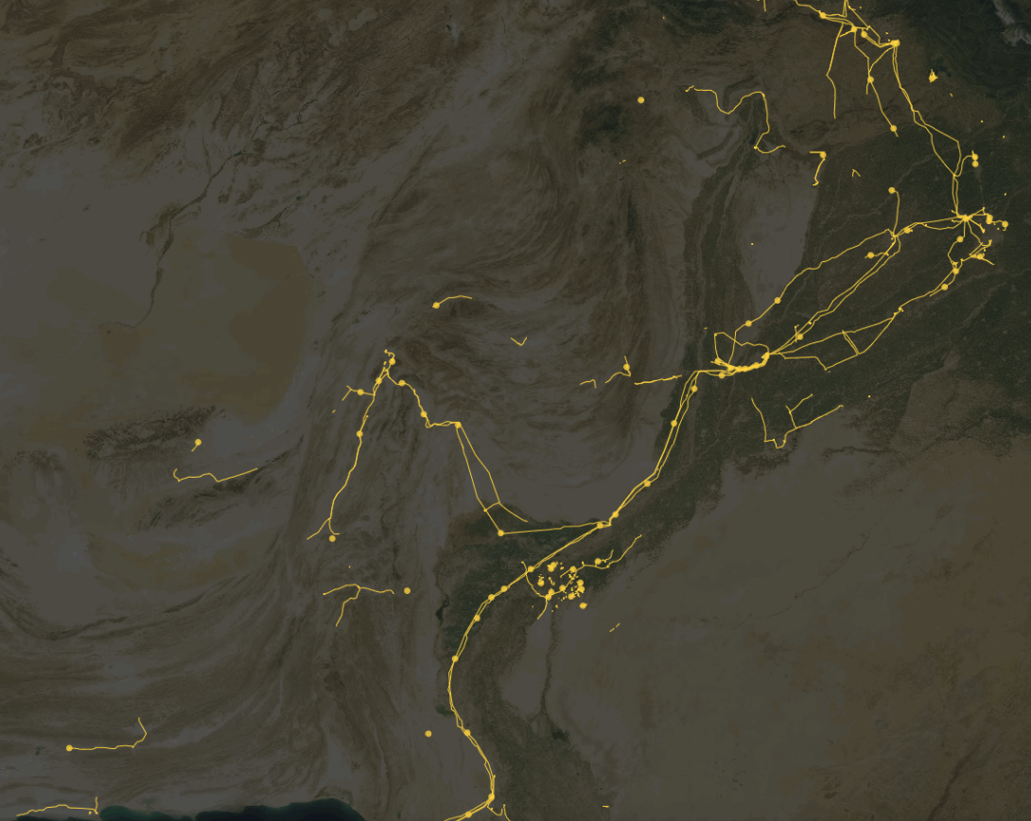
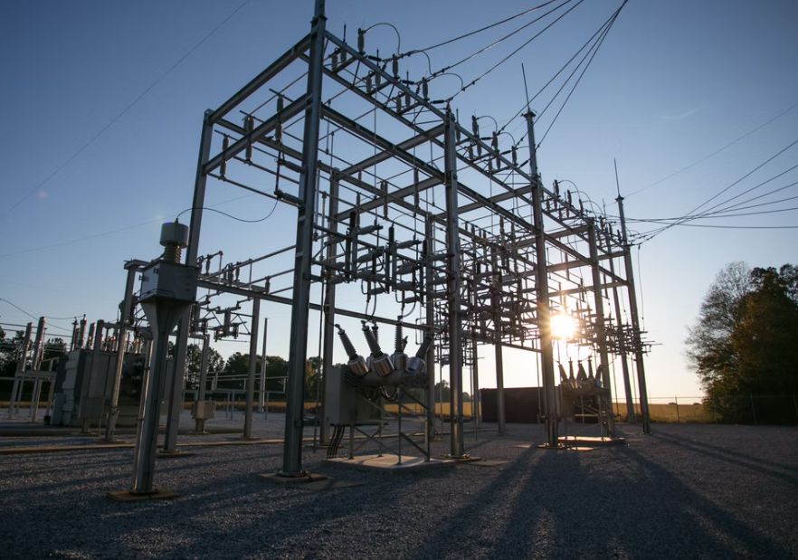
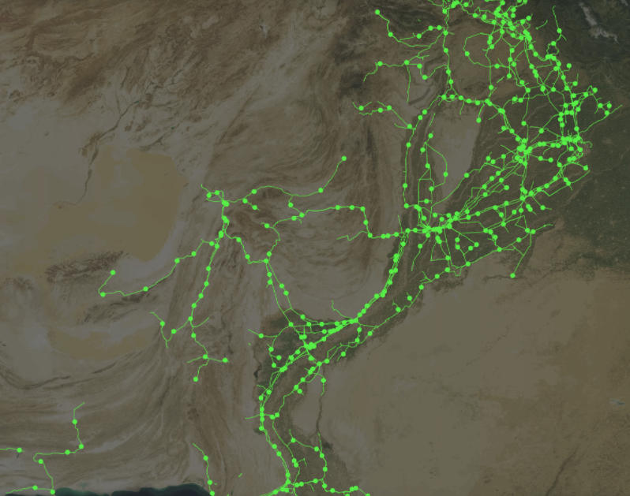
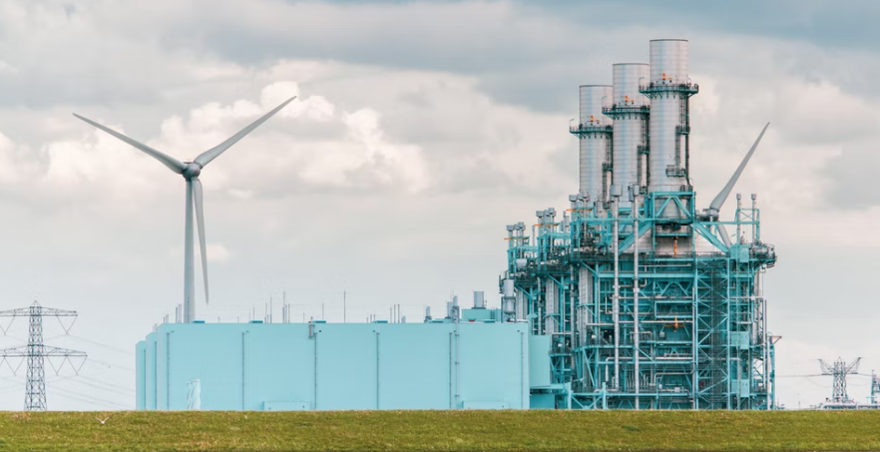
Before
Current Focus
After

Slide 10
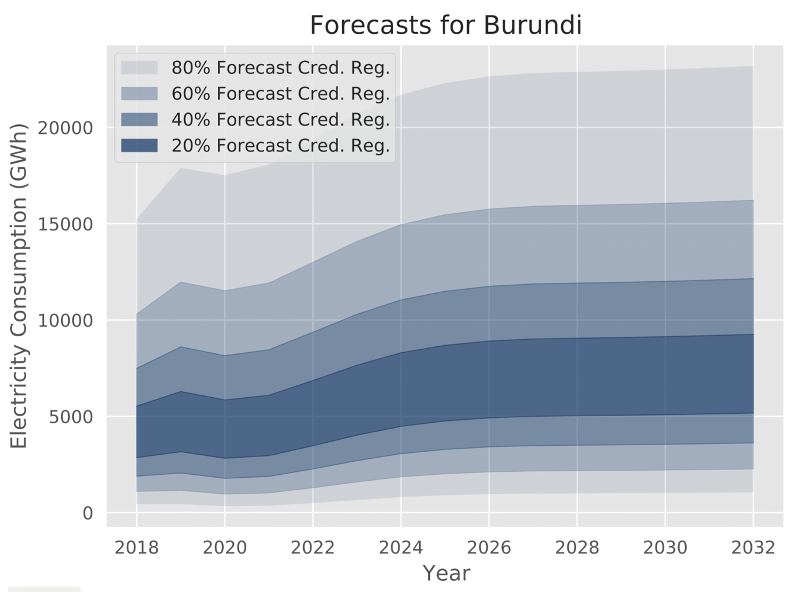
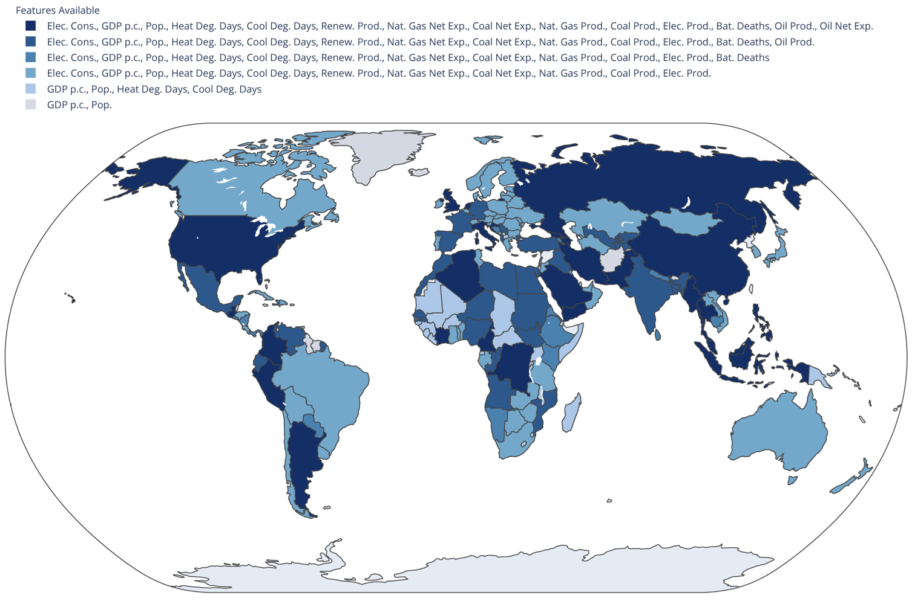
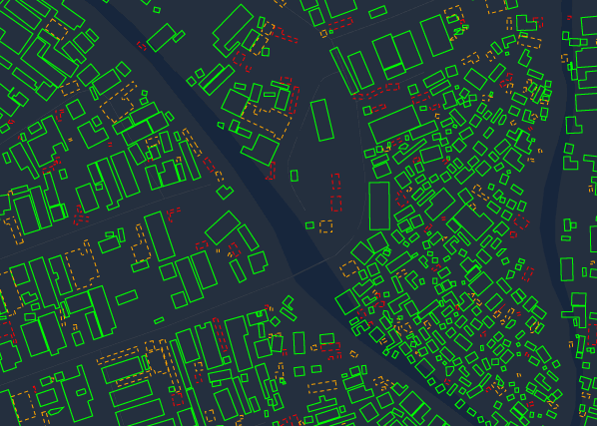
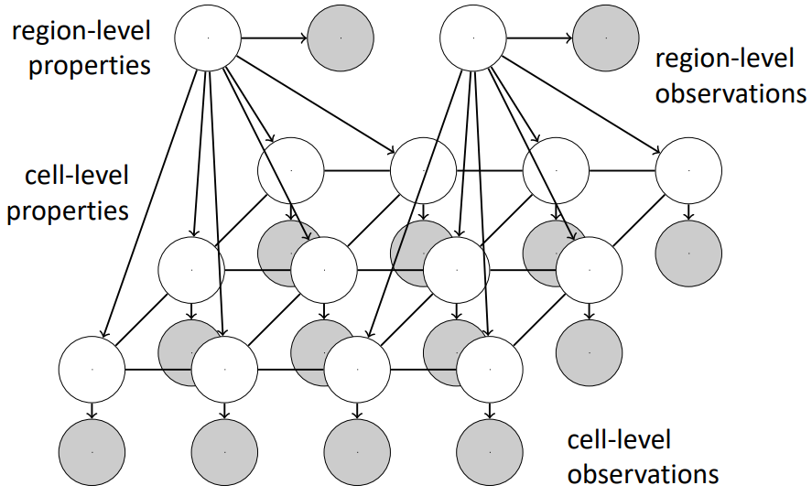
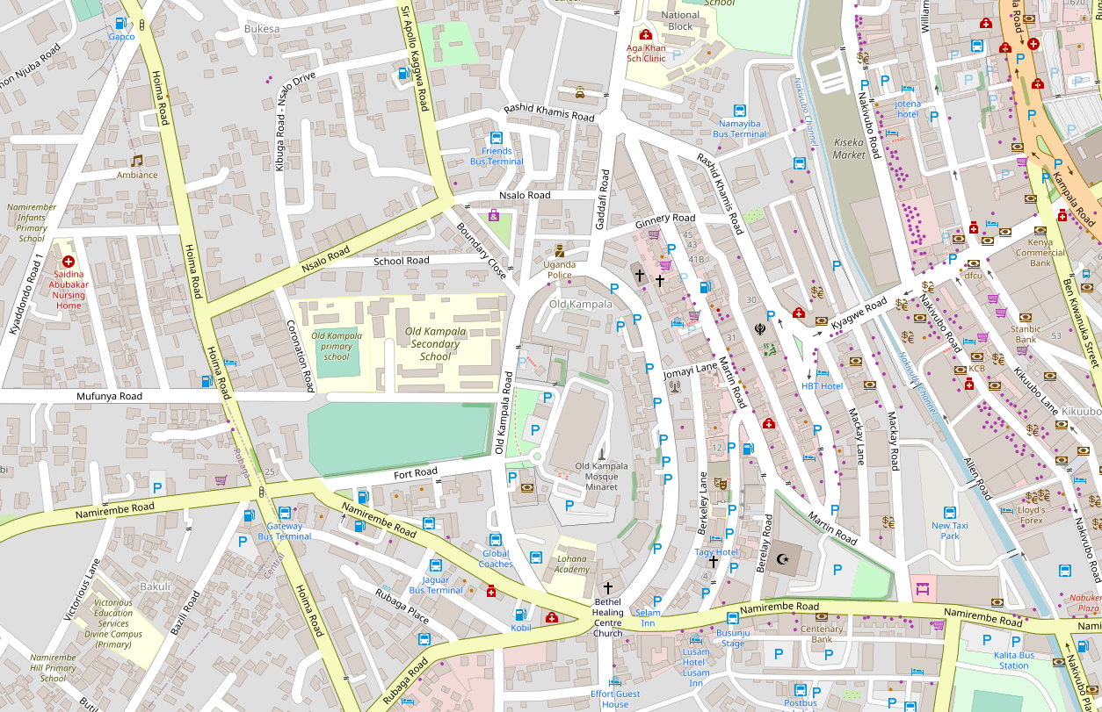
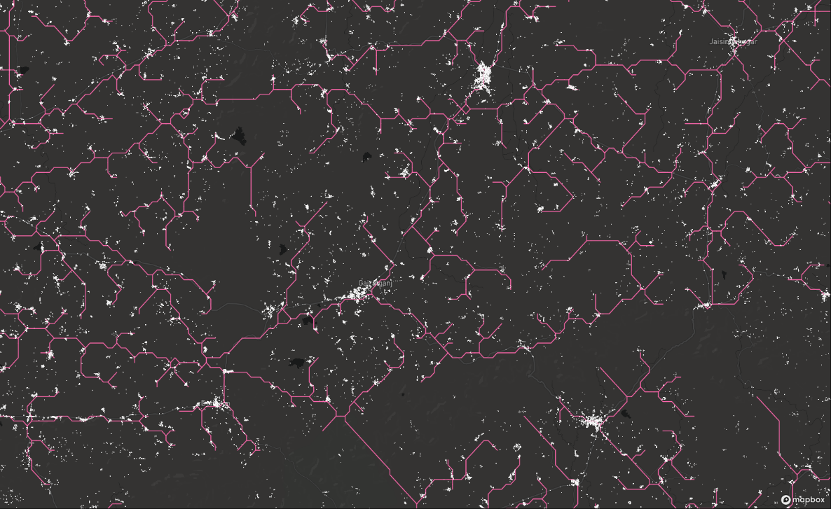
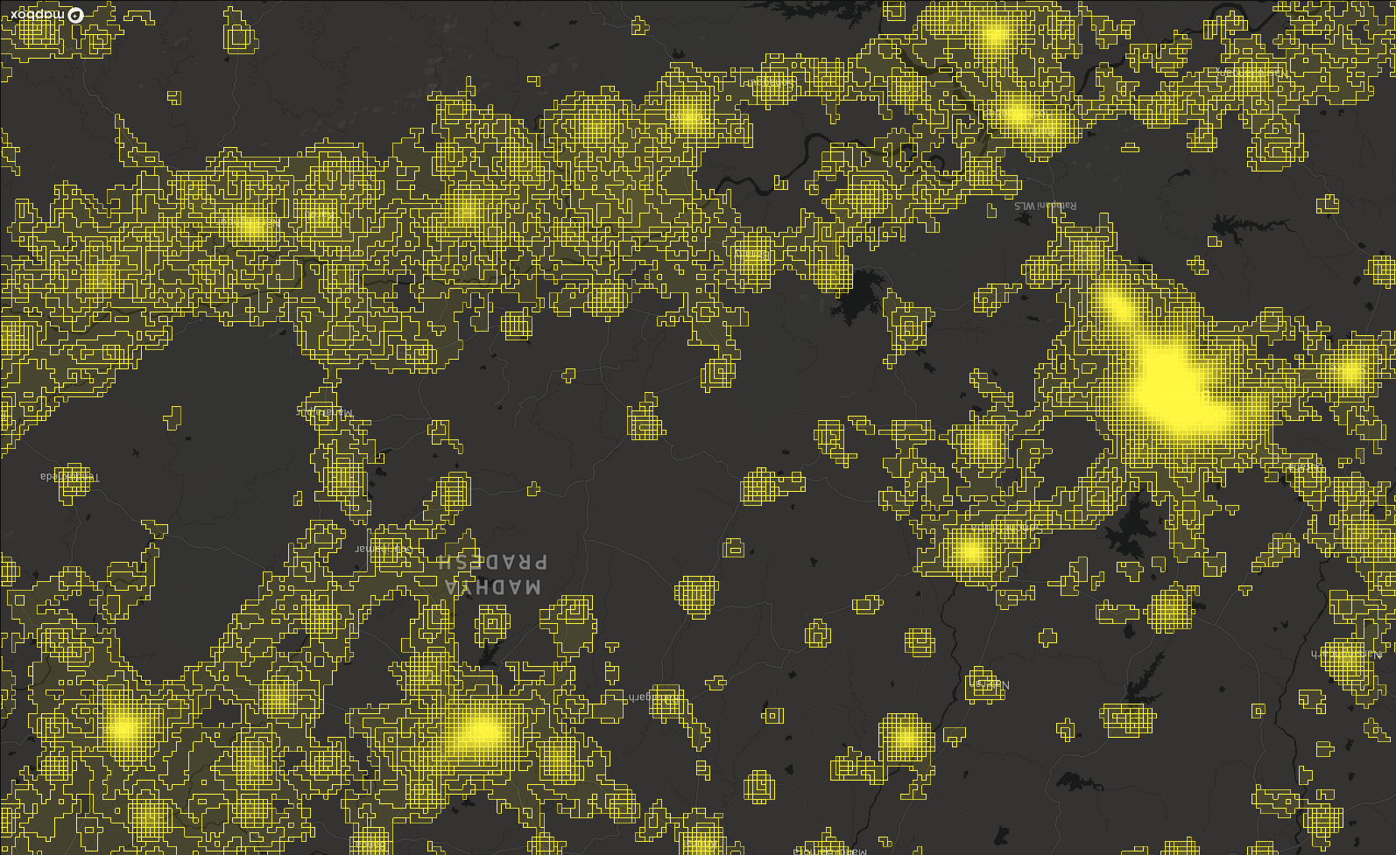
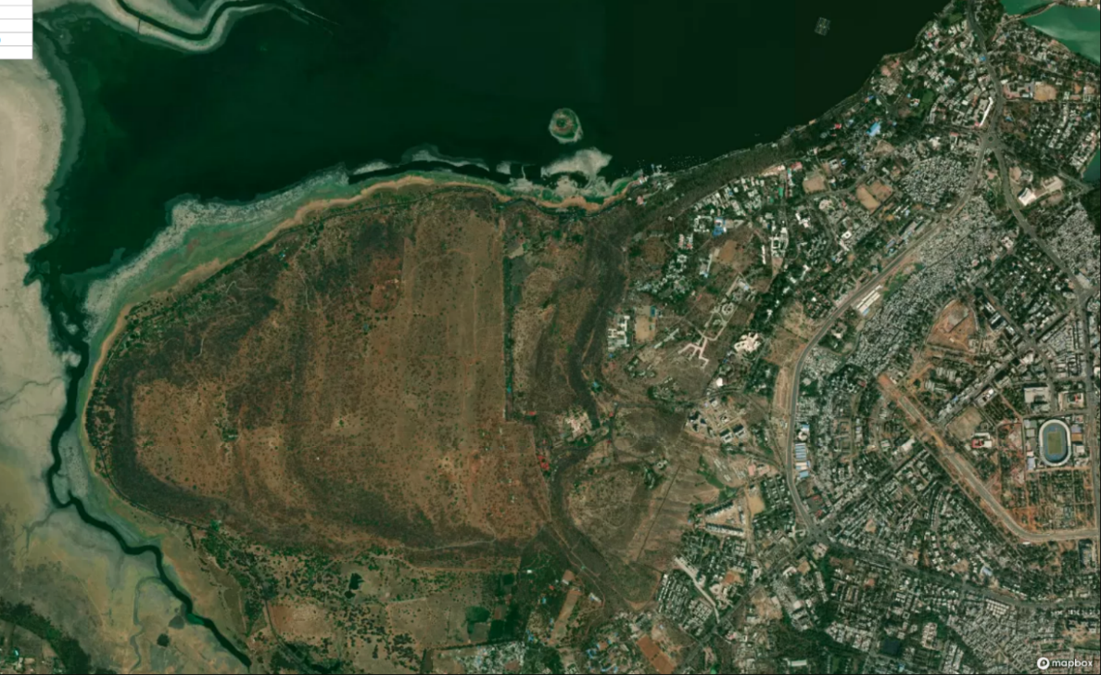
Country-Level Demand Forecasting
via Bayesian Deep Learning and Others
2. Downscaling via Economics-Informed Probabilistic Models and Others
3. Building-Level Demand Forecasting
via Bayesian Deep Learning and Others
Sources: Lee et al., “How probabilistic electricity demand forecasts can expedite universal access to clean and reliable electricity,” Energy for Economic Growth, 2021.; Lee et al., “Probabilistic forecasts of country-level electricity demand in Africa,” 2022 (not yet public). – Soon to be open-sourced, please contact authors: Sirko et al. Continental-scale building detection from high resolution satellite imagery. arXiv:2107.12283, 2021.; Haklay, M. and Weber, P., 2008. Openstreetmap: User-generated street maps. IEEE Pervasive computing, 7(4), pp.12-18.

Slide 11
Hydrogen and GIS

Slide 12
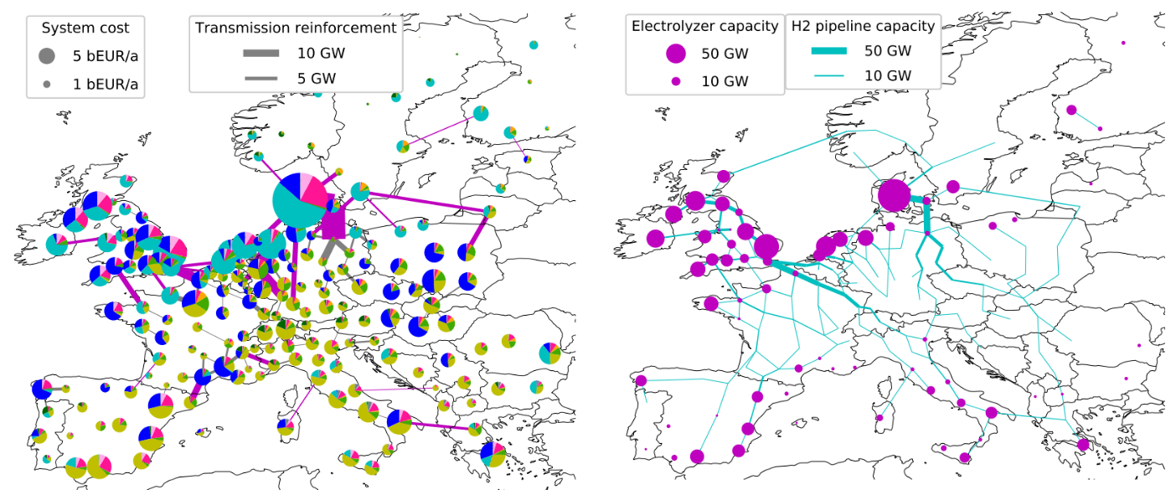
Example Output: Investments for 2050 net Zero Scenarios
Fabian Neumann and Tom Brown. PyPSA: Free Sofware for Investment Planning in Sector-Coupled Energy Systems
https://www.neumann.fyi/files/pesgm2020.pdf

Slide 13
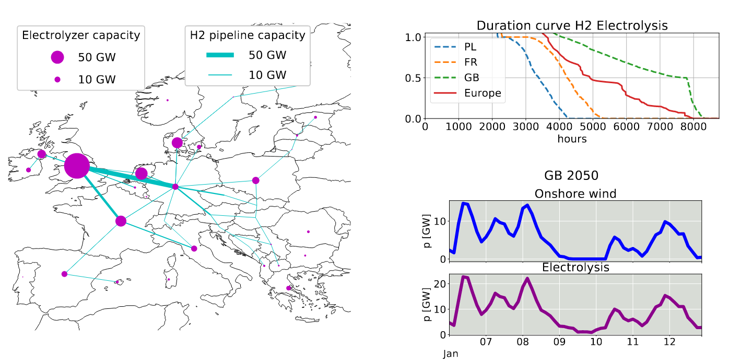
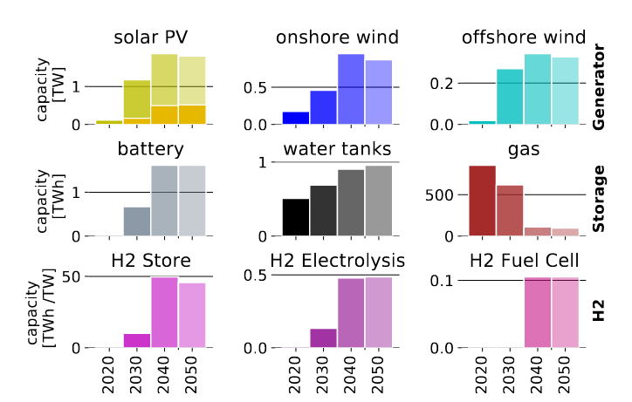
Example Output: Investments + OPERATION for 2050 net Zero Scenarios
Elisabeth Zeyen, Prof. Marta Victoria, Dr. Tom Brown
https://www.pac-scenarios.eu/fileadmin/user_upload/KIT_Aarhus_University_PAC_scenarios_with_PyPSA-Eur-Sec_15oct20.pdf

Slide 14
Example Output: Investments + OPERATION for 2050 net Zero Scenarios
Fabian Neumann and Tom Brown. PyPSA: Free Sofware for Investment Planning in Sector-Coupled Energy Systems
https://www.neumann.fyi/files/pesgm2020.pdf

Slide 15
Researchers
Professional
PhD students
Professors
Bachelors
...

Slide 16
5 ACTIVE TEAMS
ATM
Africa,
North Asia,
West-Asia
PYPSA-EARTH
(Power)
OUTREACH
PyPSA-EARTH-SEC
(Sector-coupled)
DEMAND PREDICTION
INFRASTRUCTURE DETECTION
PyPSA-MiniGRID

Slide 17
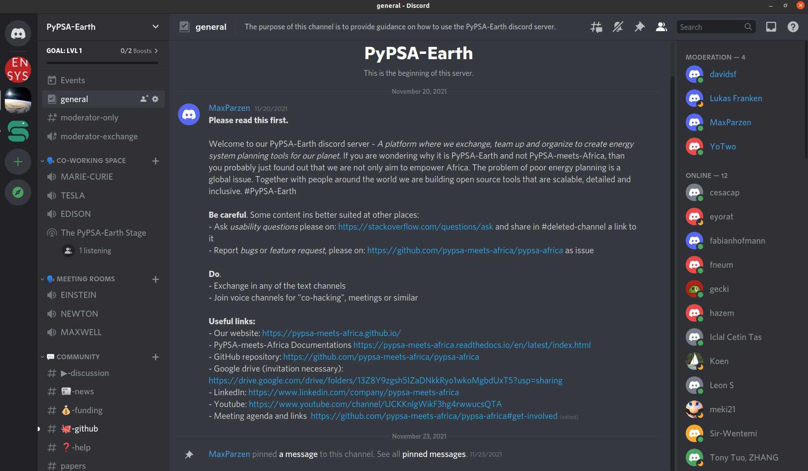
Open Community!

Slide 18
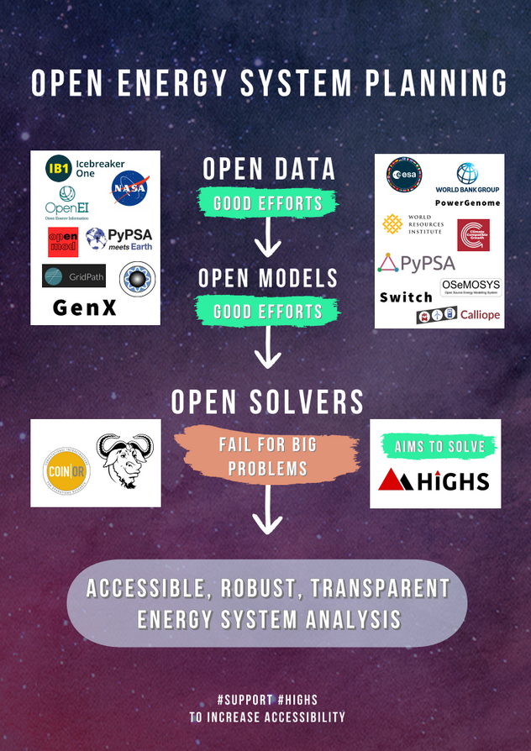
Supporting Open Solver Developments

Slide 19
OPEN Global Independent Research Initiative
High resolution
Open
Collaborative
Help sustaining
Support
developers
Creating open
data
Predicting
data
ENERGY SYSTEM MODELS
USER AND DEVELOPER COMMUNITY
SOLVER
Features
Performant
DATA
Dialogue
Reveal
bottlenecks
Initiate new paths
Data
workflow
High resolution
Problem
formulator
Modular
Training
Empower
Notes:
OPEN:
- To avoid information asymetries industry and policy
TOGETHER means:
1 model to cover the world
1 modular architecture to allow parallel work and improvement
BENEFITS OF WORKING TOGETHER:
- Faster development
- Improvements have global impact
- Less documentation per person
Everyone can earn maintainership

Slide 20
MAXIMILIAN PARZEN
Steering the PyPSA meets Earth initiative
https://pypsa-meets-africa.github.io/
max.parzen@ed.ac.uk

