Slide 1
Webinar-Series:
Open-Source GIS Solutions in Energy Access
12.04.2022, Maximilian Parzen

Slide 2
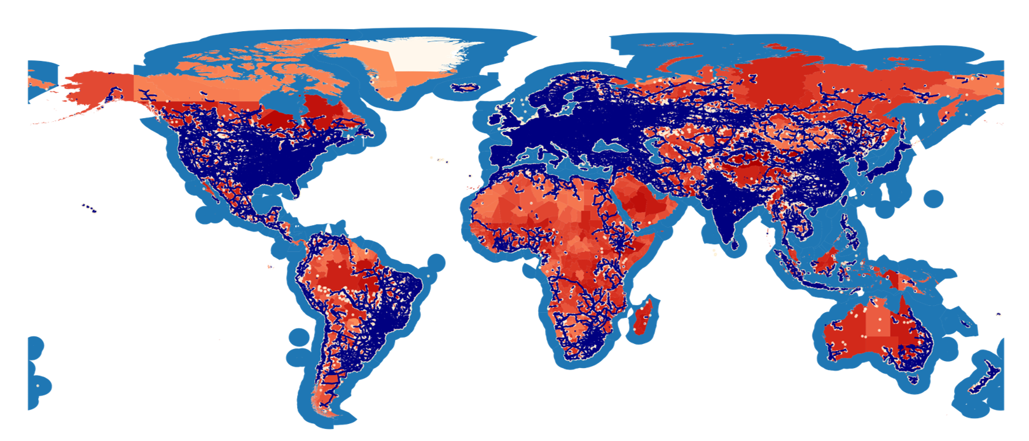
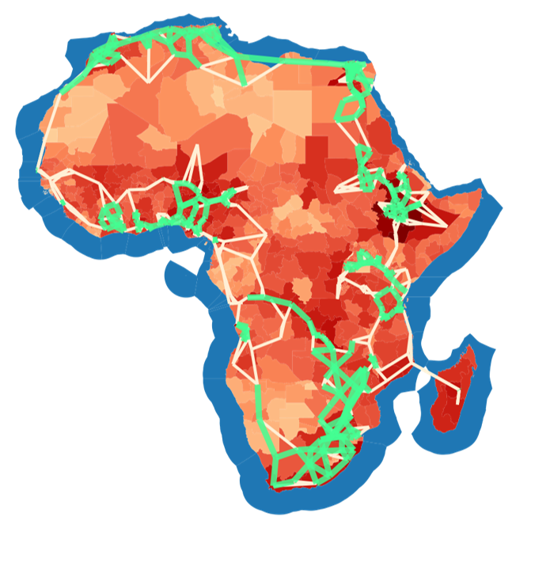
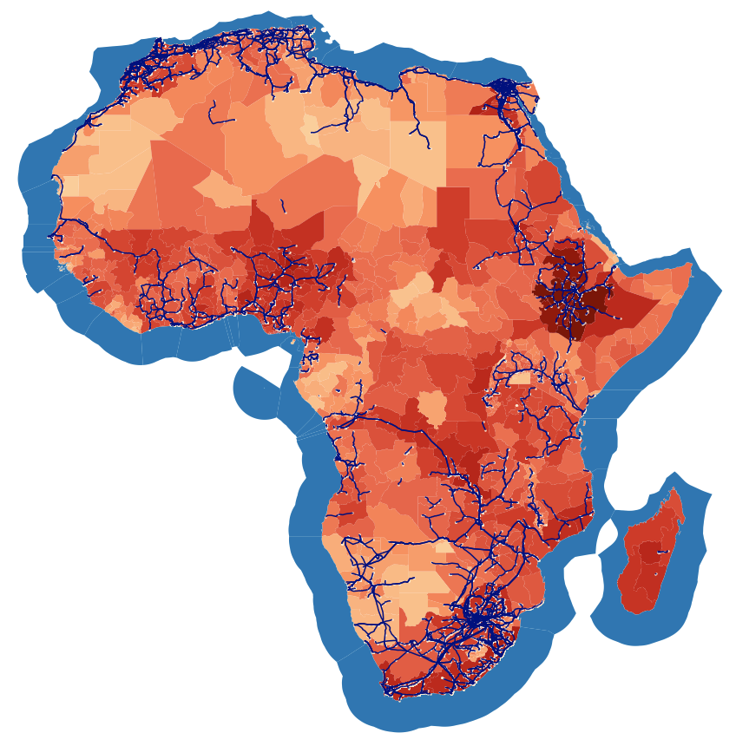
WHO IS MAX?
Bored PhD student
Winter 20/21
PyPSA-Eur
PyPSA-Earth & Co.
Used it & loved it
Started activities on global scale
Created an
initiative
PyPSA-Africa & Co.
Extended the initiative
Built a model. Release
Q4 2021

Slide 3
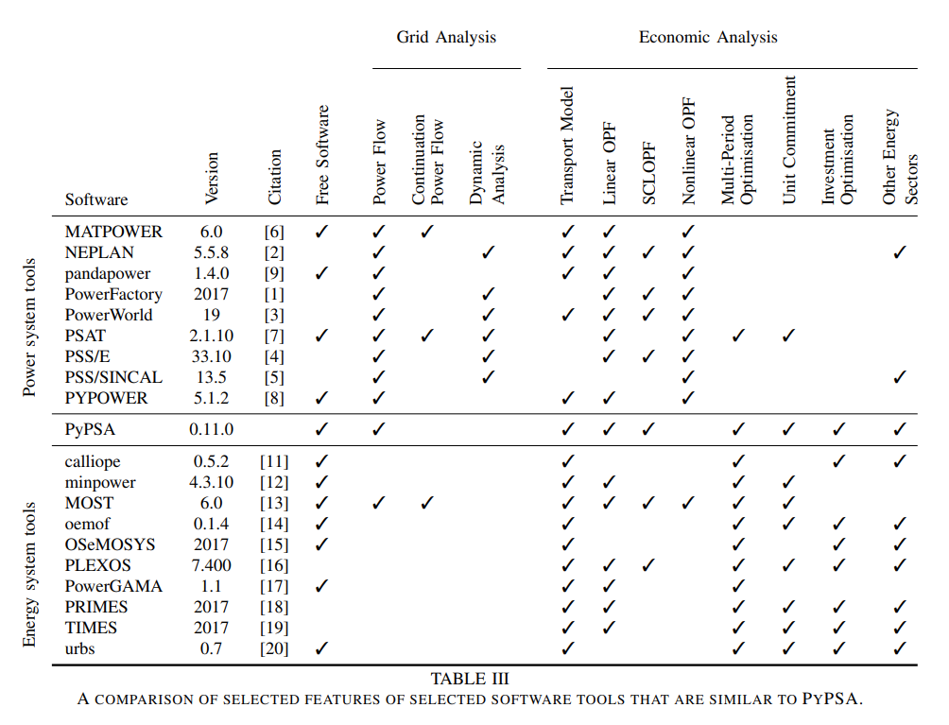
WHAT IS PyPSA?
Purpose:
A tool that can do both economic analysis and grid analysis (load flow studies)
Developed for large scale optimization and
Studies in high spatial resolution
Source: Tom Brown, Jonas Hoersch, David Schlachtenberger (2017), https://arxiv.org/abs/1707.09913

Slide 4
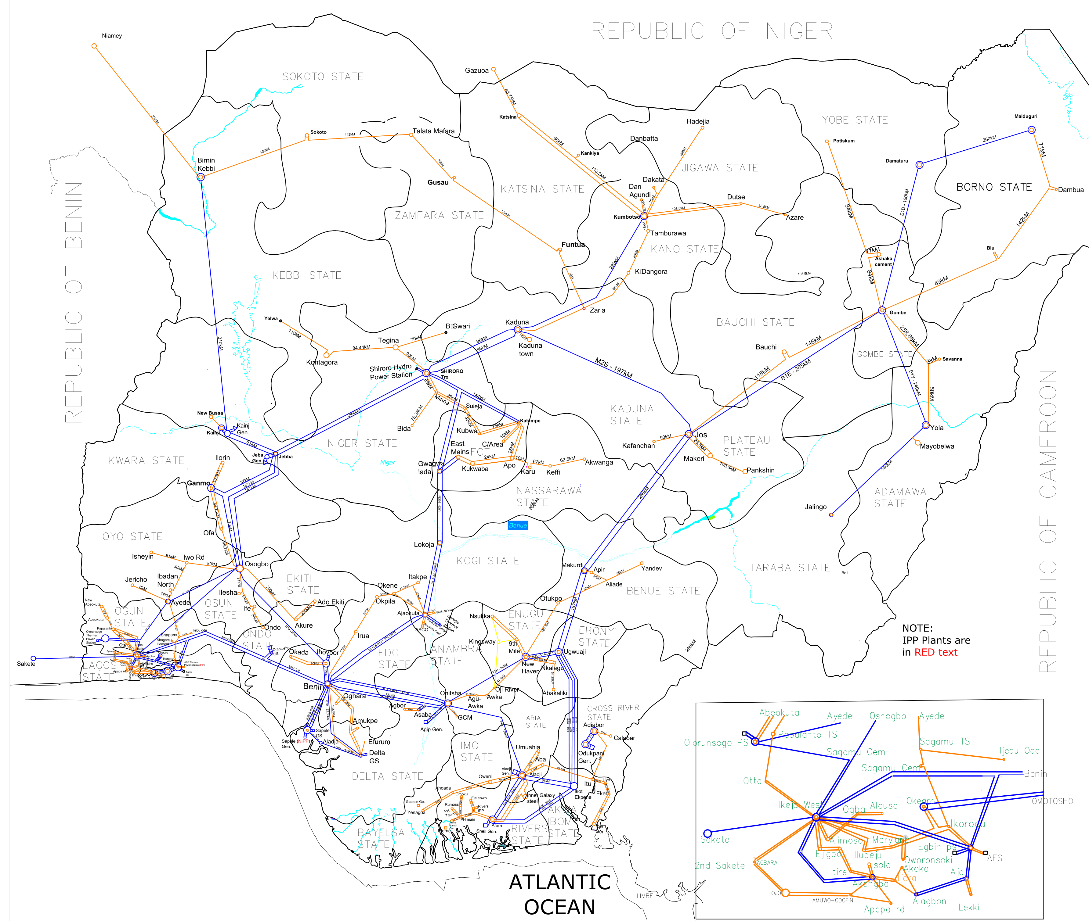
The Spatial resolution in Energy Planning Studies
Classical models. 1 or slightly more aggregation nodes per county
PyPSA models. Up to 1000 nodes per region of interest fetched automatically. (resolution limits are improving continuously)

Slide 5
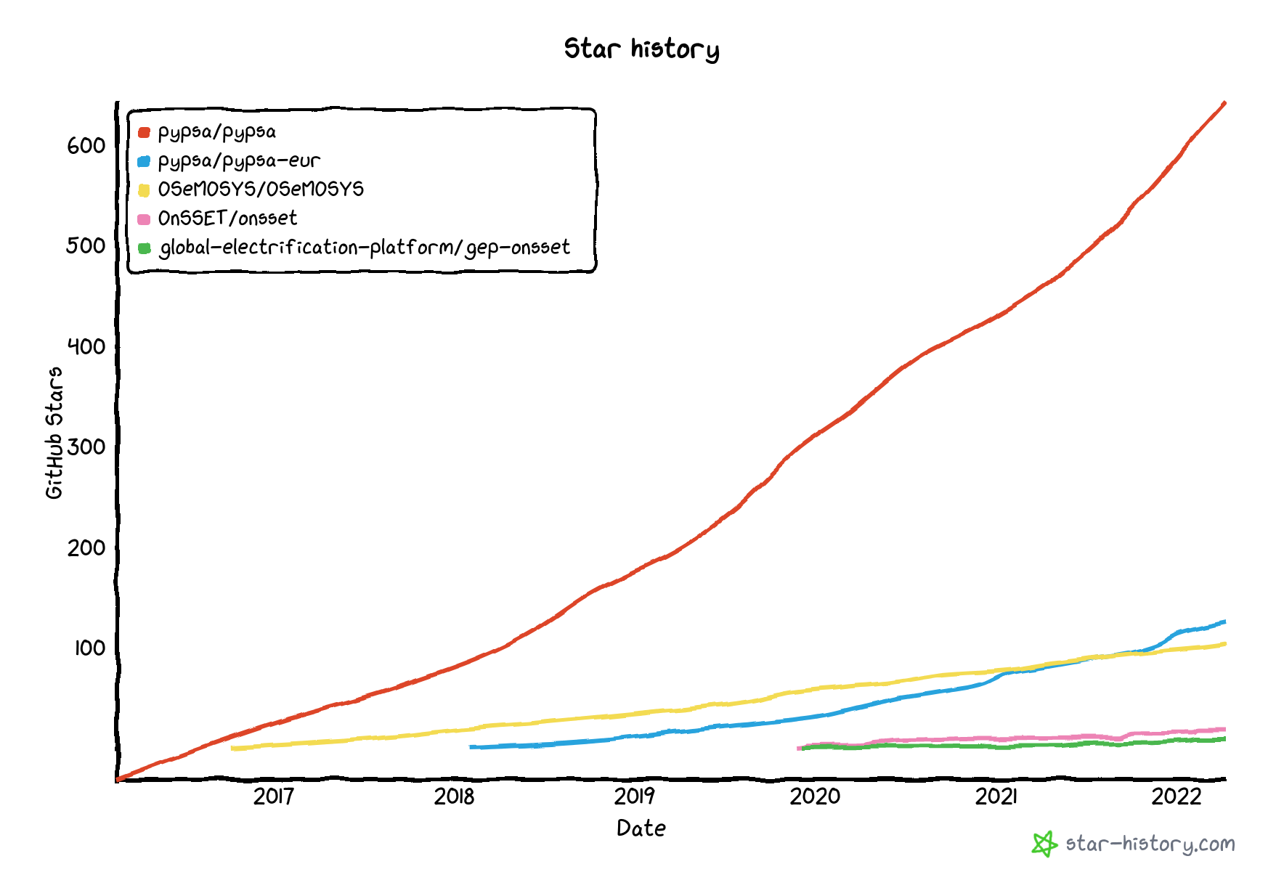
Is PyPSA popular?
GitHub stars – indicating the user popularity
pypsa
PyPSA framework has in total more than 1000+ stars
pypsa-eur
OsMOSYS
onsset
onsset-gep

Slide 6
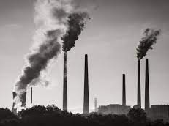
USE CASES
SUPPLY DIVERSI.
PLANS
ENERGY-TRANSITION PLANS
MINI-VS-GRID STUDIES
COAL-EXIT
PLANS
"Hybrid solar PV diesel mini-grids for 32 villages in Mali, selected for funding in the first cycle." by International Renewable Energy Agency (IRENA) is licensed under CC BY-NC-ND 2.0
"Energiewende - Energy transition" by florianric is marked with CC BY-SA 2.0.

Slide 7
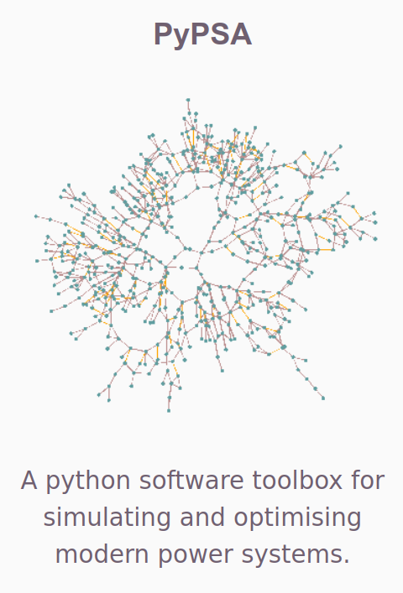
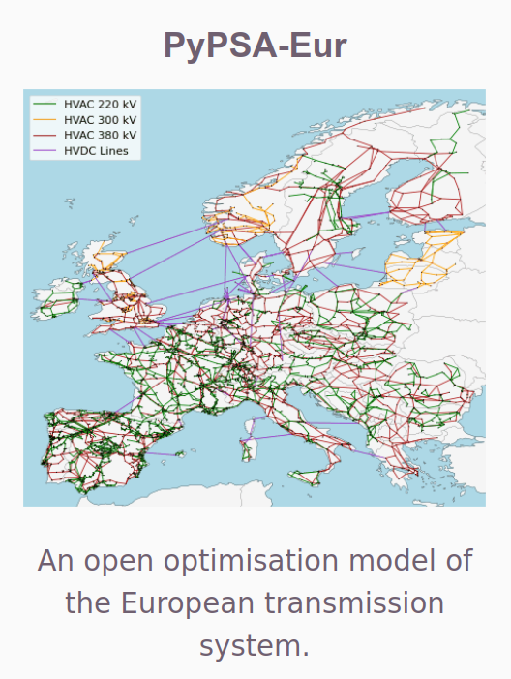
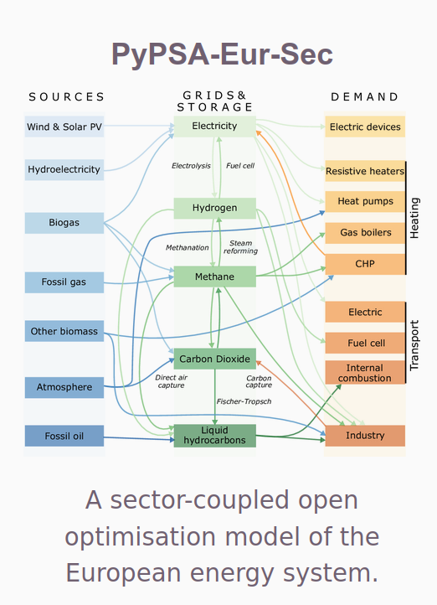
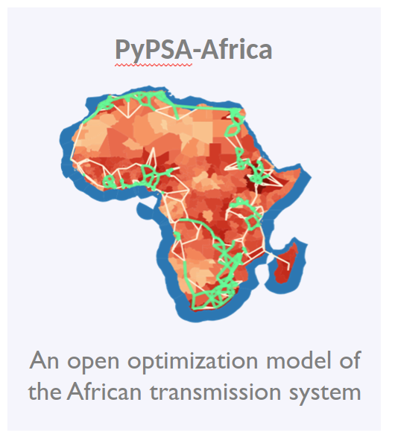
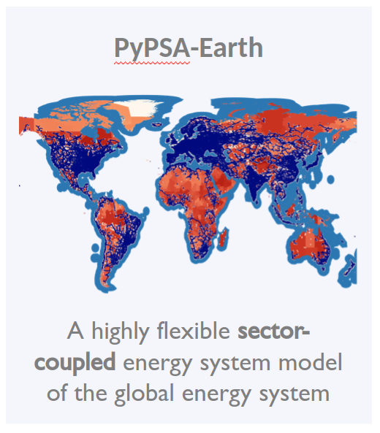
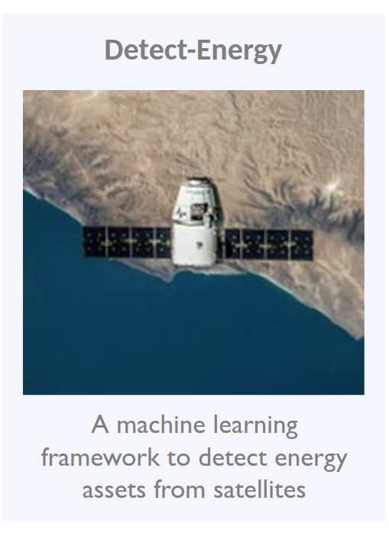
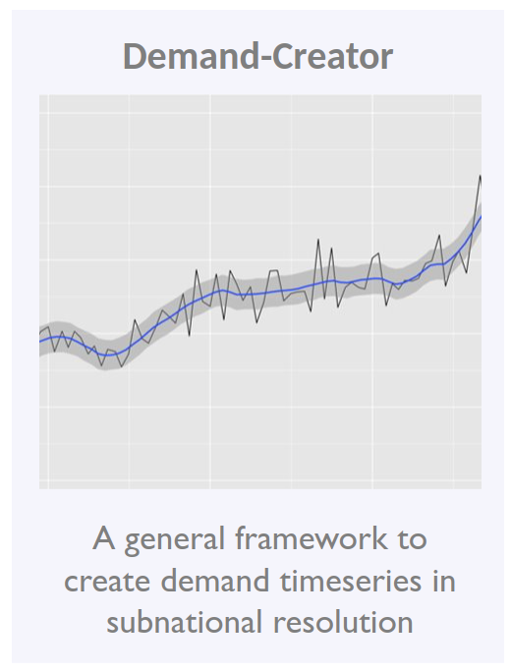
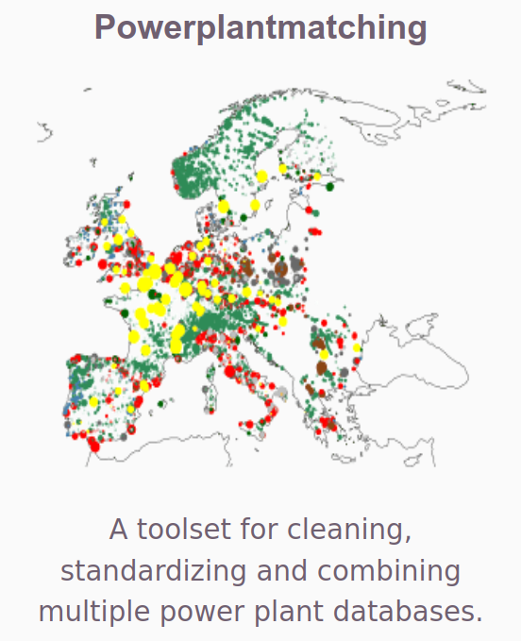
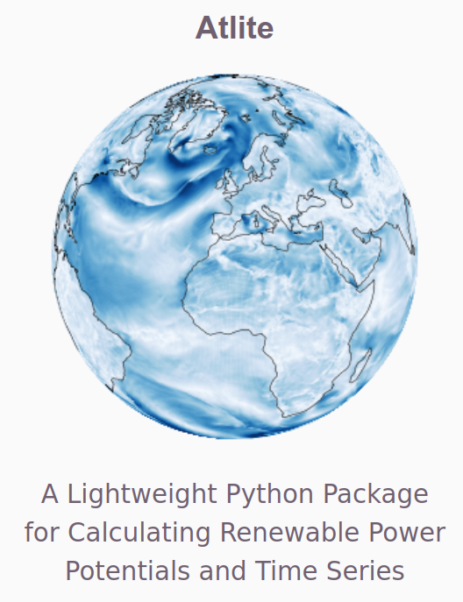
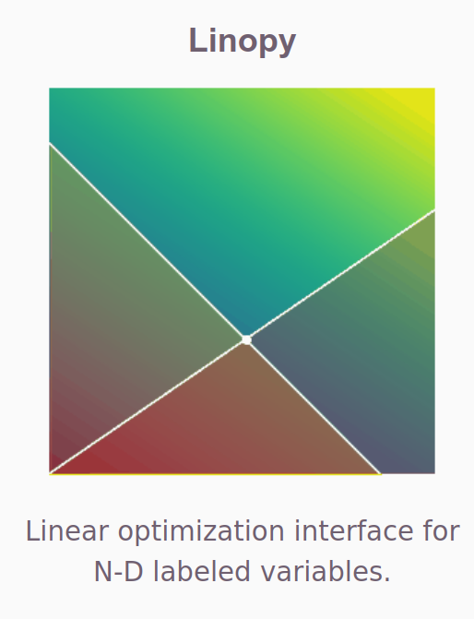
PyPSA is a framework. We build tools on top.
PyPSA-Africa
An open optimization model of the African transmission system
PyPSA-Earth
A highly flexible sector-coupled energy system model of the global energy system

Slide 8
Example of automated workflow
I/O
Data Collection
GIS Inputs
Non-GIS Inputs
Infrastructure
T&D Network
Substation and trafo.
Power plants
(road network)
...
Env. Data
Solar irradiation
Wind speed
Temperature
Humidity
...
Socio-Economic
Population raster
GDP raster
Productive activities
...
Other layers
Demand raster
Night time lights
Elevation
Land classification
...
Other inputs
Emission target
Technology cost
Technology specs.
Fuel prices
Policies & legislation
Equity constraints
Others
Data creation
Data Fusion and Modification
Renewable timeseries and potentials
Infrastructure detection
Data-driven demand forecast
Fusion of multiple datasets to one
Cleaning. Processing, preparation
Calibration with national statistics
...
PyPSA = problem formulator
Add data to optimization framework
Rich set of modular components
Constraint writing
Power flow, LOPF formulation
Solver integration
Outputs – data and plots
Solver
.csv
.geojson
Open source and commercial solver integration
Finds optimal solution e.g. least cost system
.nc (netCDF)

Slide 9
Applied Methods
Investment and dispatch optimization for multiple-horizons
Powerflow optimization (e.g. AC powerflow, security constrained LOPF, DCOPF)
Data-driven constraint formulation (e.g. renewable potentials, protected areas, climate-change impacts)
Machine learning (Object detection with transfer learning, super resolution, Time-series prediction with DeepML, Bayesian inference for demand prediction..)
Graph theory (for spatial clustering and graph expansion e.g. k-means, steiner-tree, minimum spanning tree,...)
Statistics (e.g. data-driven disaggregation, demand predictions)
Parallel and cloud computing (dask and xarray)
Workflow management system (snakemake for reproducibilty and ease of use)

Slide 10
Validation approaches
For Energy Model:
Powerflow optimization tested against PyPOWER/MATPOWER and pandapower
Comparison to public accessible stats and reports (e.g. IRENA on existing renewables)
Comparison to other commercial models (e.g. provide same results as PLEXOS)
For Machine Learning:
Back-testing of historic data
Validation data from manual validation (e.g. satellite detected images) or existing data (e.g. smart meter data)
Source: Tom Brown, Jonas Hoersch, David Schlachtenberger (2017), https://arxiv.org/abs/1707.09913

Slide 11
WHAT'S NEXT ?

Slide 12
PyPSA-EARTH
- 1 MODEL 1 EARTH COMMUNITY -
"Model your province, your country, your continent or the whole planet under one framework"
"Accelerate innovation/time, support quality, make meaningful impact"

Slide 13
Researchers
TEAM
Professional
PhD students
Professors
Bachelors
...

Slide 14
OPEN Global Independent Research Initiative
ENERGY SYSTEM MODELS
USER AND DEVELOPER COMMUNITY
SOLVER
DATA
Notes:
OPEN:
- To avoid information asymetries industry and policy
TOGETHER means:
1 model to cover the world
1 modular architecture to allow parallel work and improvement
BENEFITS OF WORKING TOGETHER:
- Faster development
- Improvements have global impact
- Less documentation per person
Everyone can earn maintainership

Slide 15
LET'S OPEN UP THE BLACK BOX
+ MAKE THE "OPEN BOX" THE STANDARD

Slide 16
MAXIMILIAN PARZEN
Co-steering the PyPSA meets Earth initiative
https://pypsa-meets-africa.github.io/
max.parzen@ed.ac.uk

Slide 17
Appendix

Slide 18
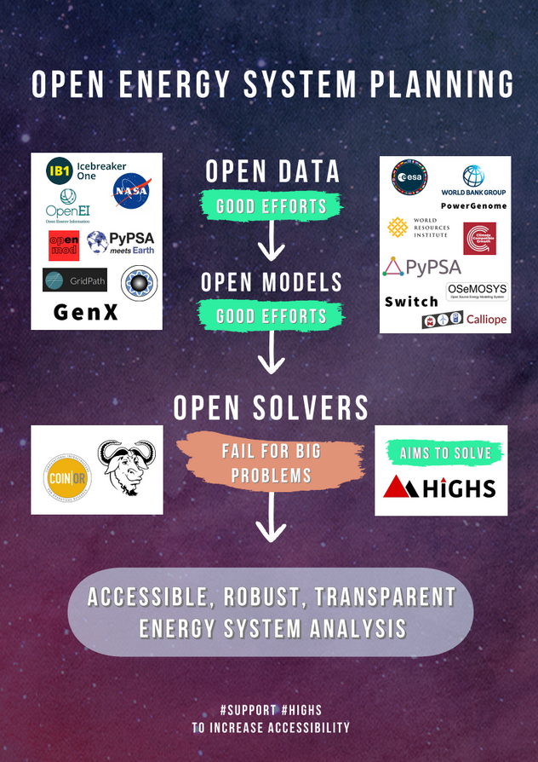
DONATE NOW.
WE RAISE 100+k FOR DEVLOPING
10-100x FASTER OPEN-SOURCE SOLVER
DETAILED PROPOSAL*:
https://pypsa-meets-africa.github.io/highs.html
*In collaboration with University of Edinburgh, TU Berlin and Princeton University

Slide 19
OPEN Global Independent Research Initiative
High resolution
Open
Collaborative
Help sustaining
Support
developers
Creating open
data
Predicting
data
ENERGY SYSTEM MODELS
USER AND DEVELOPER COMMUNITY
SOLVER
Features
Performant
DATA
Dialogue
Reveal
bottlenecks
Initiate new paths
Data
workflow
High resolution
Problem
formulator
Modular
Training
Empower
Notes:
OPEN:
- To avoid information asymetries industry and policy
TOGETHER means:
1 model to cover the world
1 modular architecture to allow parallel work and improvement
BENEFITS OF WORKING TOGETHER:
- Faster development
- Improvements have global impact
- Less documentation per person
Everyone can earn maintainership

Slide 20
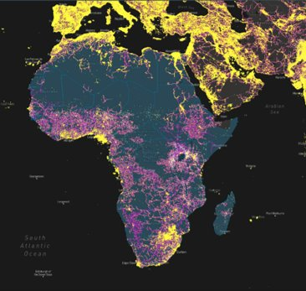
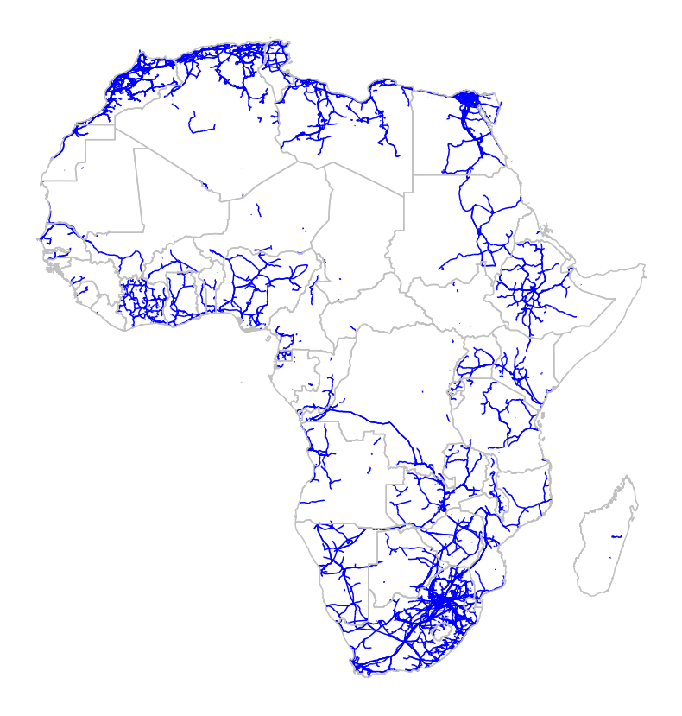
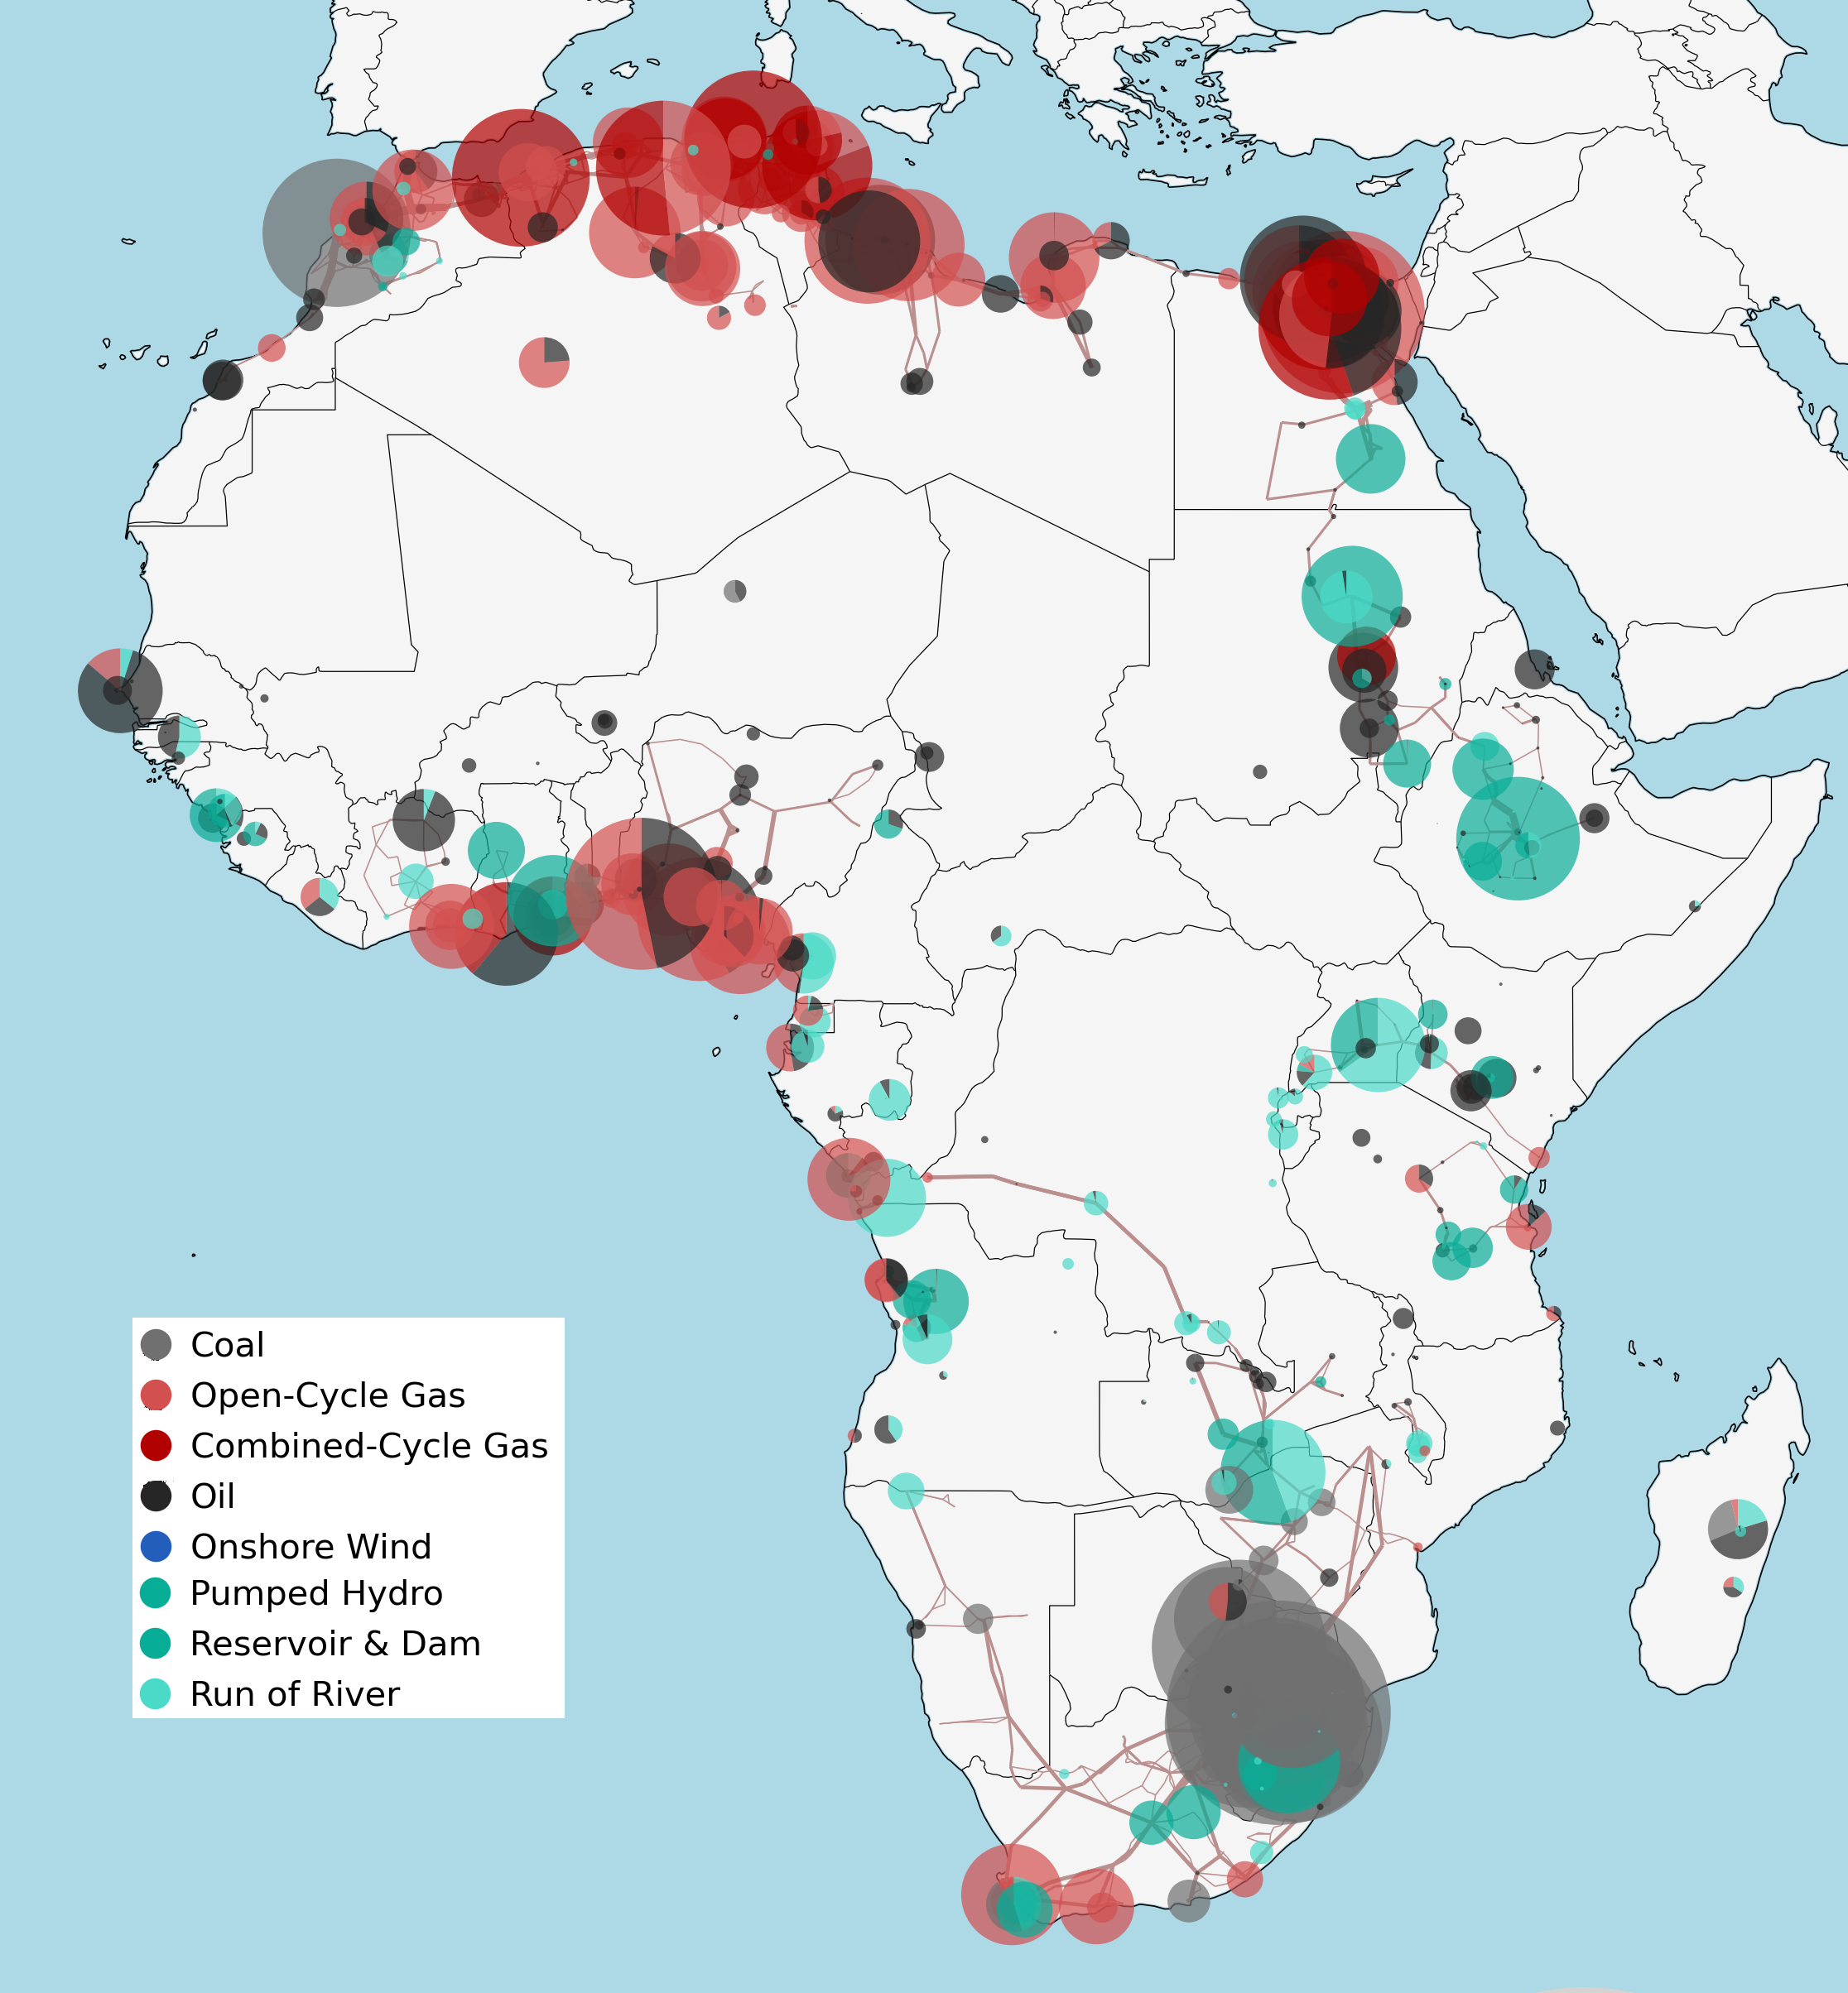
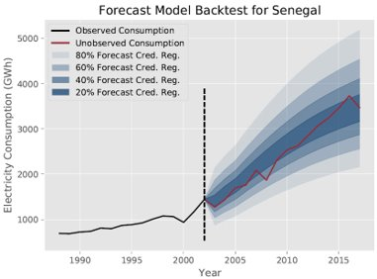
USE EXISTING DATA TO PLAN THE FUTURE
DEMAND
SUPPLY
NETWORK

Slide 21
GLOBAL DATA BY DEFAULT
WIKIPEDIA
OF APPLIED
DATASTREAMS

Slide 22
WHAT IF YOU ARE MISSING DATA?

Slide 23
I.
INFRASTRUCTURE
DETECTION
II.
DEMAND PREDICTION

Slide 24
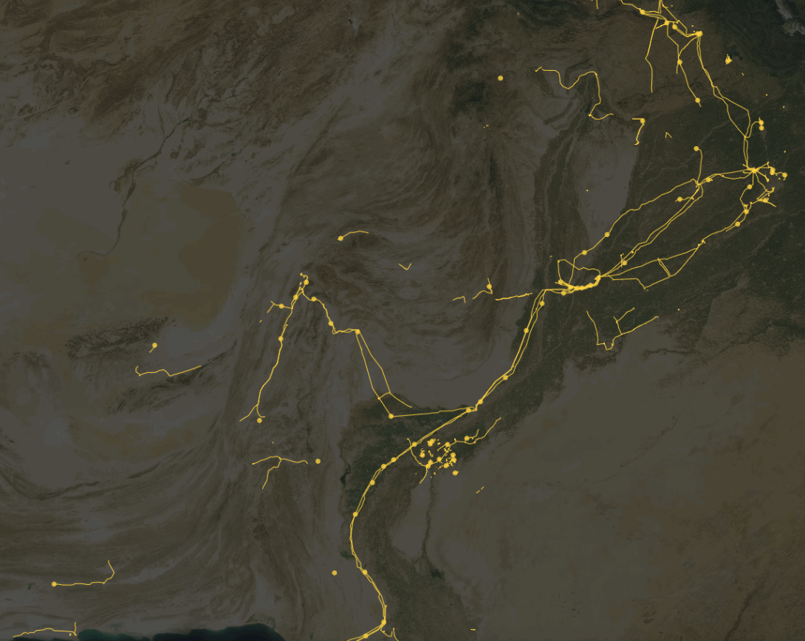
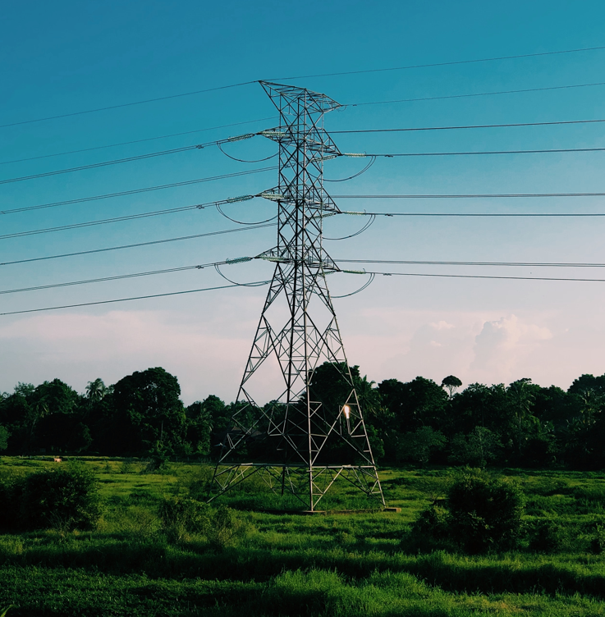
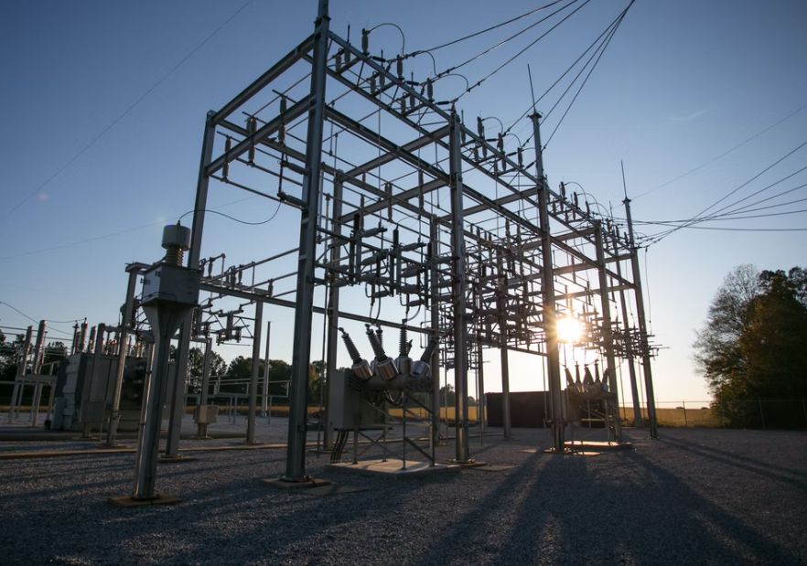
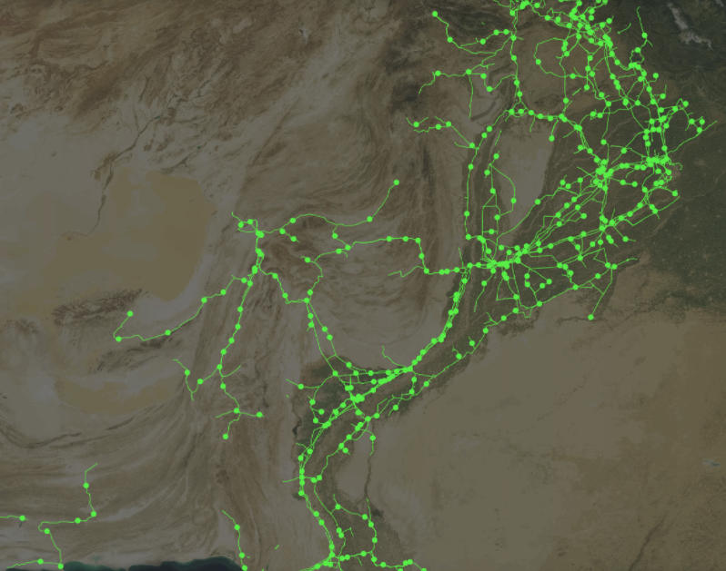
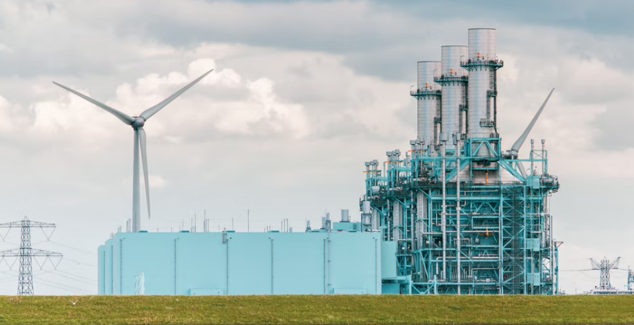
Before
Current Focus
After

Slide 25
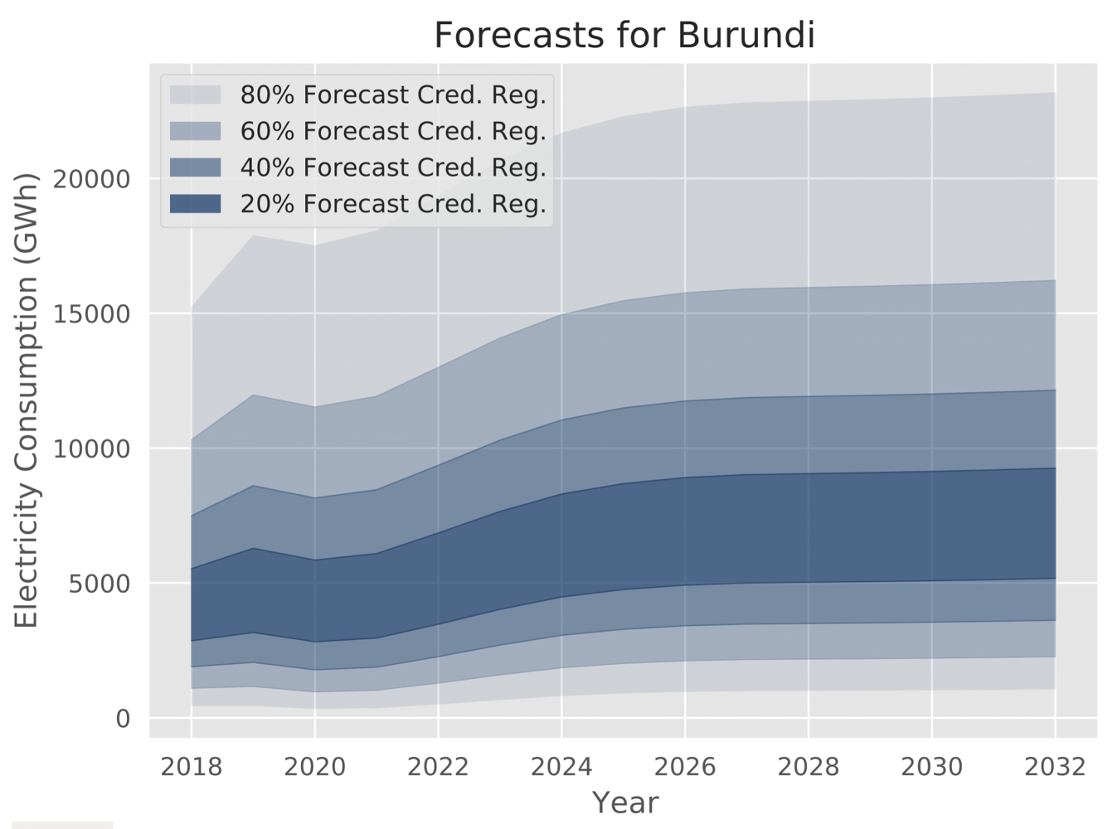
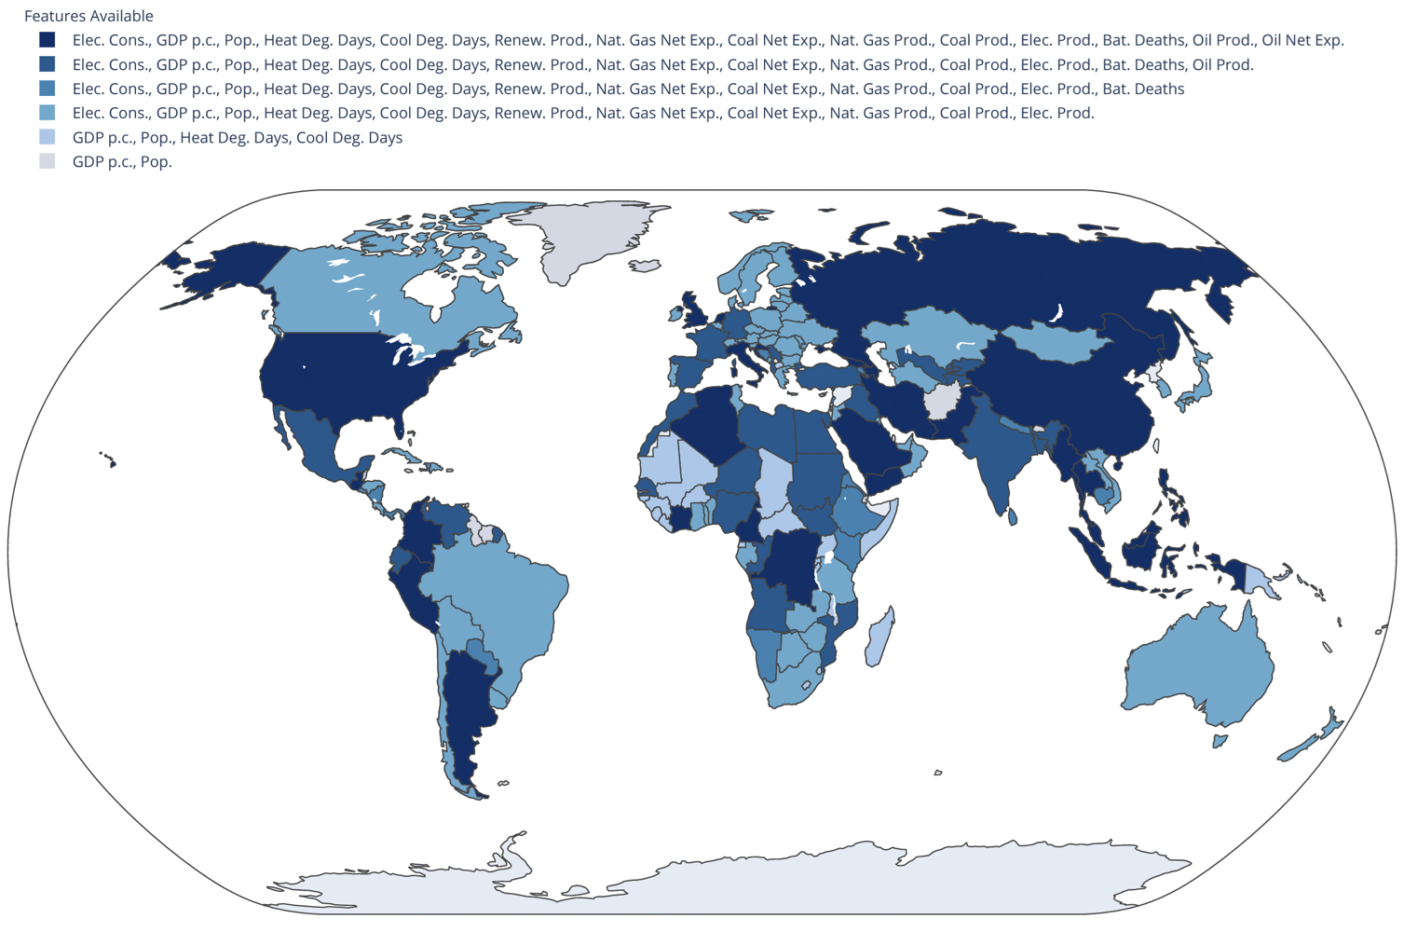
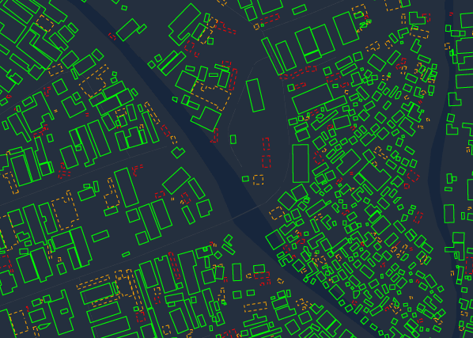
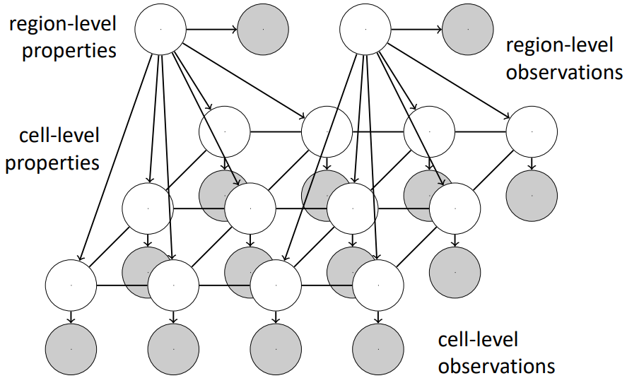
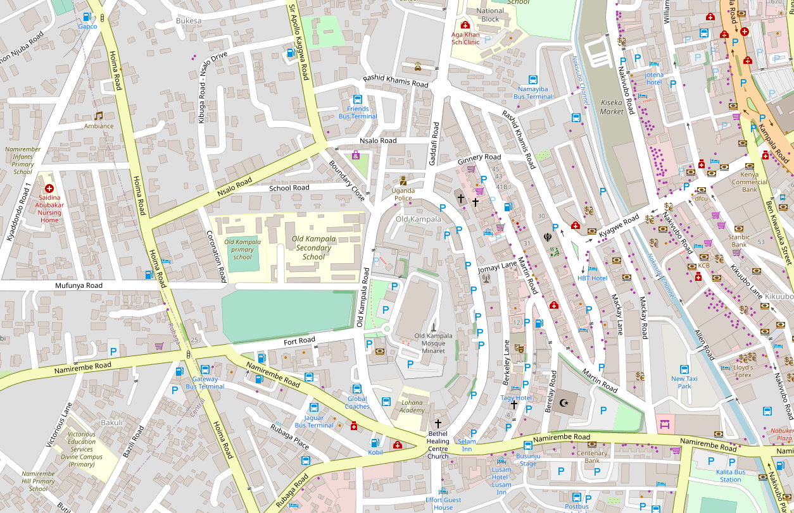
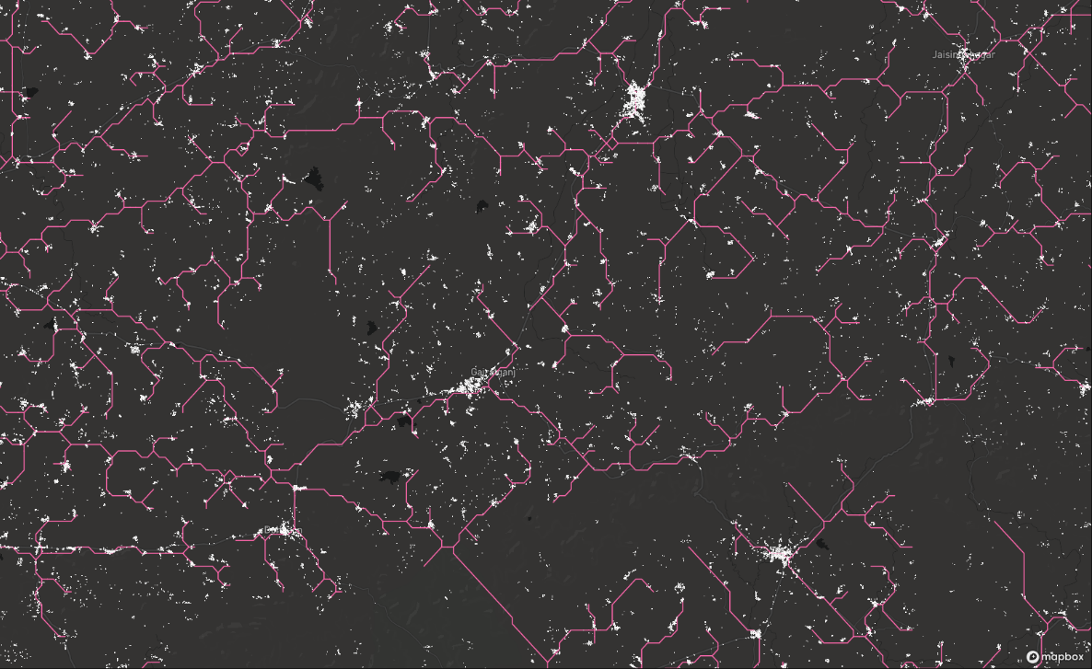
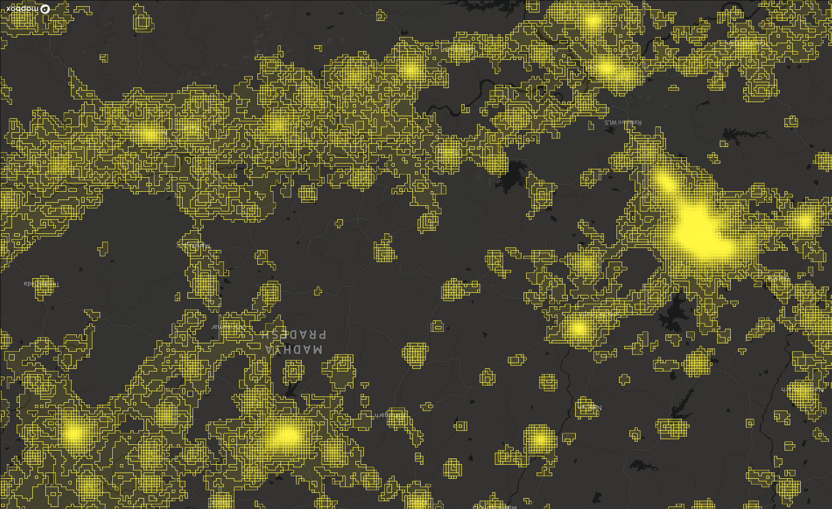
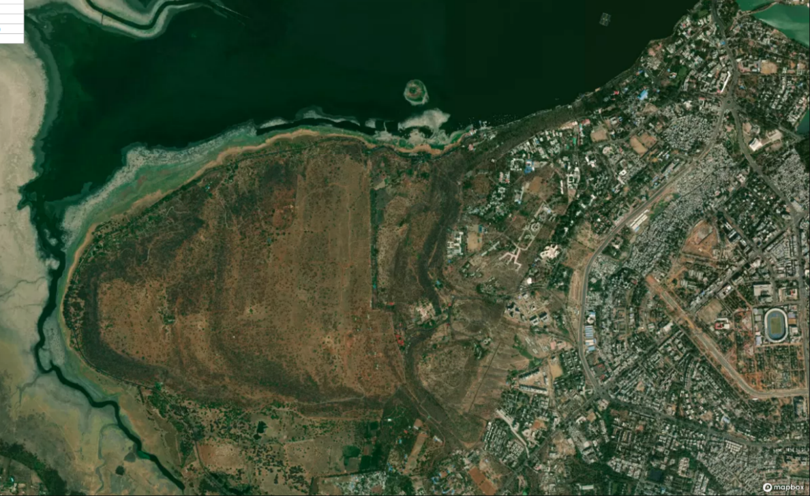
Country-Level Demand Forecasting
via Bayesian Deep Learning and Others
2. Downscaling via Economics-Informed Probabilistic Models and Others
3. Building-Level Demand Forecasting
via Bayesian Deep Learning and Others
Sources: Lee et al., “How probabilistic electricity demand forecasts can expedite universal access to clean and reliable electricity,” Energy for Economic Growth, 2021.; Lee et al., “Probabilistic forecasts of country-level electricity demand in Africa,” 2022 (not yet public). – Soon to be open-sourced, please contact authors: Sirko et al. Continental-scale building detection from high resolution satellite imagery. arXiv:2107.12283, 2021.; Haklay, M. and Weber, P., 2008. Openstreetmap: User-generated street maps. IEEE Pervasive computing, 7(4), pp.12-18.

Slide 26
Hydrogen and GIS

Slide 27
Example Output: Investments for 2050 net Zero Scenarios
Fabian Neumann and Tom Brown. PyPSA: Free Sofware for Investment Planning in Sector-Coupled Energy Systems
https://www.neumann.fyi/files/pesgm2020.pdf

Slide 28
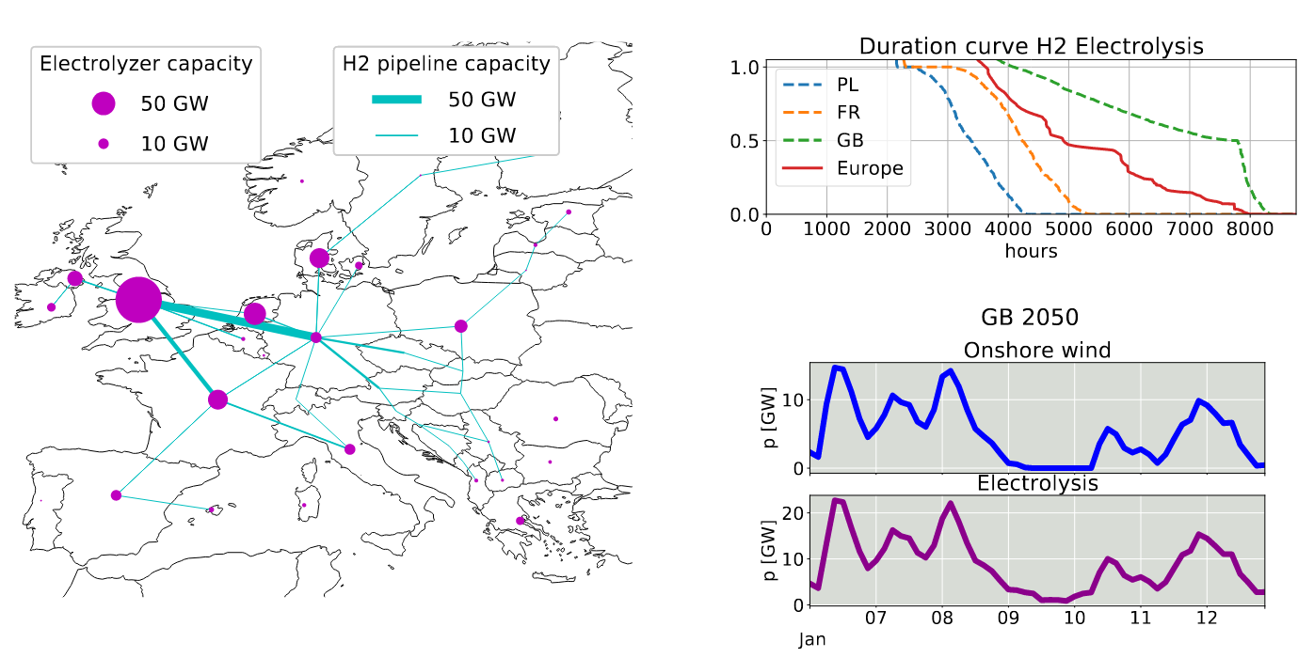
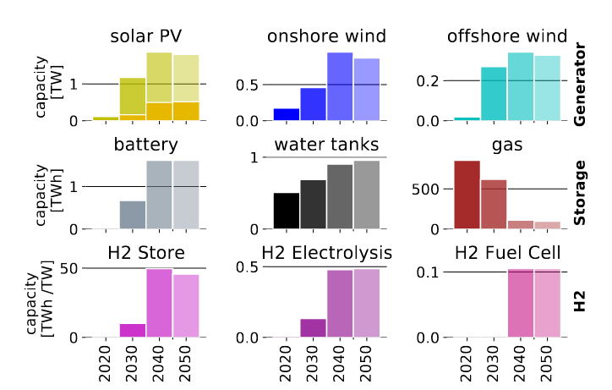
Example Output: Investments + OPERATION for 2050 net Zero Scenarios
Elisabeth Zeyen, Prof. Marta Victoria, Dr. Tom Brown
https://www.pac-scenarios.eu/fileadmin/user_upload/KIT_Aarhus_University_PAC_scenarios_with_PyPSA-Eur-Sec_15oct20.pdf

Slide 29
Example Output: Investments + OPERATION for 2050 net Zero Scenarios
Fabian Neumann and Tom Brown. PyPSA: Free Sofware for Investment Planning in Sector-Coupled Energy Systems
https://www.neumann.fyi/files/pesgm2020.pdf

Slide 30
5 ACTIVE TEAMS
ATM
Africa,
North Asia,
West-Asia
PYPSA-EARTH
(Power)
OUTREACH
PyPSA-EARTH-SEC
(Sector-coupled)
DEMAND PREDICTION
INFRASTRUCTURE DETECTION
PyPSA-MiniGRID

Slide 31
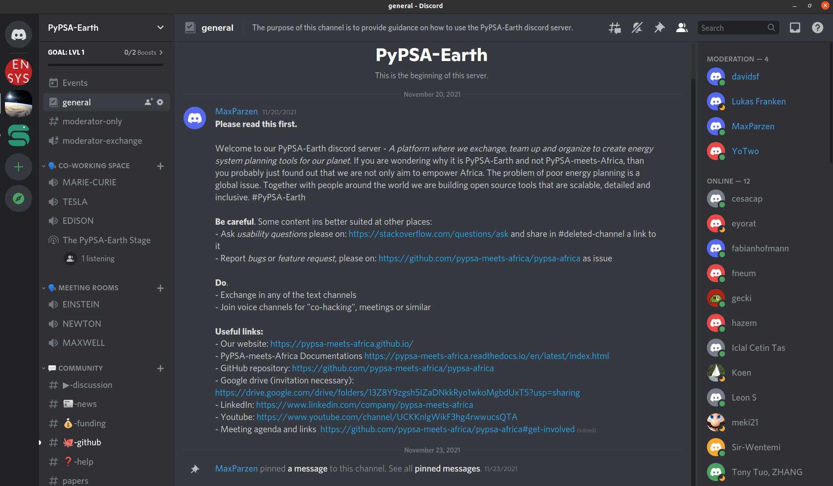
Open Community!

