Slide 1
Open-Source Power Systems Analysis Packages: Cross-package Coordination for System Planning
Special Interest Group on Open-source Power System Planning Tools June 22, 2022

Slide 2
Zoom Housekeeping
This webinar is being recorded and will be shared with attendees.​
You will be automatically muted upon joining and throughout the webinar. ​
Please use the chat feature to add comments and share input.
Please use the Q&A function to ask questions and ensure your question is answered. You can find this function in your toolbar.
If you have technical issues, please use the chat feature to message Emily Klos.
You can adjust your audio through the audio settings. If you are having issues, you can also dial-in and listen by phone. Dial-in information can be found in your registration email.​
There is a short survey that will launch at the end of the webinar. Your survey responses help us tailor training content, improve your webinar experience, and gain support to host future trainings.

Slide 3
G-PST and LF Energy Overview
Juha Kiviluoma
G-PST Pillar 5 Lead, VTT Finland
Benoît Jeanson
Enterprise Architect, Open-Source Program Office of RTE (French TSO), RTE France

Slide 4
Contributors
Roman Bolgaryn
Shuli Goodman
Nicolas Omont
Hannele Holttinen
Clayton Barrows
Researcher
Fraunhofer IEE
Executive Director LF Energy
Vice President of Operations
Artelys
G-PST Pillar 5 Lead
Recognis Consultnig
Senior Engineer
NREL
Maximilian Parzen
Benoît Jeanson
Juha Kiviluoma
Dheepak Krishnamurthy
Distribution Systems Researcher
NREL
Director / PhD Candidate
PyPSA meets Earth Initiative / University of Edinburgh
Enterprise Architect, Open-Source Program Office of RTE (French TSO)
RTE France
G-PST Pillar 5 Lead
VTT, Finland

Slide 6
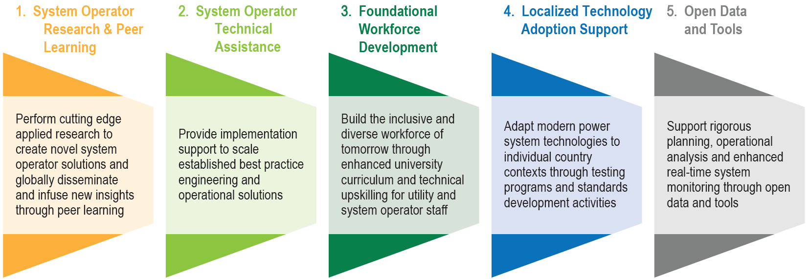
Global Power System Transformation Consortium advances action in 5 key areas
CORE TEAM – All Core Team members contribute to all activity pillars
REGIONAL LEADS – Coordinate regional peer learning networks and country-level TA delivery efforts for Africa, Asia, and Latin America and the Caribbean
INTERIM SECRETARIAT – Work program coordination, partnerships and support, outreach, etc.

Slide 7
Providing a 21st century plan of action to decarbonization through open source, open frameworks, reference architectures, and a support ecosystem of complementary projects.
Notes:
Talking Points:
- LF Energy is taking the power of Linux and focusing it on energy
But why do we exist?
Because in energy we now face similar conditions as those examples we discussed in the private sector.
We now must exist in an open source economy

Slide 8
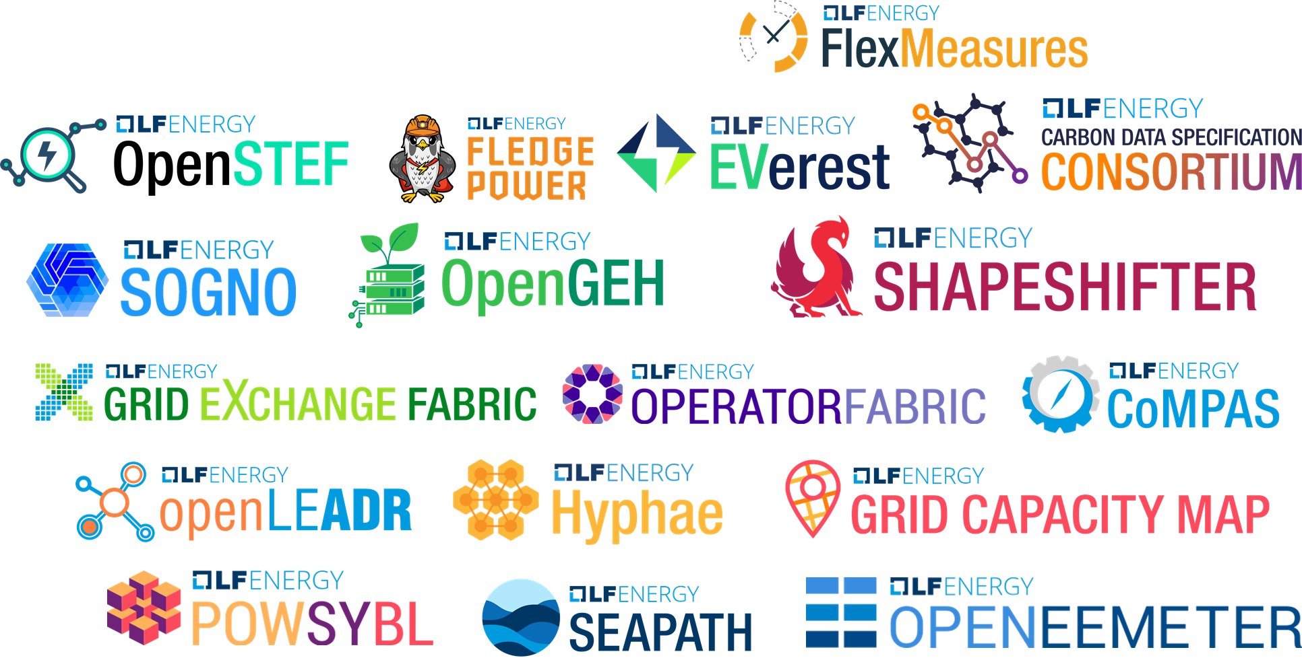
LF Energy Projects (+1)
Notes:
Plus another 3 by the end of the month.

Slide 9
LF Energy Members
Strategic
General
Associate
Notes:
36 members and counting
Source: https://landscape.lfenergy.org/pages/members

Slide 10
Agenda
Introduction
Workflow and Tool Demonstrations
Outcomes and Lessons

Slide 11
Contributors
G-PST
Hannele Holtenen – Recognis
Juha Kiviluoma – VTT
PyPSA
Max Parzen – University of Edinburgh
pandapower
Roman Bolgaryn – Fraunhofer IEE
Sadia Ferdous Snigdha – Fraunhofer IEE & TU Ilmenau
PowSybl
Benoit Jeanson – RTE
Nicolas Omont – Artelys
PowerSimulations.jl
Clayton Barrows – NREL
Dheepak Krishnamurthy – NREL

Slide 12
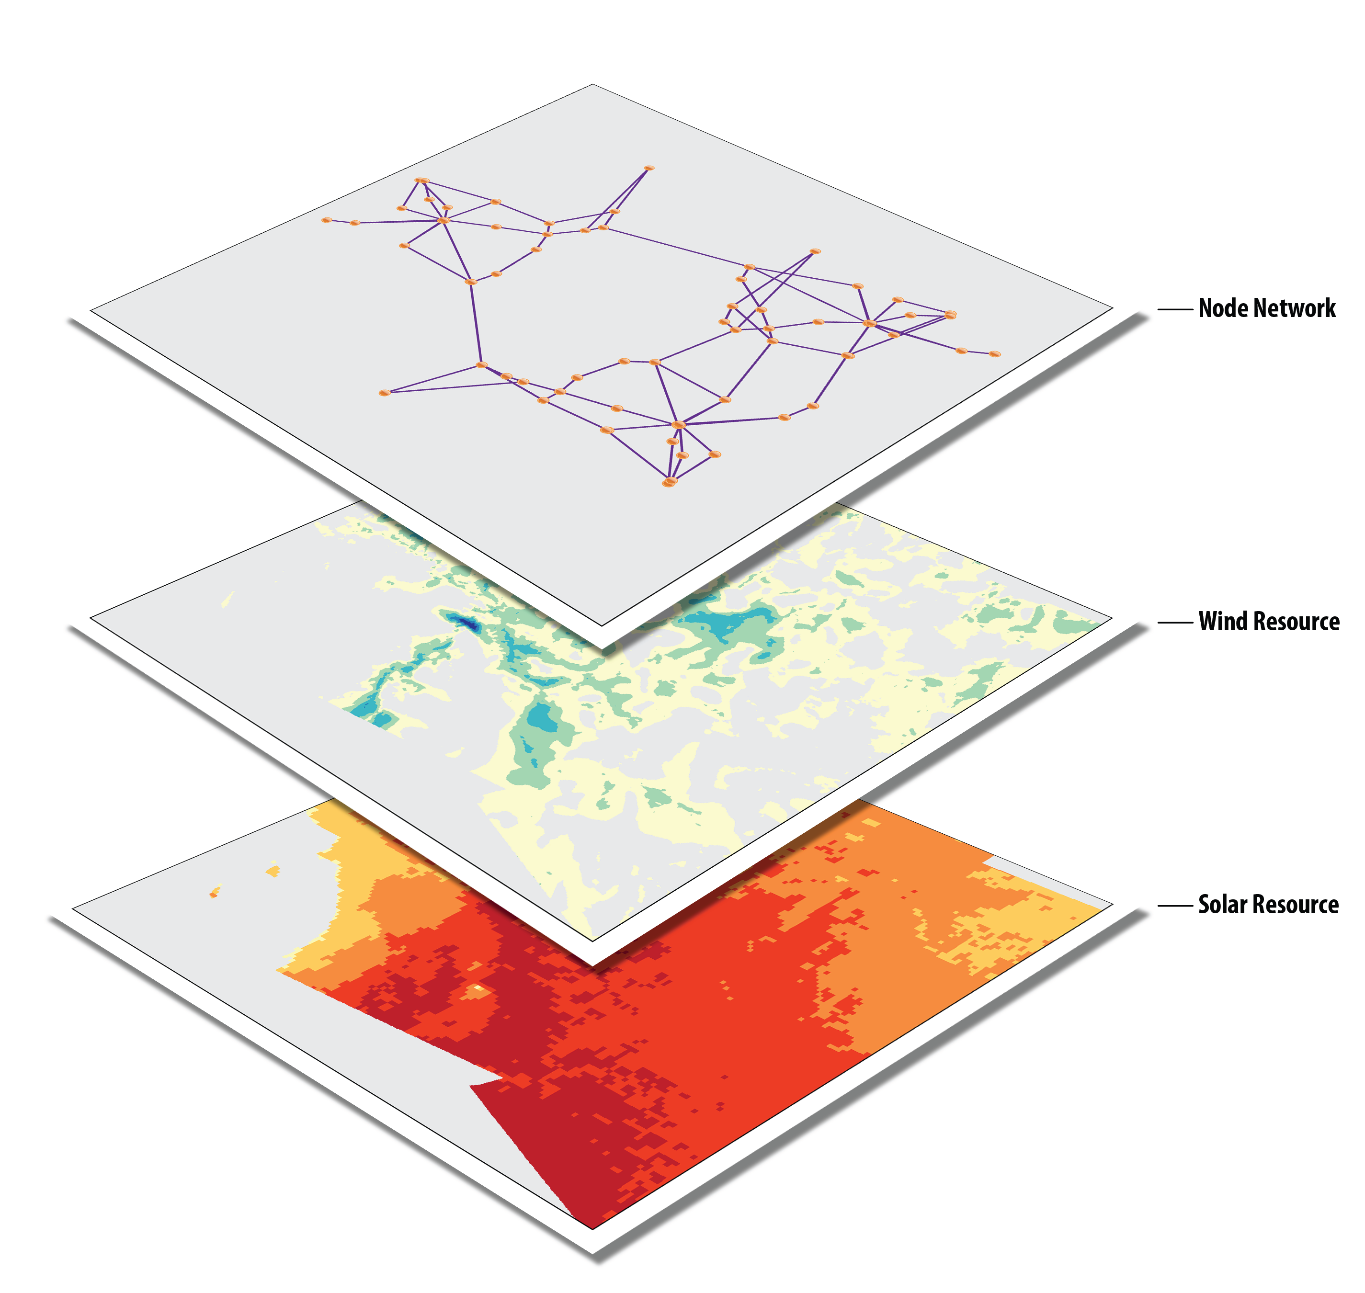
Data
RTS-GMLC (github.com/gridmod/rts-gmlc)
73 buses, 120 branches, and 115 generators

Slide 13
Problem and Workflow Specification
Event 2: System expansion planning and analysis
Existing RTS-GMLC
Capacity expansion
(new assets can be build)
Operational analysis
(PyPSA results valid?)
New
Perform invest and dispatch co-optimization
Add investment costs
Add constraints (i.e.CO2)
Add load scenario

Slide 14
Value Proposition
Demonstration of open-source power systems modeling capabilities
Coordination:
Utilize the strengths of multiple tools to perform a diverse set of analysis
Standardize data specifications, enhance/build tool interoperability

Slide 15
Workflow Step Demonstrations
Maximilian Parzen, Co-steering the PyPSA meets Earth initiative

Slide 16
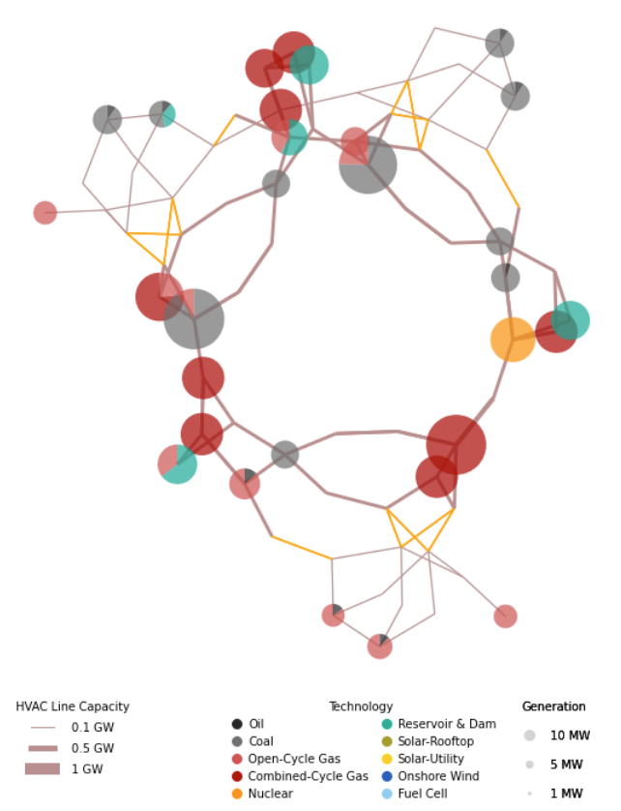
PyPSA
Official website:
https://pypsa.org/
GitHub repository:
https://github.com/PyPSA
Documentation:
https://pypsa.readthedocs.io/en/latest/

Slide 17
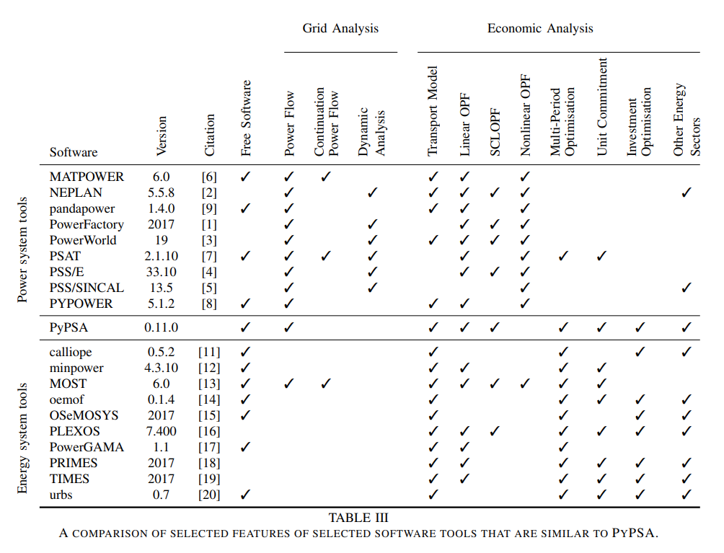
What is PyPSA?
Purpose:
A tool that can do both economic and grid analysis
Developed for large-scale optimization and
Studies in high spatial resolution

Slide 18
Planning exercise
Existing RTS-GMLC
Capacity expansion
(new assets can be built)
New
Add data for 1 year!
Add investment costs
Add constraints (i.e.CO2)
Add load scenario

Slide 19
Planning exercise
Capacity expansion
(new assets can be built)
5 SCENARIOS:
New

Slide 20
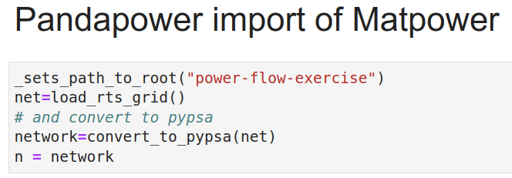
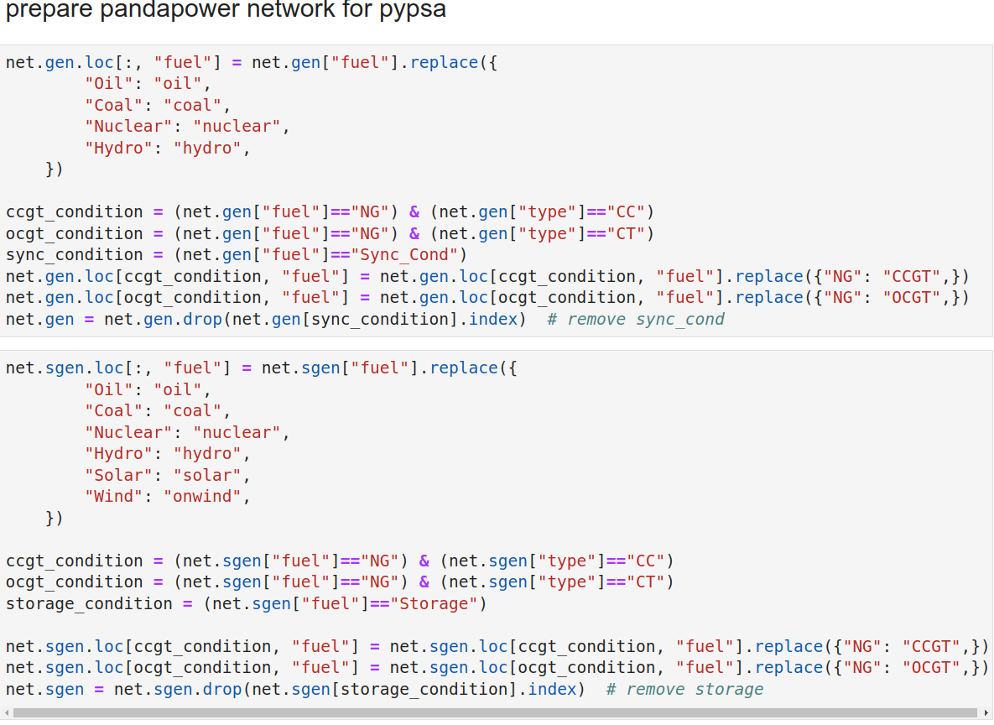
Planning exercise
Existing RTS-GMLC
Required some renaming:

Slide 21
Planning exercise
Capacity expansion
(new assets can be built)
New
Load and prepare time-series (for all tech)
Add data for 1 year!
Add investment costs
Add constraints (i.e. CO2)
Solve

Slide 22
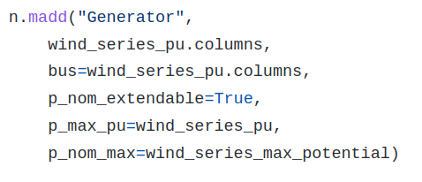
Planning exercise
Capacity expansion
(new assets can be built)
New
Add time-series to network
Add data for 1 year!
Add investment costs
Add constraints (i.e. CO2)
Solve

Slide 23
Planning exercise
Capacity expansion
(new assets can be built)
New
Add data for 1 year!
Add investment costs
Add constraints (i.e.CO2)
Solve

Slide 24
Planning exercise
Capacity expansion
(new assets can be built)
New
Add data for 1 year!
Add investment costs
Add constraints (i.e.CO2)
Solve

Slide 25
Planning exercise
Capacity expansion
(new assets can be built)
New
Add data for 1 year!
Add investment costs
Add constraints (i.e.CO2)
Solve

Slide 26
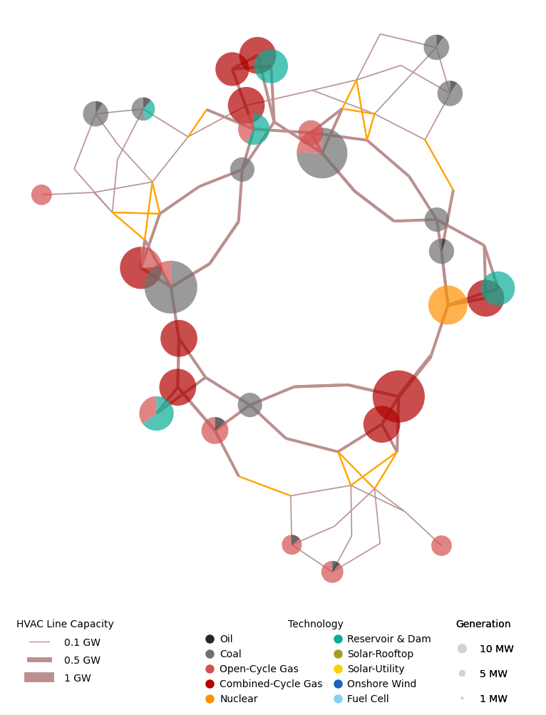
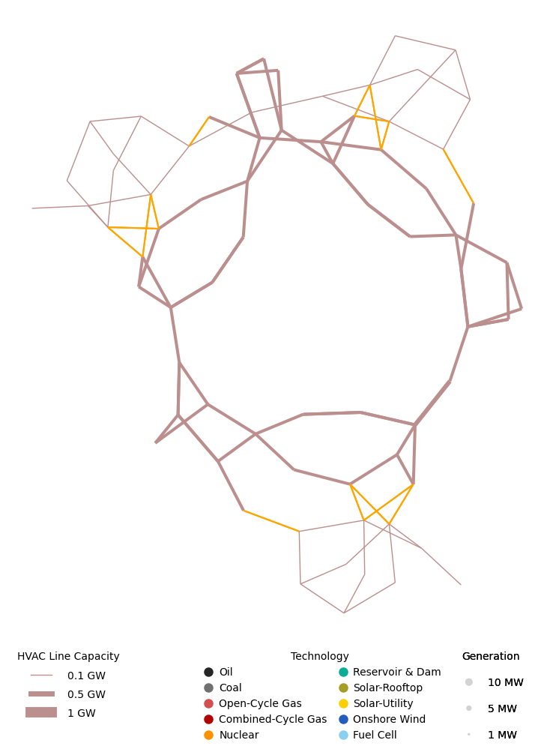
Planning exercise
FAILS. SYSTEM NOT STABLE. SUPPLY DOES NOT MATCH DEMAND.
ORIGINAL
NO EXPANSION BUT LOPF

Slide 27
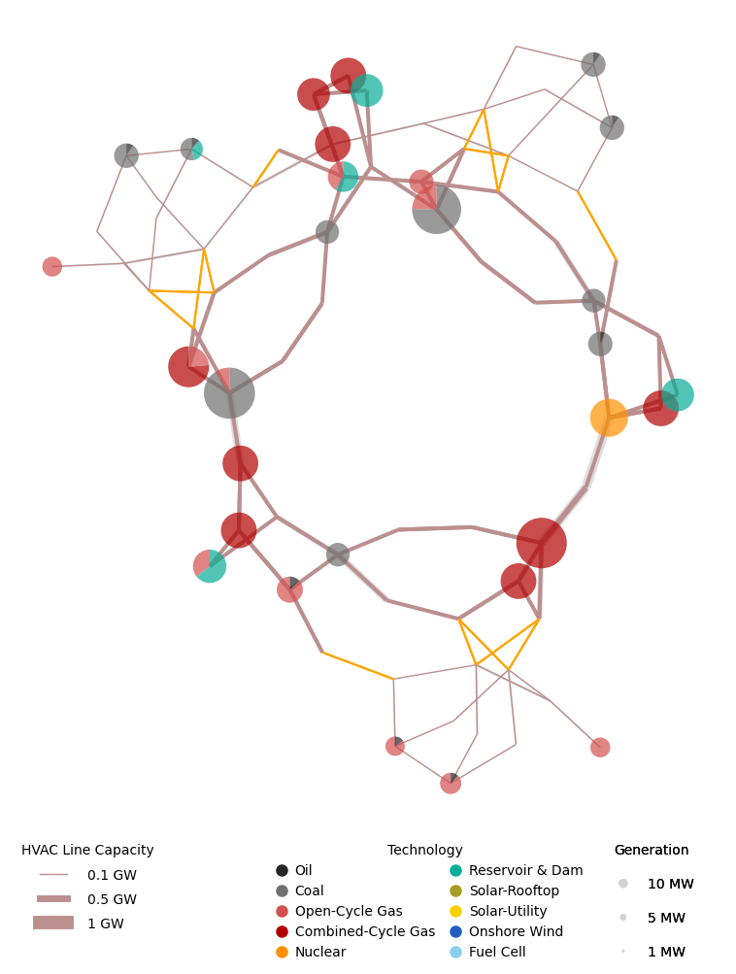
Planning exercise
ORIGINAL
LINE EXPANSION
Bottleneck
~1.5x expansion

Slide 28
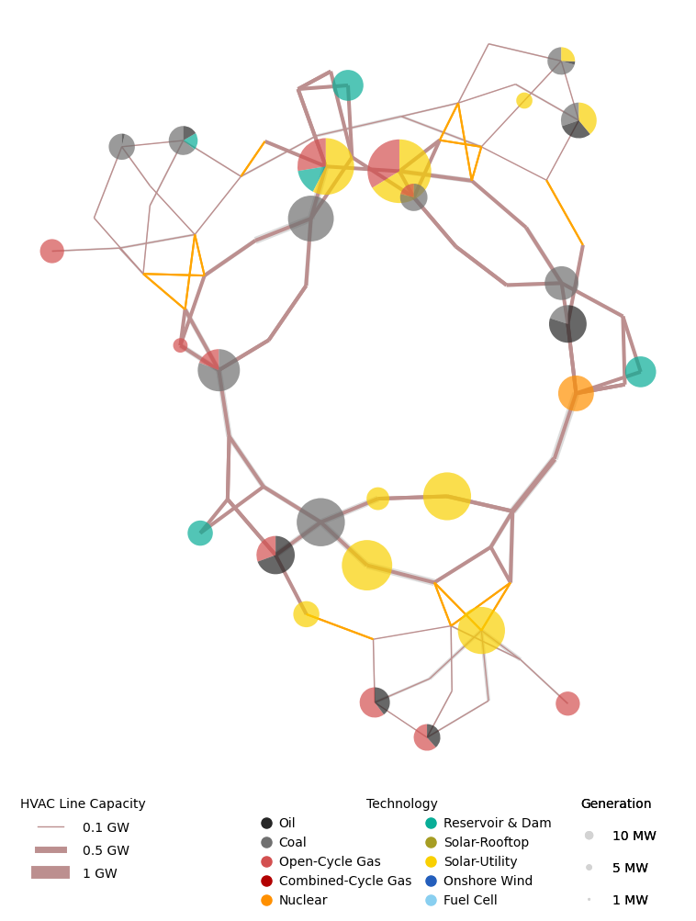
Planning exercise
ORIGINAL
LINE + GEN. EXPANSION
Solar PV
replaces CCG.
Enough flexibility available.

Slide 29
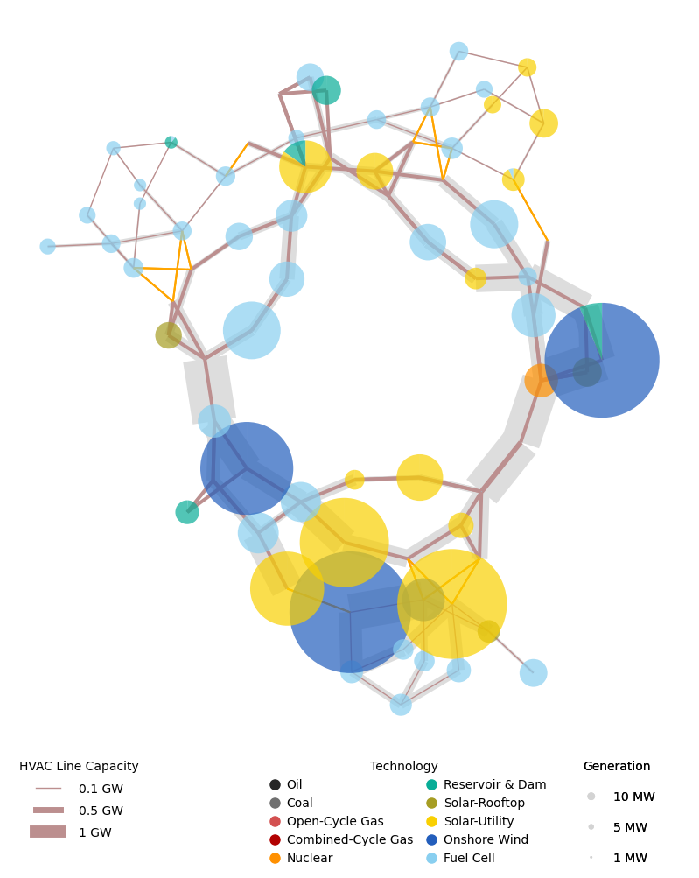
Planning exercise
LINE + GEN. EXPANSION +
zero emission + 1.5x load
ORIGINAL
South = Main supply region

Slide 30
BUILDING A MODEL TAKES TIME...
VALIDATING AND MAINTAINING IT DOES, TOO...
Photo by christopher lemercier https://unsplash.com/photos/12yvdCiLaVE

Slide 31
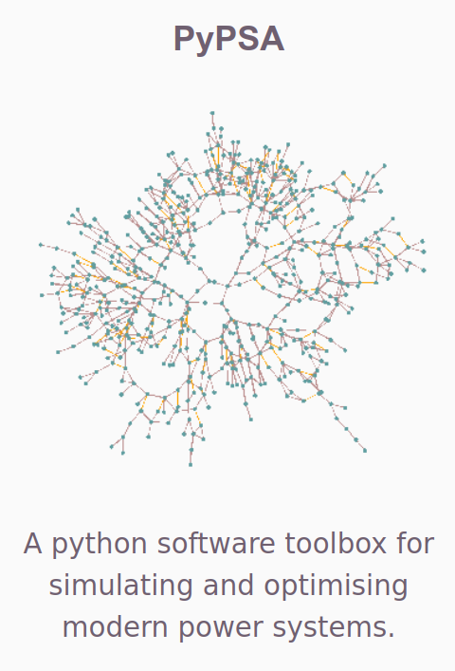
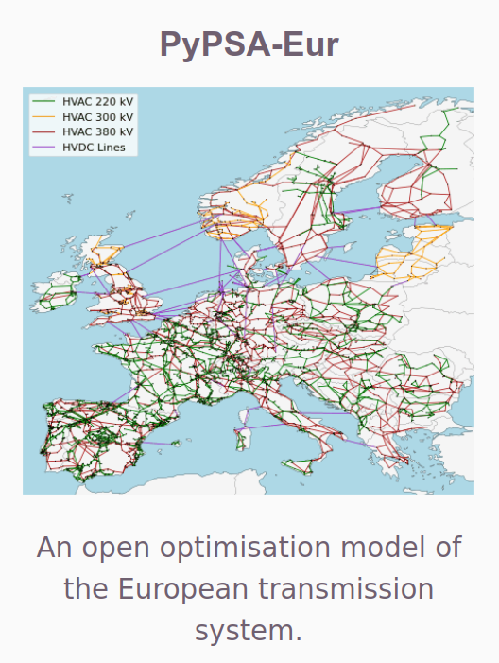
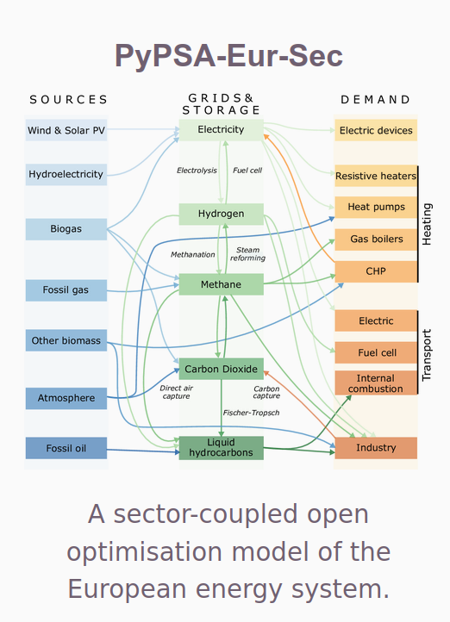
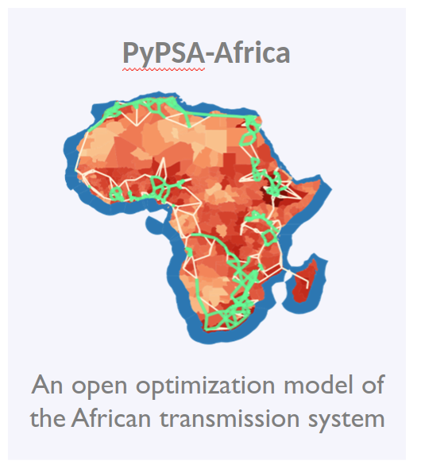
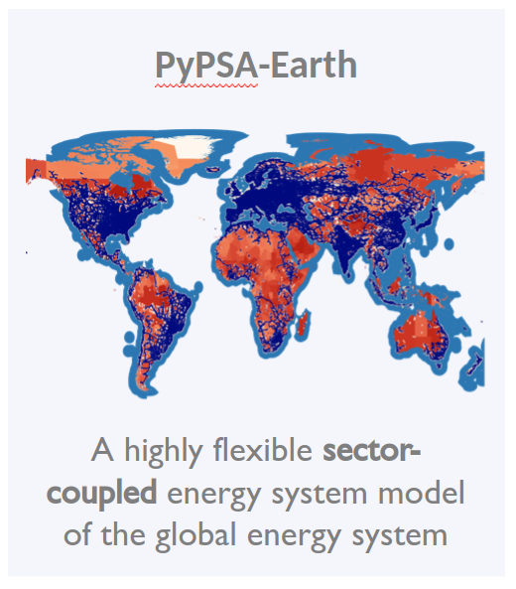
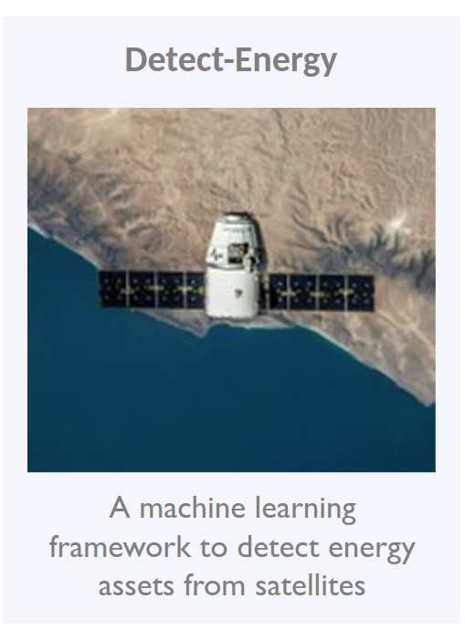
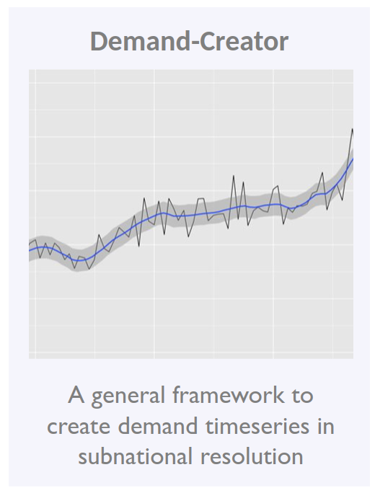
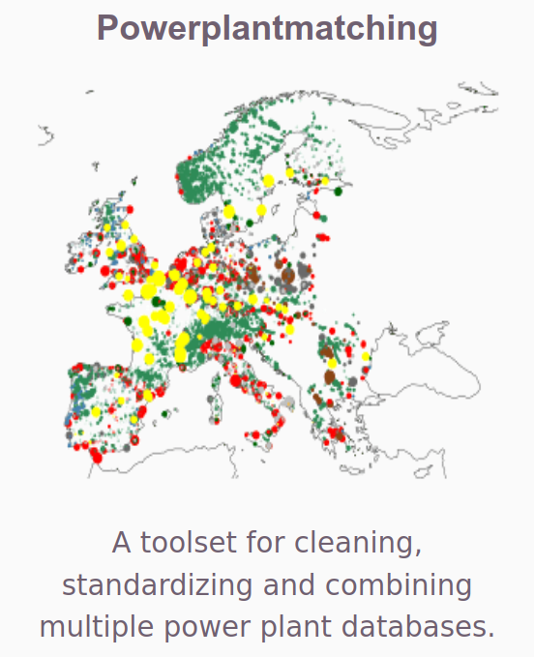
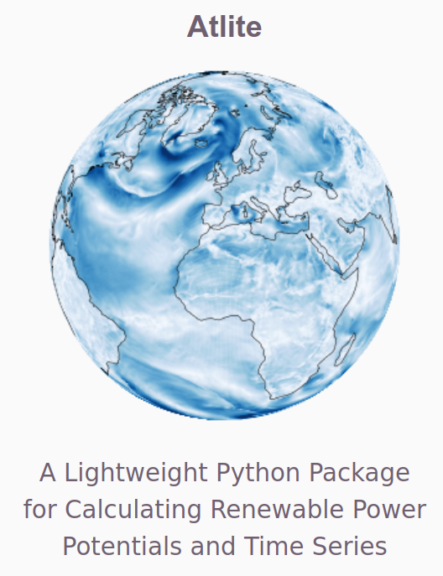
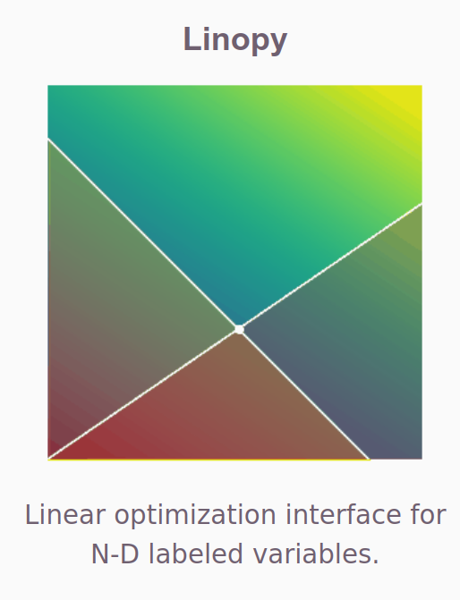
Official website:
https://pypsa.org/
GitHub repository:
https://github.com/PyPSA
Documentation:
https://pypsa.readthedocs.io/en/latest/
PyPSA is a framework. We build tools on top.
MODEL = Data+Framework
FRAMEWORK
MODEL
MODEL
MODEL
MODEL
DATA
DATA
DATA
DATA
BETTER PYOMO

Slide 32
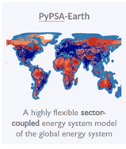
Official website:
https://pypsa.org/
GitHub repository:
https://github.com/PyPSA
Documentation:
https://pypsa.readthedocs.io/en/latest/
PyPSA-Earth: The Wikipedia for energy models.
MODEL ANY COUNTRY OF THE EARTH WITH GLOBAL DEFAULT DATA WORKFLOW
REPLACE DEFAULT DATA WITH CUSTOM DATA WORKFLOW THAT CAN BE SHARED = SUSTAINED (OR NOT)

Slide 33
“PyPSA meets Earth's vision is to create together the most compelling open-data and open-source planning tools to accelerate the world’s sustainable energy transition.”
CHALLENGE THE BLACK-BOX MODELLING STANDARD
Notes:
Mission statements:
Accelerating global energy transition
Improving openness to maximize global impact
Enabling effective global collaboration

Slide 34
MAXIMILIAN PARZEN
Co-steering the PyPSA meets Earth initiative
https://pypsa-meets-africa.github.io/
max.parzen@ed.ac.uk
@maxparzen

Slide 35
pandapower
Roman Bolgaryn
Researcher, Fraunhofer IEE

Slide 36
pandapower
Official website:
http://www.pandapower.org/
GitHub repository:
https://github.com/e2nIEE/pandapower
Documentation:
https://pandapower.readthedocs.io
Useful links

Slide 37
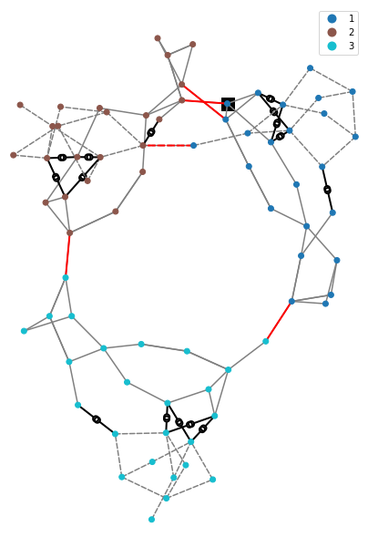
Case study for the RTS grid
Adjustments had to be made for the case study for AC-feasibility
Model conventional generation as PV node instead of PQ node
Use distributed slack with conventional generation
Add transformer tap changer controllers

Slide 38
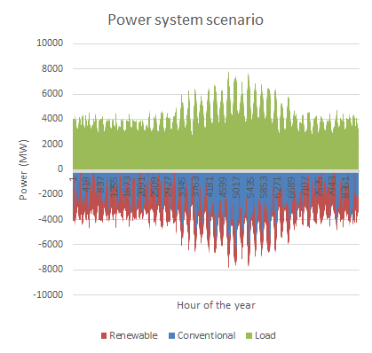
Case study: scenario
The scenario represents the load, conventional generation and renewable generation
The conventional generation is used to cover the gap between the load and renewable generation

Slide 39
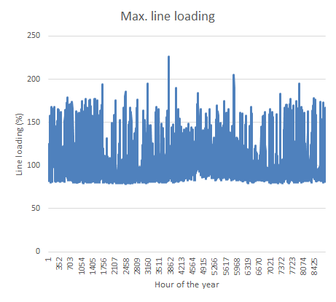
Case study: initial line loading
Input data: load profiles and renewable generation profiles
Conventional generation is considered in a simplified manner: balancing with the distributed slack approach, weighed by the installed power
This results in line overloading during many time steps

Slide 40
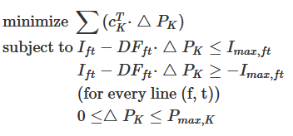
Case study: method
AC-OPF with LP problem formulation
Positive costs for conventional generation and negative costs for renewable generation
OPF can be repeated with load shedding enabled for the time steps that fail. It was required for 1 time step in the case study

Slide 41
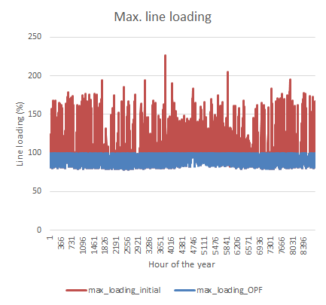
Case study: line loading
The line loading could be maintained within a set limit for all time steps

Slide 42
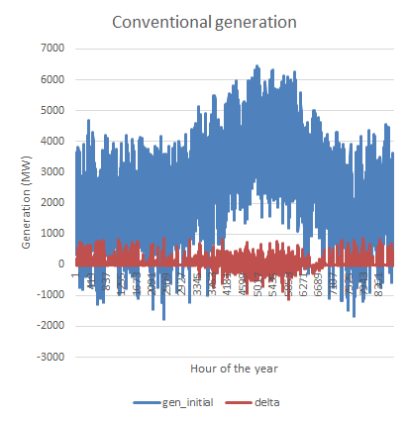
Case study: generation
The redispatch of conventional generation is not very high in overall (in absolute values)
Reason: the balancing was already done with distributed slack
The OPF is redistributing the conventional generation across the power system
Renewable generation did not need to be redispatched

Slide 43
Conclusions and Further work
Challenges in AC LP-OPF:
Performance
"Oscillations" of the solution
Advantages:
AC-feasible solution
Possible to include outer-loop control (e.g. transformer tap changer), with an easier formulation
Further work:
Security-Constrained AC LP-OPF
Consideration of preventive and curative measures
Consideration of overhead line temperature and thermal inertia

Slide 44
System Planning with Powsybl – Metrix
Application to the GLMC-RTS model
Nicolas Omont
Vice President of Operations, Artelys

Slide 45
System Planning with Powsybl – Metrix
Application to the GLMC-RTS model
Linux Foundation Energy – GMLC Webinar

Slide 46
Introduction to Powsybl
PowSyBl (Power System Blocks, powsybl.org) is an open-source framework written in Java and dedicated to power grid analysis and simulation
Created in 2012 (iTesla EU funded collaborative R&D project)
Community of 70 users
Many supported formats
CIM-CGMES, UCTE, Matpower, PSS/E…
Power-flows, OPFs, security analysis, dynamic simulation
Advanced features
Analysis tools, visualization tools
Grid topology operations
Extensions, Extractions, Merges…
Friendly to non-Java developers
Python binding, fine-tuning using Groovy

Slide 47
Introduction to Metrix (1/2)
An optimization model used to assess and optimize preventive and curative remedial actions to respect the network constraints on a high number of variants
Created in 2010 (fully open-sourced in 2021, including the linear solver)
Interfaced with PowSyBl
Load / Non dispatchable generation
Network model
METRIX
List of contingencies
Redispatch, curtailment, loss of load
Topological remedial actions

Slide 48
Introduction to Metrix (2/2)
Three computation modes
DC security analysis (N, N-k)
SC-DCOPF* w/o redispatching (N, N-k)
SC-DCOPF* w/ redispatching (N, N-k)
Minimizing global cost while satisfying max flow constraints
No optimization, simple power flow
Minimizing: max flow violations
Inputs:
Network model
Base case topology
Contingencies (N-k)
Load and generation timeseries (Gen. must match demand)
Inputs:
Same as DC security analysis
Available topological remedial actions (preventive and curative)
Inputs:
Same as DC security analysis
Available preventive and curative actions
Topological remedial actions
Redispatch costs
Results:
Flows at each element (N)
Max flow violations (N, N-k)
Results:
Same as DC security analysis
Selected preventive actions
Selected curative actions
Remaining violations (N, N-k)
Results:
Same as SC-DCOPF without redispatching
Production and consumption adjustments (redispatch, curtailment, loss of load)
* SC-DCOPF = Security Constrained Direct Current Approximation Optimal Power Flow
A tutorial covering this functional perimeter is available online: https://github.com/powsybl/powsybl-tutorials/tree/metrix/metrix/src/main Tutorial introduction video: https://vimeo.com/722882701
Tutorial introduction pdf: https://github.com/powsybl/powsybl-tutorials/raw/metrix/metrix/src/main/resources/PowSyBl-metrix-6-node-tutorial-presentation.pdf

Slide 49
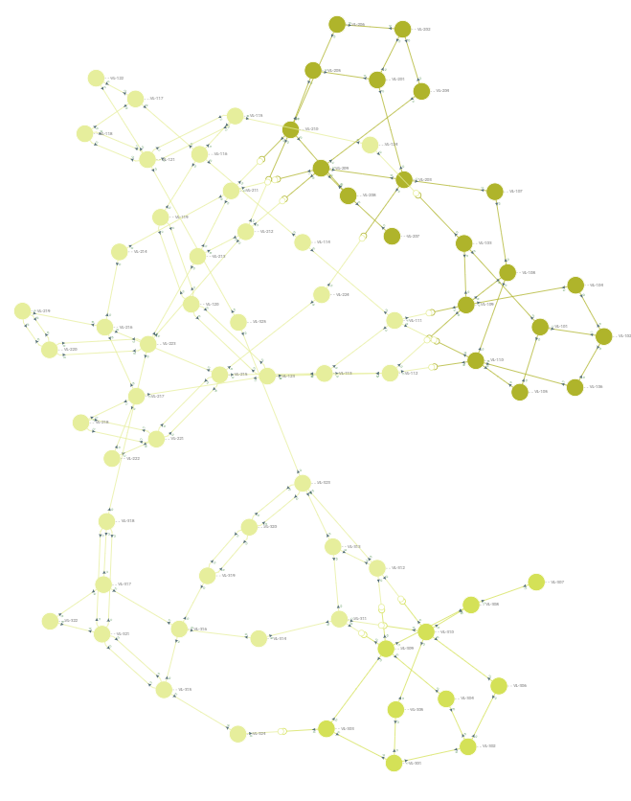
Application on the RTS-GMLC model
Study case building:
Loading the network from the Matpower format
Mapping annual non-dispatchable generation and load timeseries (8784 hourly time steps) to each node, as well as dispatchable generation initial set points.
Study computation:
N-K analysis: single contingencies (N-1) on all 120 elements (lines+trafos)
Available remedial actions: preventive redispatch
Evaluation of the value of an inter-zone transmission line by comparison of the cases w/ and w/o this line.
Not in scope: topological actions, curative remedial actions, HVDC lines.
Analysis (KPIs)
Flows on the four inter-zone transmission lines (in bold on the map)
Localization of their threats (i.e. the contingency leading to the largest flow on a given line)
Assessment of redispatch and curtailment to evaluate the decrease of generation costs brought by the inter-zone transmission line.
Data: https://github.com/GridMod/RTS-GMLC

Slide 50
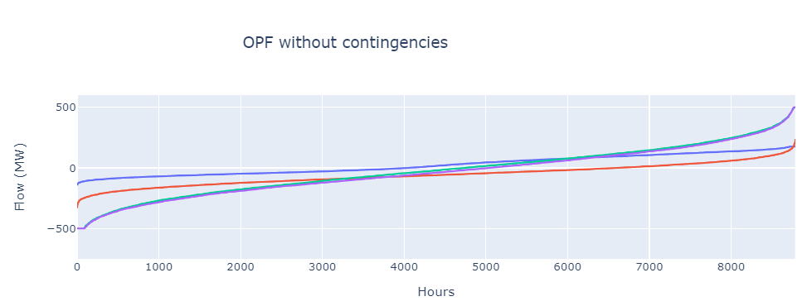
Base case without contingencies (N)
Power flow (w/o redispatch)
With redispatch: no major difference (~almost no N constraints)
Limit: 500MW
Limit: 175MW

Slide 51
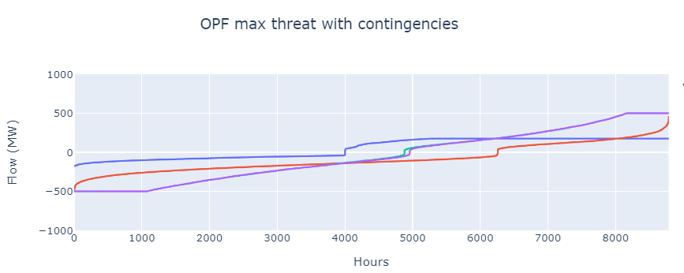
Base case with contingencies (N, N-1)
DC Security Analysis (24 s. for 8784 timesteps)
Optimized Power Flow (49 s. for 8784 t.s.)
Enforcement of max flow limits is visible
Limit: 500MW
Limit: 175MW

Slide 52
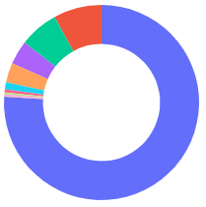
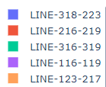
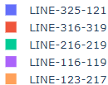
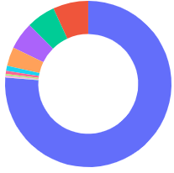
Base case with contingencies: threat location
Location of the contingency causing the max flow
For Line 318-223: For 75% of time steps, line 325-121
For Line 325-121: 80% of time steps, line 318-223

Slide 53
Base case with contingencies: redispatch
Redispatch cost
3 main regimes:
- No congestion
- Increase of ~0.1 $/MWh of additional load
- Increase of ~0.5 $/MWh of additional load

Slide 54
Value of a transmission line
Weekly generation cost
Comparison with and without line 325-121,one of the two lines linking zone 1 and 3
Line’s total savings = $3,7M/year

Slide 55
Conclusion on PowSyBl-Metrix
PowSyBl Metrix is a SC-DCOPF
Handling both preventive and curative remedial actions
Including redispatching, HVDC set point adjustment and topological actions
Build for outstanding performance on sequential simulations (on independent timesteps)
Illustration of preventive redispatching on the RTS-GMLC model
Maximum threat a line is subject to.
Cost of redispatch
Value of a line by comparison of redispatching cost w/ and w/o the line
More info online:
Installation guide
A tutorial based on a 6-node grid illustrates all features:
https://github.com/powsybl/powsybl-tutorials/tree/metrix/metrix/src/main

Slide 56
PowerSimulations
Clayton Barrows
Senior Engineer, NREL

Slide 57
PowerSystems.jl
Data:
Transmission systems
Quasi-static, technical and economic system operational data
Dynamic parameters
Time series
Parsing from standard file formats (.m, .csv, .raw, dyr)
De/serialization (compressed storage)
Consistency checks
Calculations
Network matrices (YBus, Adj, PTDF, LODF)
Power flow

Slide 58
PyPSA2PowerSystems.jl
Creates a System from a PyPSA netCDF input or output file

Slide 59
PowerSimulations.jl
Formulations:
Devices: 55 formulations
Networks: 52 formulations (through integration with PowerModels.jl)
Services (reserves): 8 formulations
Models:
Decision Model: UC, ED… usually multi-period forecast data
Emulation Model: single period realization data
Simulations:
Multiple executions: 365x UC
Multiple models:
365x (UC – 24x ED) = 365 + 8,760 = 9,125
365x (DA – 24x (HA – 12x (RT – 75x AGC))) = 365 + 8,760 + 105,120 + 7,884,000 = 7,998,245
LT – DA, DA – RT – Emulation…
Co-simulation
Helics
Custom

Slide 60
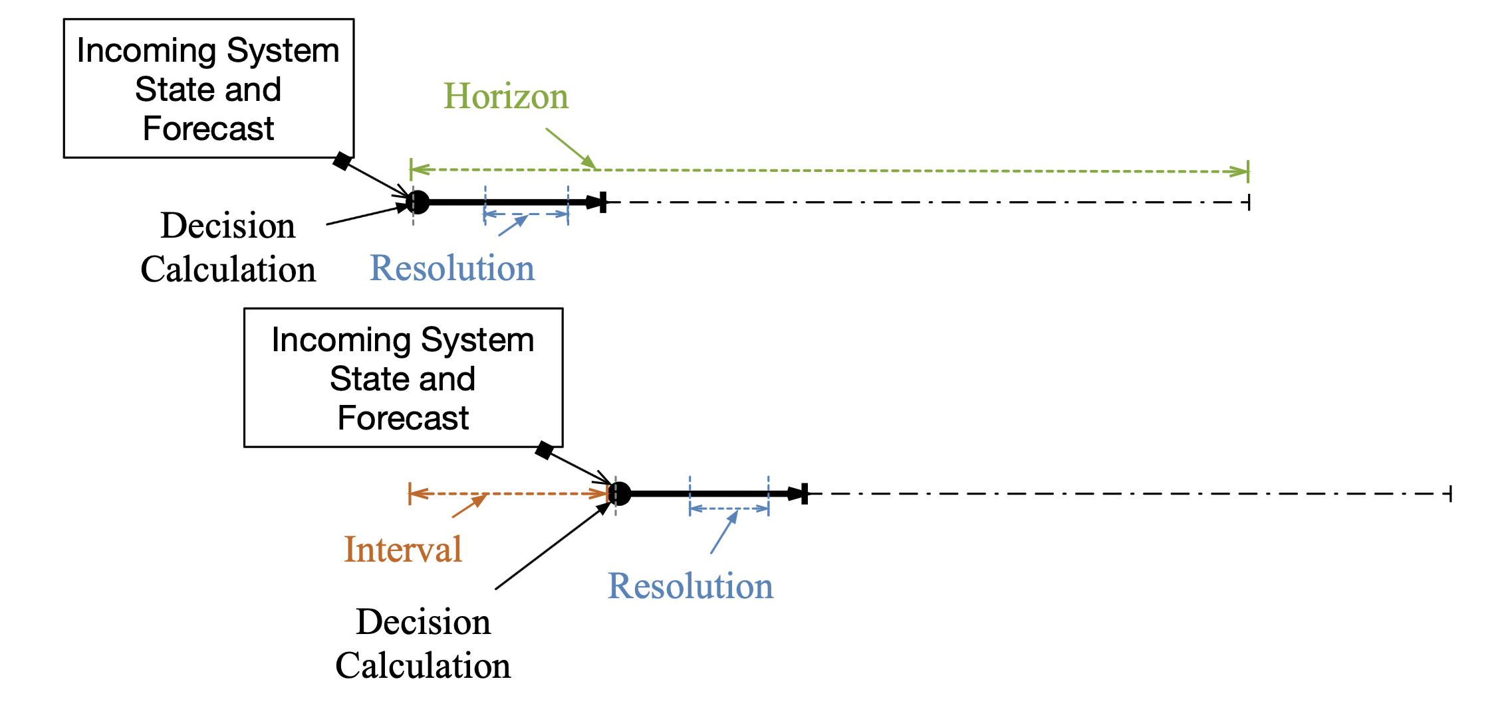
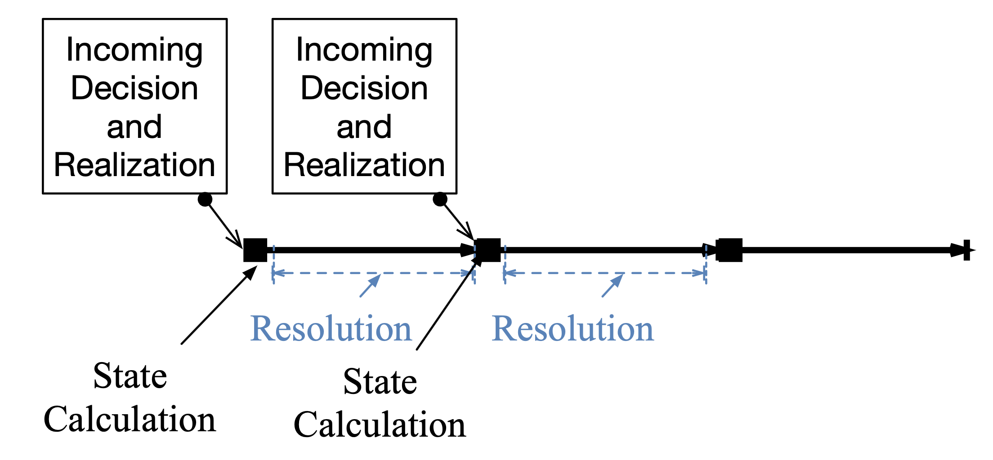
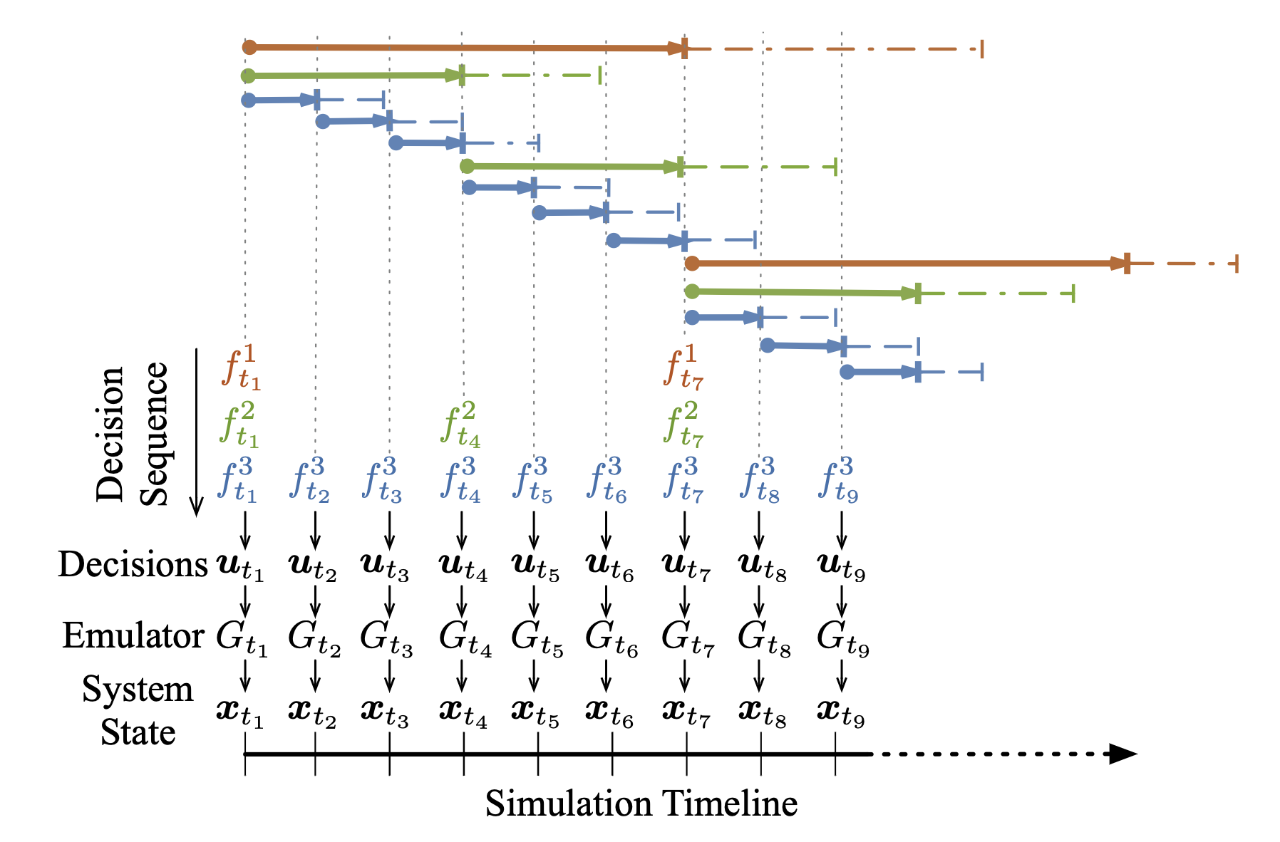
Flexible Simulation Specifications
Decision Model
Emulation Model
Simulation

Slide 61
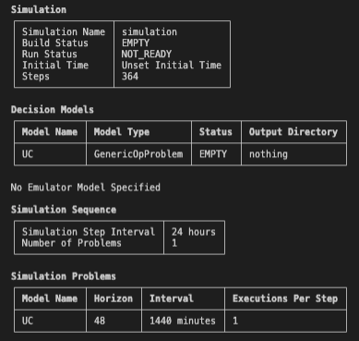
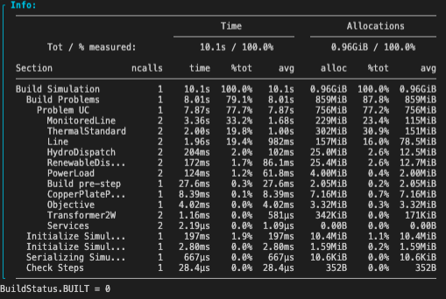
Exercise Simulation Specification

Slide 62
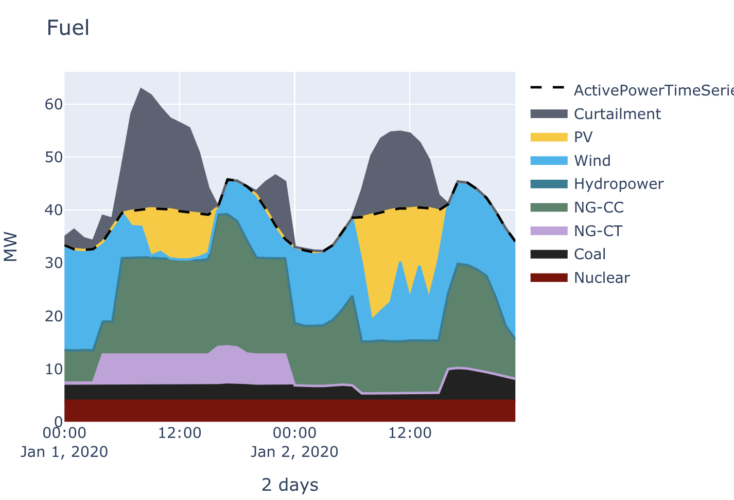
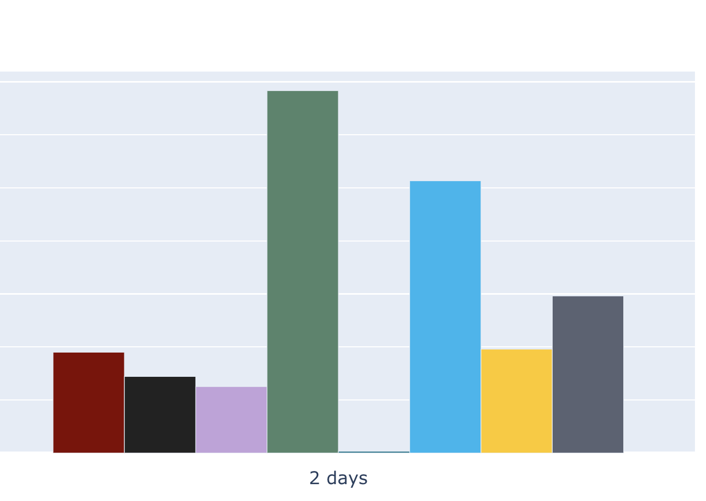
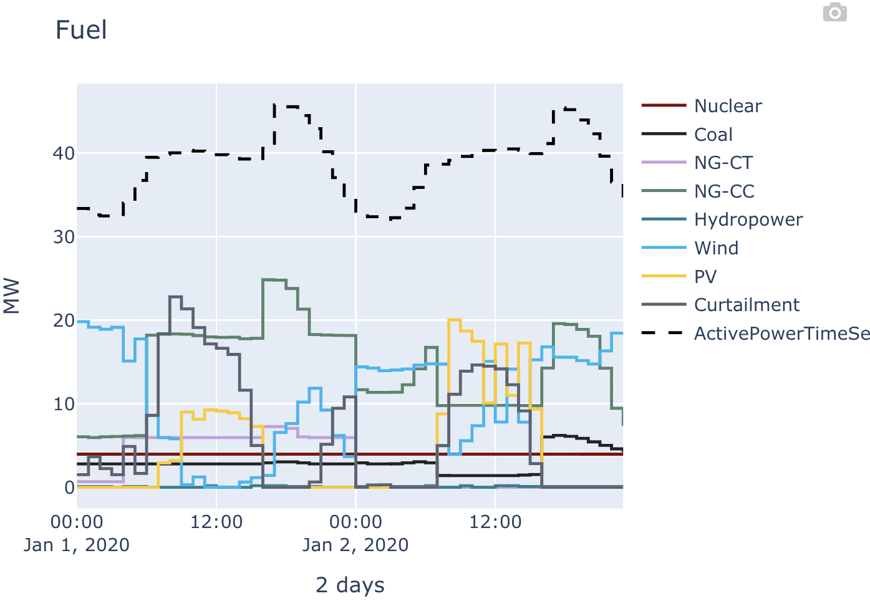
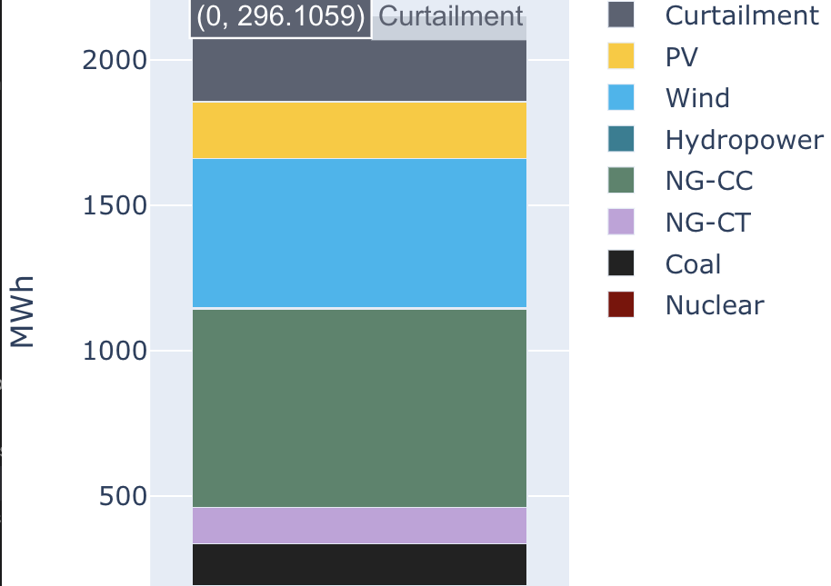
PowerGraphics.jl
Plot types: bar, stack, line, (coming soon: networks)
Data: System, PSI.Results, (coming soon: PSID.Results)
Backends: GR (static), PlotlyJS (basic interactivity)

Slide 63
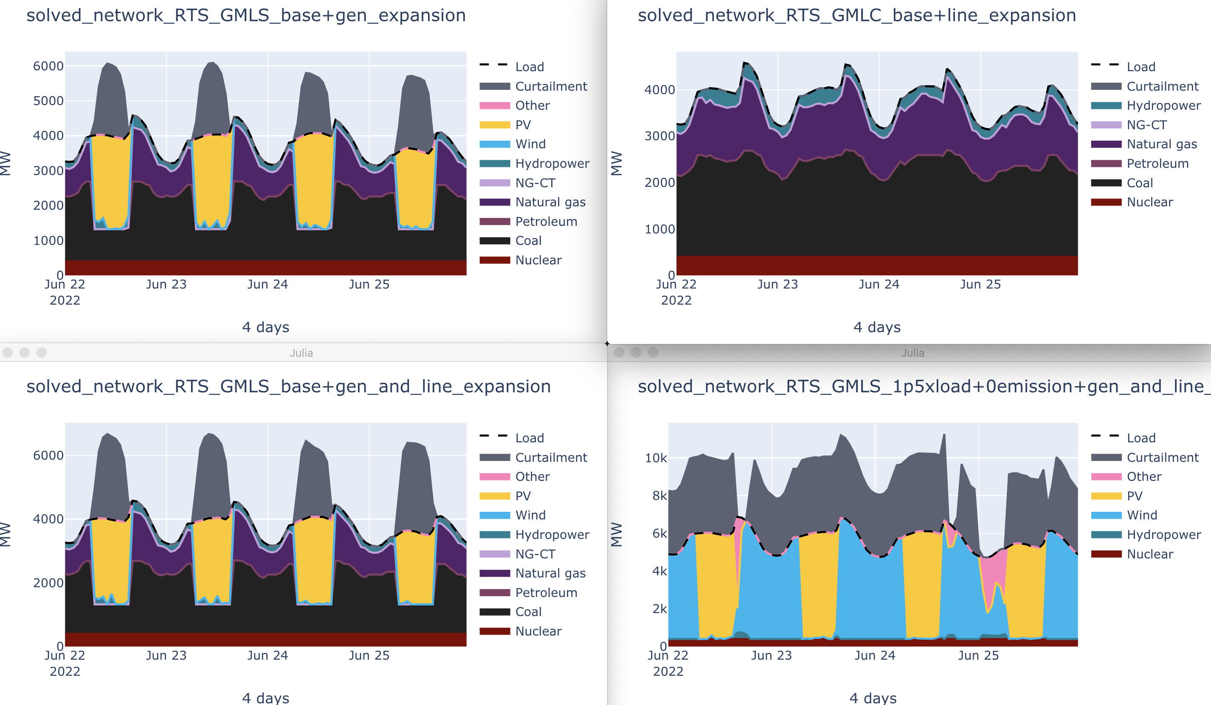
Example Scenario Results

Slide 64
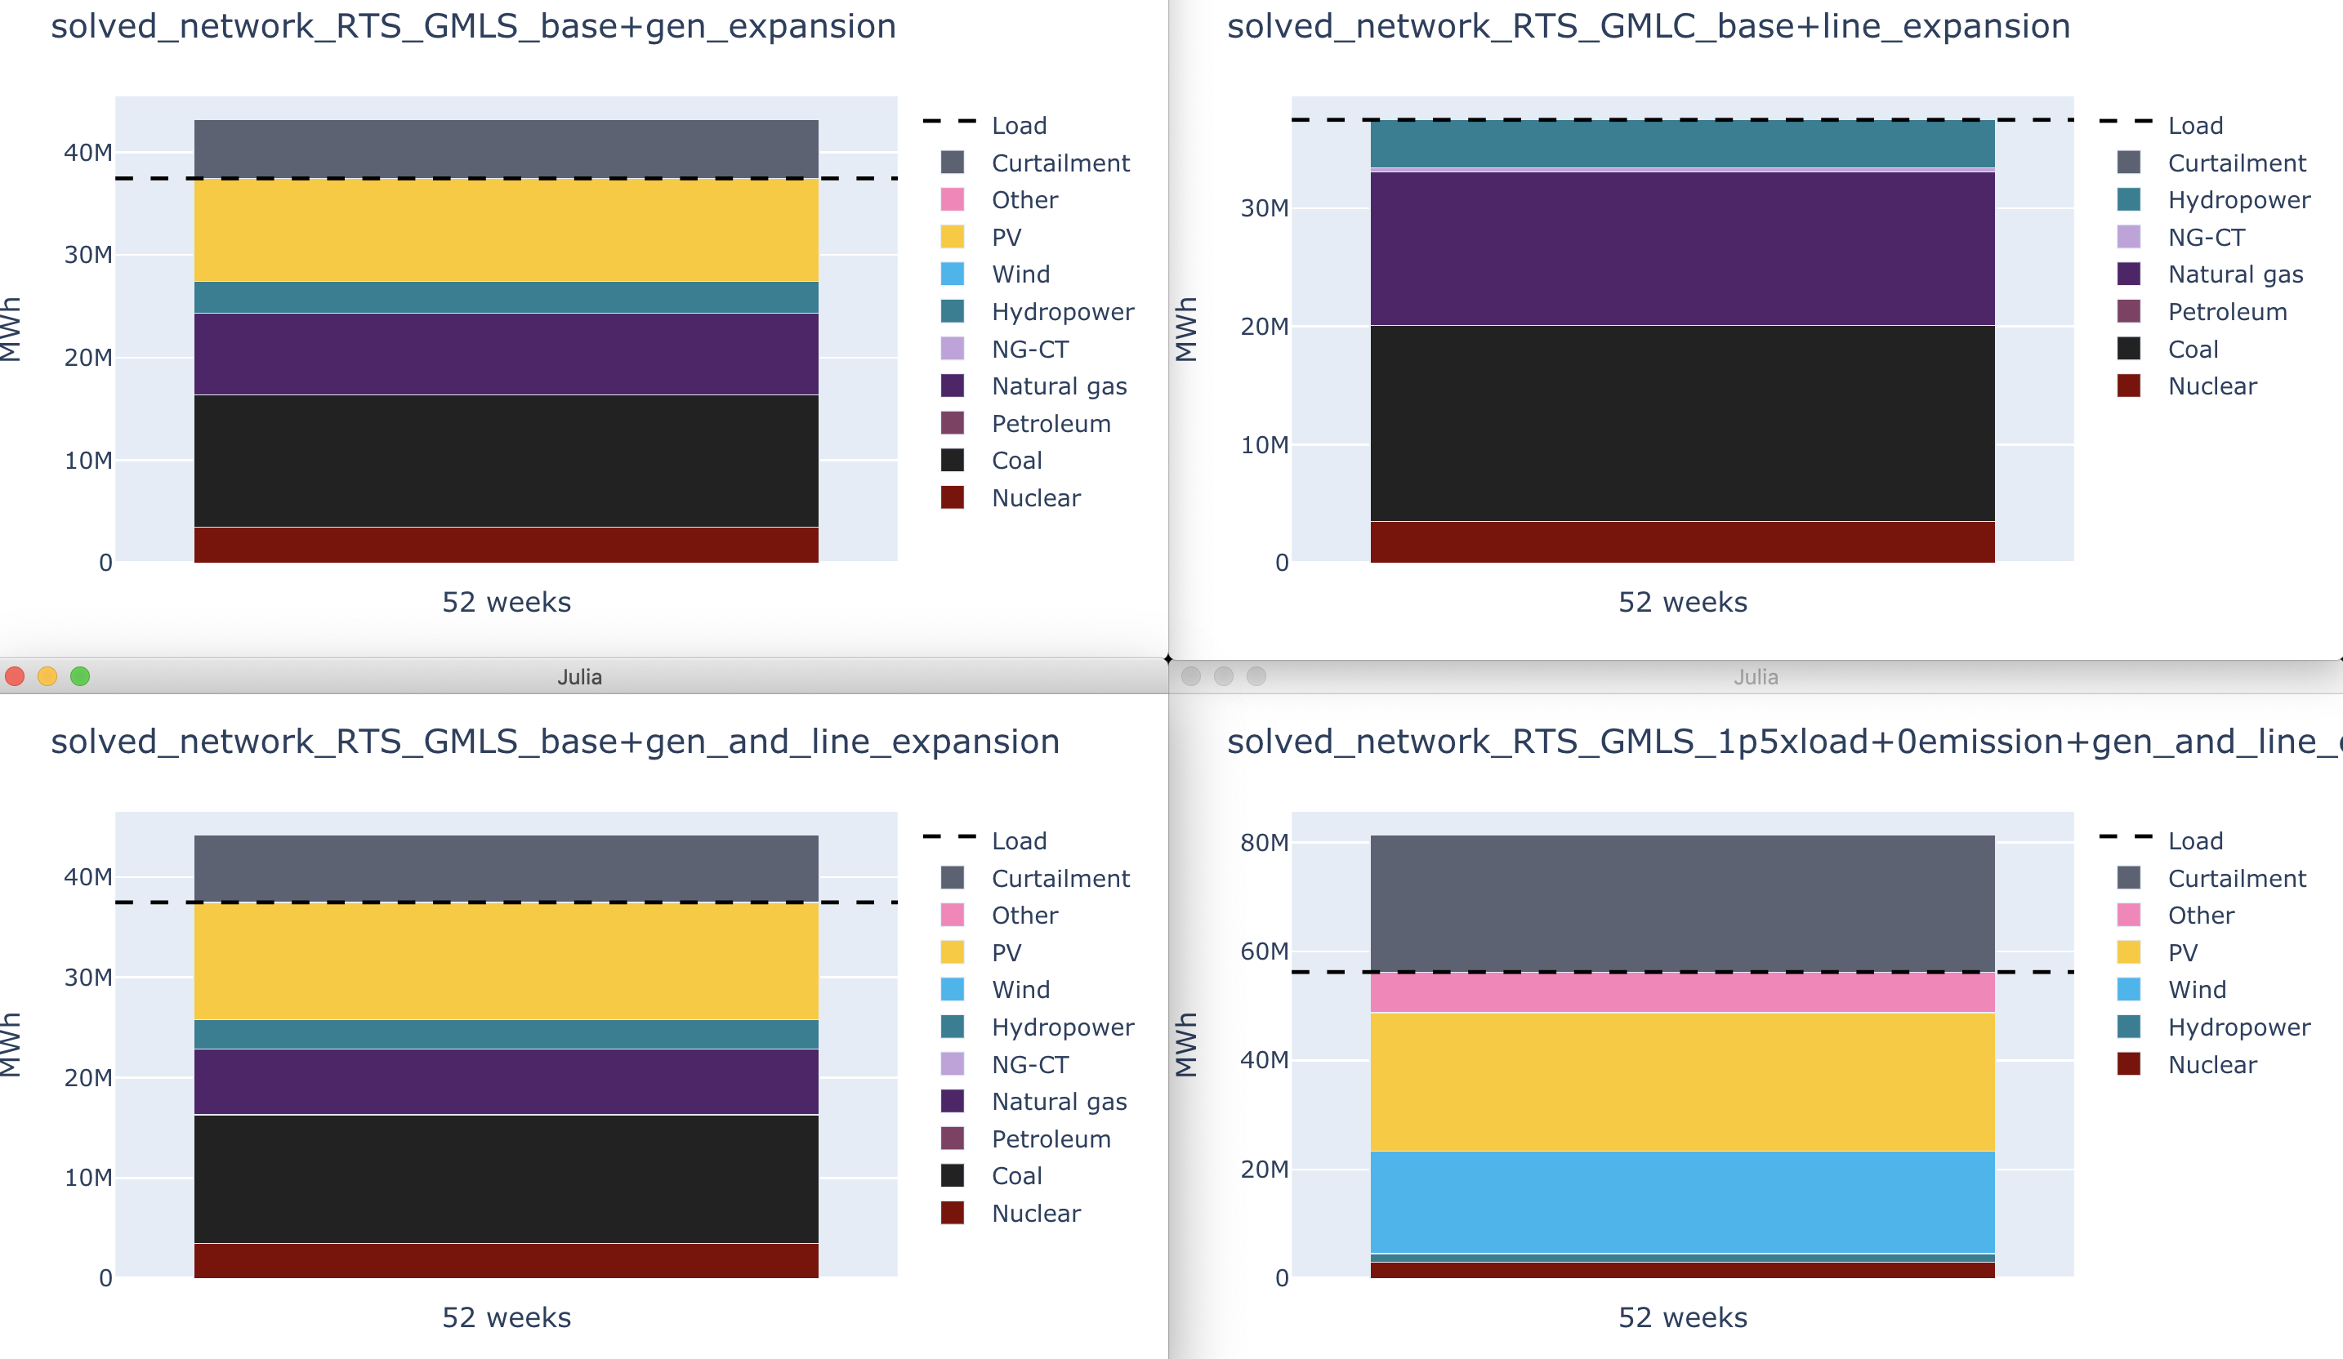
Example Scenario Results: Annual Generation

Slide 65
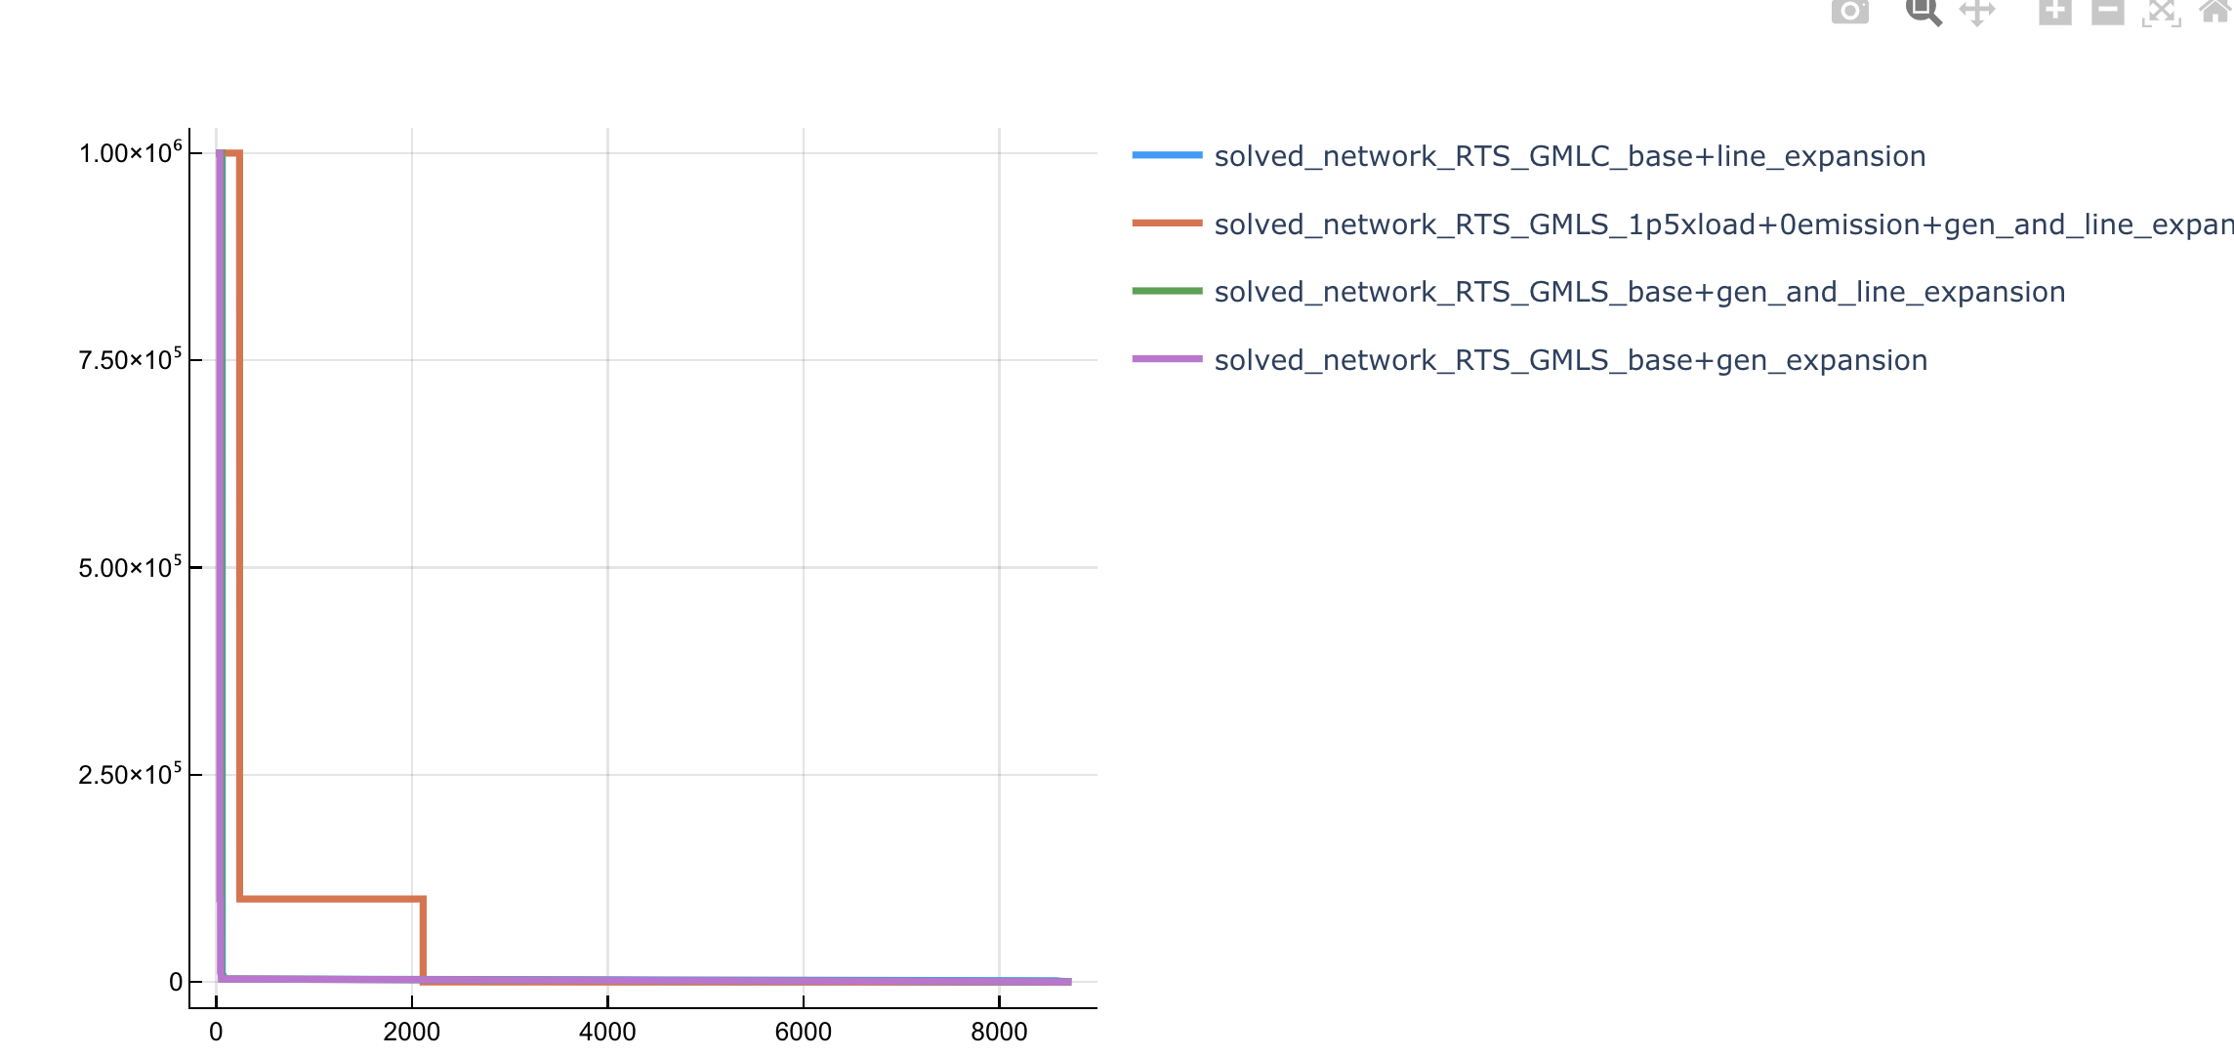
All results are accessible in DataFrames

Slide 66
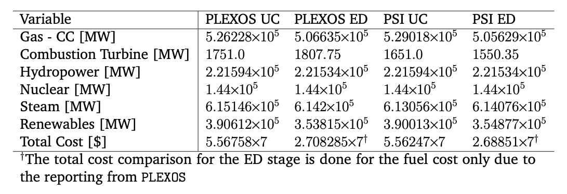
PowerSimulations.jl Benchmarks

Slide 67
PowerSimulations.jl for reserve deployment modeling
Model the allocation and deployment mechanisms of Frequency Regulation Reserve (FRR) in a quasi-steady state model.
Use mathematical programming to pose it as an optimization problem.
Use fast optimization solvers to accelerate the studies.
Evaluate a study case with a Unit Commitment (UC) model, an Economic Dispatch (ED), and our proposed AGC formulation.
Lara, José Daniel, et al. "AGC Simulation Model for Large Renewable Energy Penetration Studies." 2020 52nd North American Power Symposium (NAPS). IEEE, 2021.

Slide 68
Scalable Integrated Infrastructure Planning for Power Systems SIIP::Power
NREL-SIIP
PowerSystems.jl
PowerSimulations.jl
PowerSimulationsDyanmics.jl
PowerGraphics.jl
Extensions
Rigorous power system data model:
Parsers
Time series
Quasi-static model data
Dynamic model data
Basic power-flow calculations
Mathematical formulations and simulation assemblies:
Quasi-static problems and simulations
PCM, UC/ED, OPF
Reserve co-optimization
AGC/ACE simulation
Integrated with PowerModels.jl
Scalable stability modeling:
Advanced AD
Small signal stability
Full dynamic simulations
Low inertia simulation capabilities
Modular separation between device model and numerical integrator
Lightweight interactive visualizations:
Extensible and configurable graphics
Interactive visualizations with PlotlyJS
Supports results generated with PowerSimualtions.jl
SIIPExamples.jl
PowerModelsInterfaces.jl
HydroPowerSimulations.jl
PowerSimulationsDemand Response.jl
ReliablePowerSimulations.jl
PowerSystemCaseBuilder.jl

Slide 69
Outcomes and Lessons
Clayton Barrows​
Senior Engineer, NREL​

Slide 70
Need for better data specifications and formats
Common Information Model (CIM) designed for operational data exchange
Model specific (MATPOWER, PSS/e .raw) formats are incomplete
Is there a need for something in-between?
RTS-GMLC (not well defined, but could be a starting point)

Slide 71
Outcomes
PyPSA2PowerSystems.jl
PowerSystems.jl -> PowerModels.jl -> MATPOWER .m
RTS-GMLC -> PowSyBl-Metrix
RTS-GMLC -> PyPSA
RTS-GMLC -> pandapower
Improved pandapower -> PyPSA

Slide 72
Q&A

Slide 73
Thank you!

Slide 74
Sample panel questions
What aspects of each tool demonstration are open/closed source?
How do you obtain support?
What can be done to improve these types of workflows?
Is there a need for a "planning" data specification?
Yes, (partially) addressed by PEMMDB for planning in Europe (pan-european market model database)
Opportunities for coordination on defining specification

