Slide 1
1st PyPSA user meeting
“What the heck is PyPSA-Earth?"
21.10.2022,
Ekaterina Fedotova (Central Asia lead PyPSA-Earth),
Maximilian Parzen (Co-director PyPSA-Earth)
Notes:
https://deepai.org/machine-learning-model/text2img

Slide 2
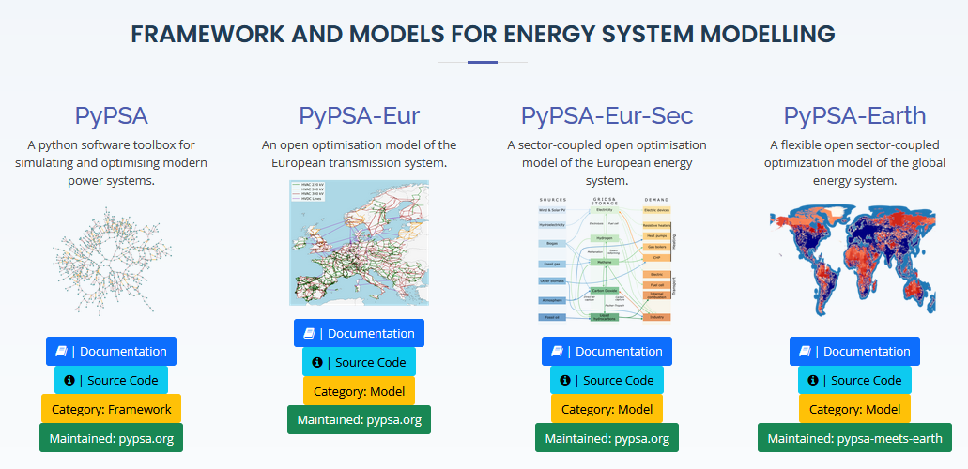
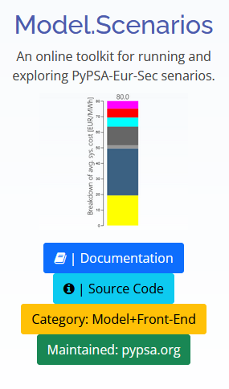
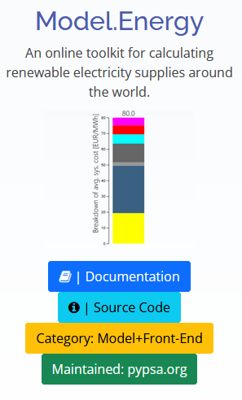
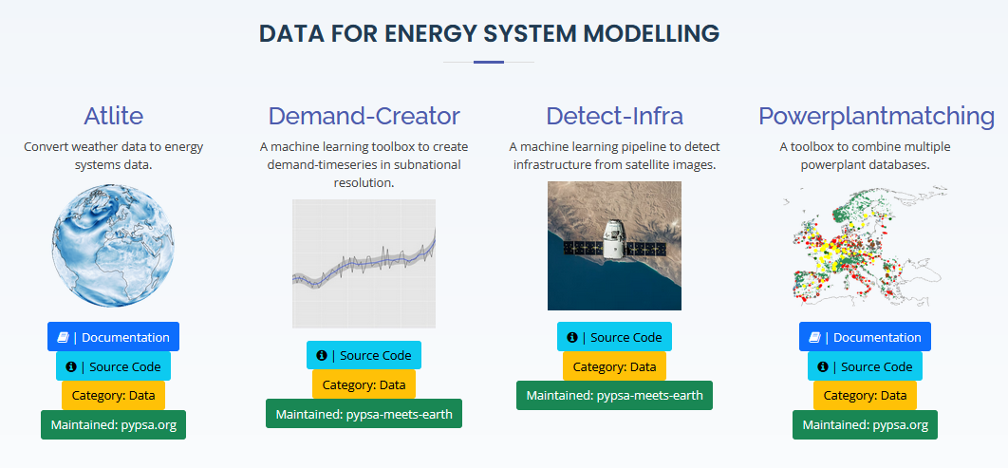
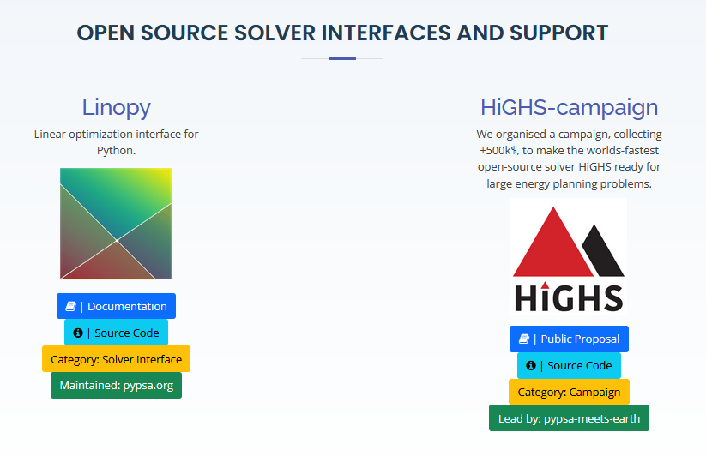
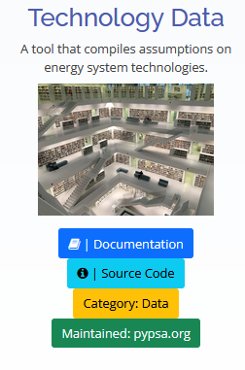
Grassroots initiative that aims to accelerate and cost-optimize the world’s transition to sustainable, accessible and reliable energy with open-source planning tools and open data.
Notes:
Mission statements:
Accelerating global energy transition
Improving openness to maximize global impact
Enabling effective global collaboration

Slide 3
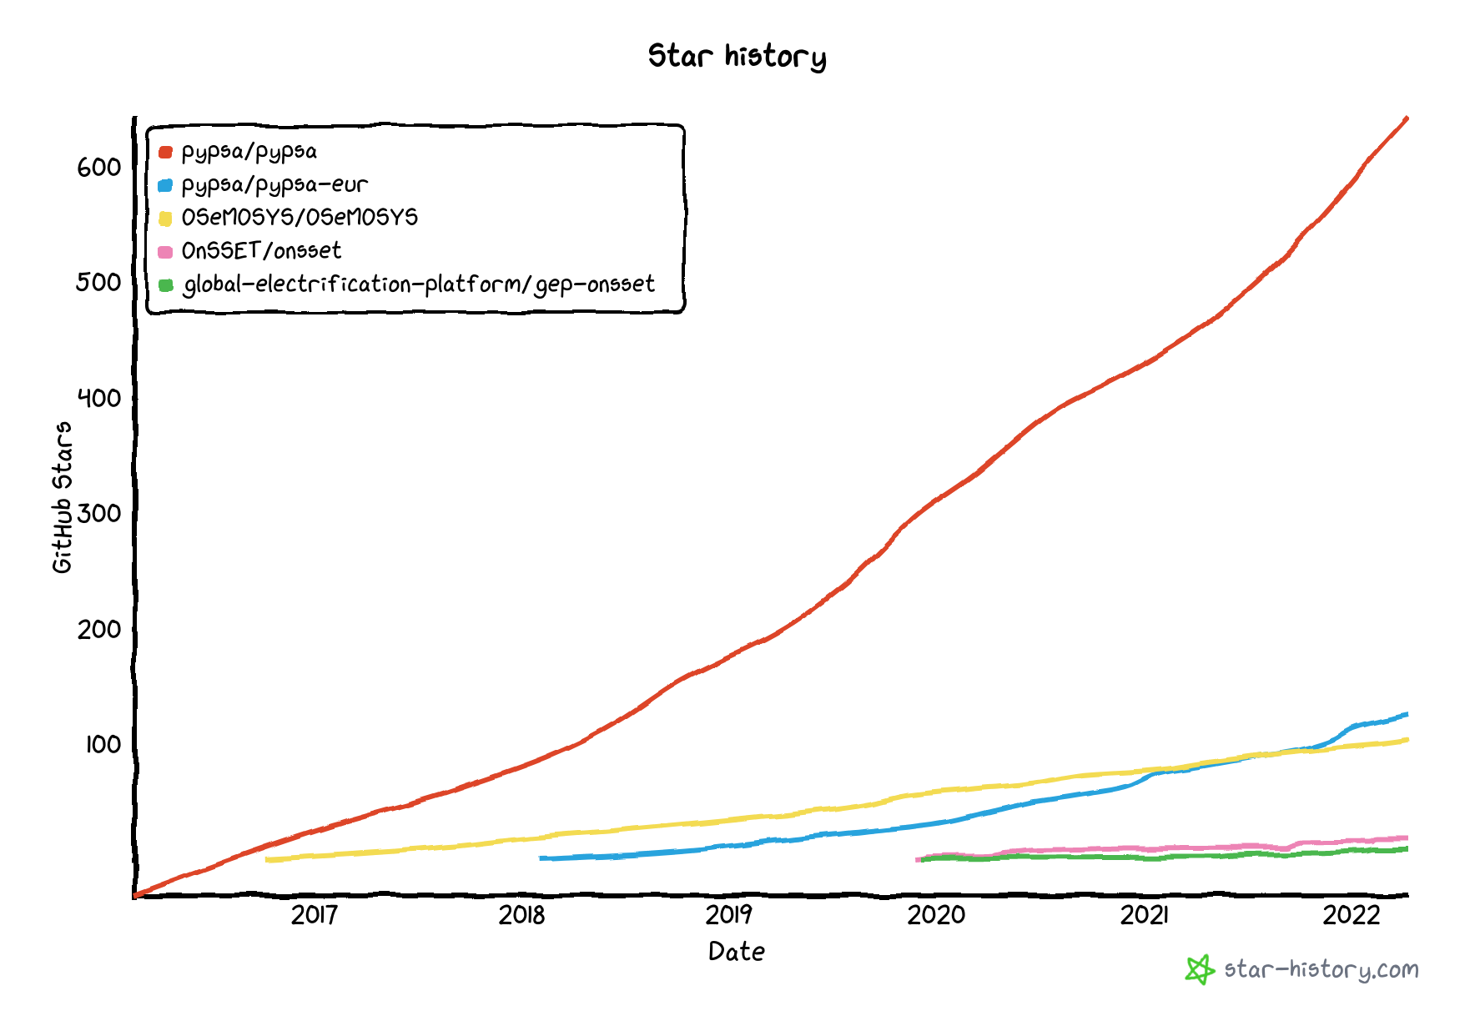
GitHub stars – indicating the user popularity and adoption
PyPSA
Tools in the PyPSA ecosystem have in total more than 1000+ stars. It is the most popular one for open-source long-term energy planning
PyPSA-Eur
OSeMOSYS
OnSSET
OnSSET-Gep

Slide 4
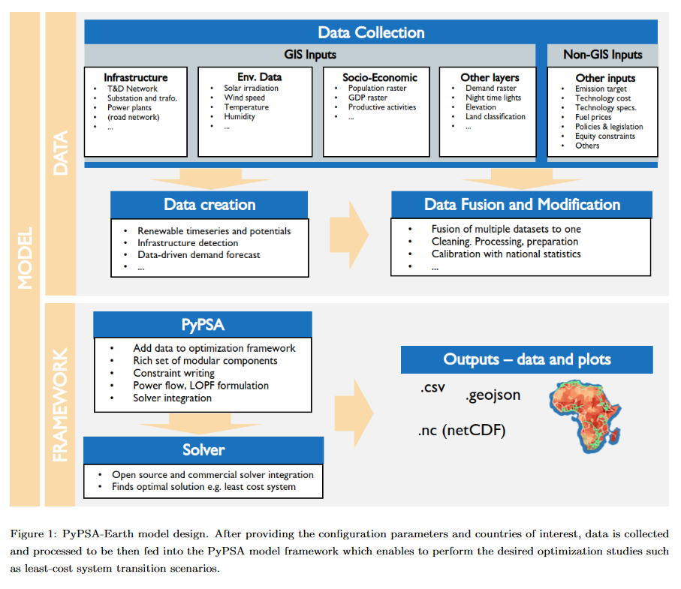
PYPSA-EARTH DESIGN (=PYPSA-EUR DESIGN)

Slide 5
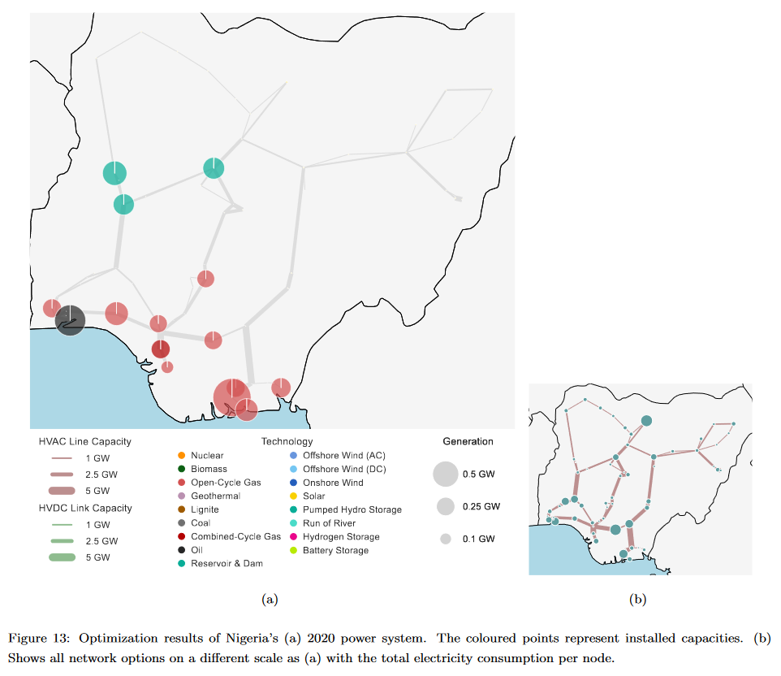
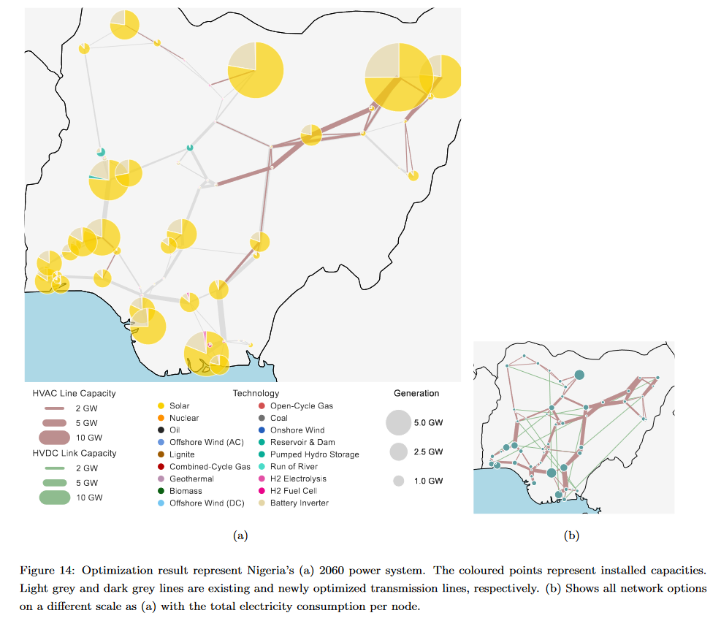
PYPSA-EARTH OUTPUT EXAMPLE
NIGERIA 2020
59 €/MWh
NIGERIA 2060
51 €/MWh

Slide 6
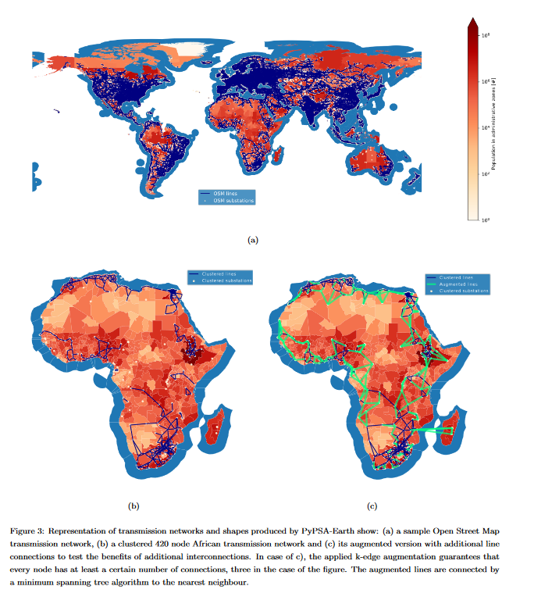
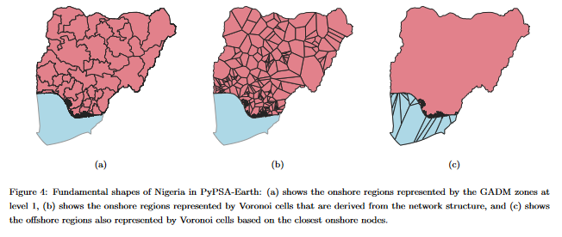
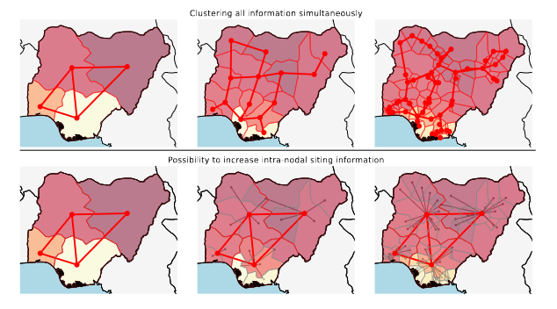
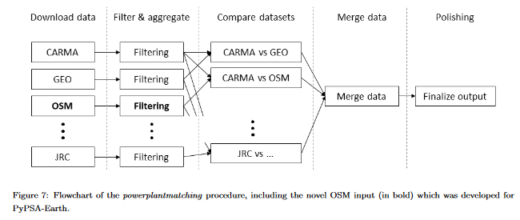
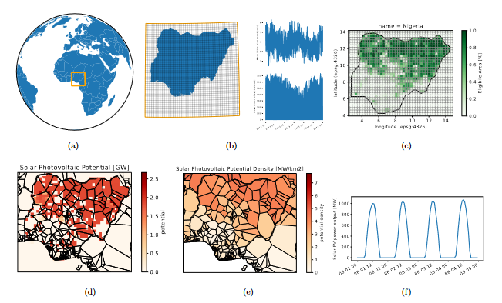
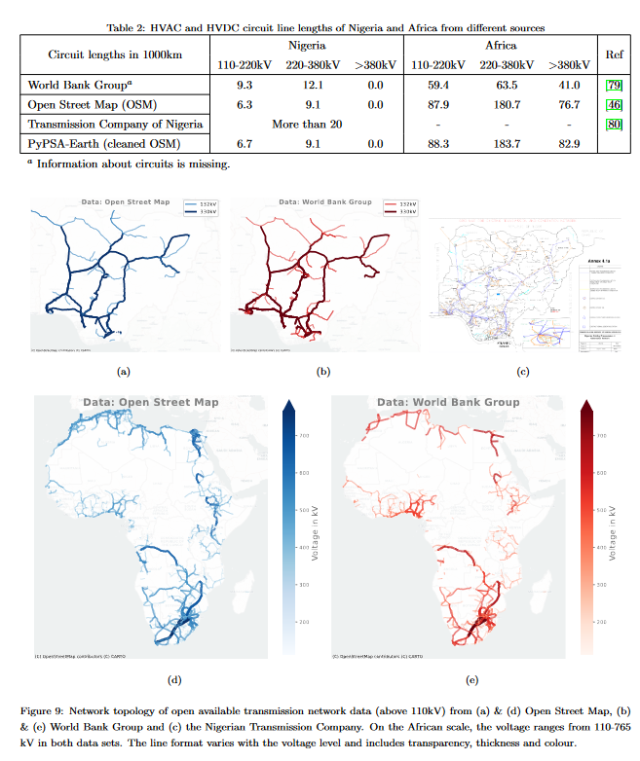
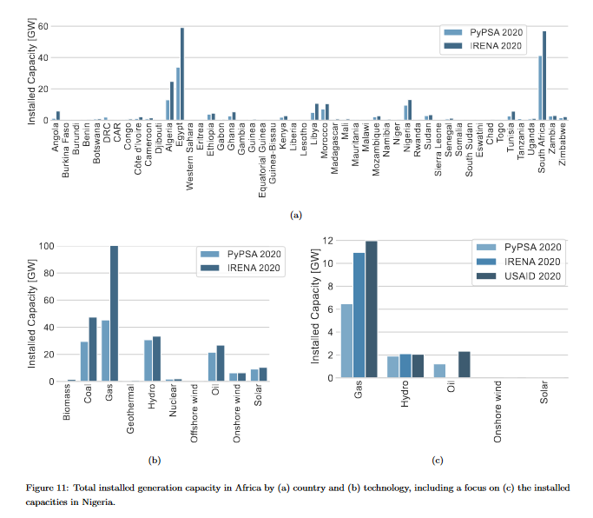
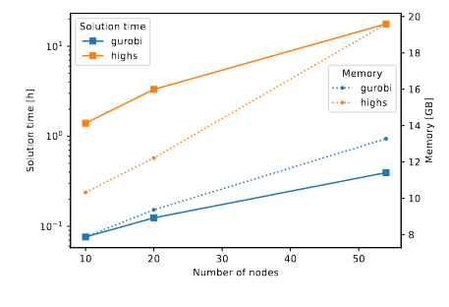
THERE IS ALSO NEW STUFF
NEW DATA INTEGRATIONS
OpenStreetMap grid,
OpenStreetMap generators,
Global protected areas
Global landcover
New load data integrations (h)
Parameter updates
NEW FUNCTIONALITIES
Functions are generalized to work on Earth
Clustering along administrative zones
Augmented lines e.g. k-edge augmentation
New testing, validation and illustration soft. design
NEW VALIDATIONS
Africa validation,,Nigeria close-look

Slide 7
How to be part of the team?
GET INFORMED
- gain knowledge -
Check out publications/papers
Checkout YouTube/ Google
GitHub issues & PR’s indicate needs
SET GOALS
- mindset to contribute -
New data interface
New methods
New technology
Performance increase
Rewrite legacy code
New validation
New package
REACH OUT
- understand how to do that -
Write us on Discord
Write a comment on GitHub
Join “open” meetings
USE TOOLS
- gain experience -
Apply tools for a small or big study
Play around with tools

Slide 8
PYPSA-EARTH: MAKING THE ENERGY TRANSITION GLOBAL
Central Asia
Energy supply&energy efficiency is associated with the region development
Water-energy nexus is critical
Energy mix is heavily based on fossil fuels
Excellent renewable resources (wind, solar, hydro)
National energy transition plans
Increasing perception towards renewable power
Knowledge gap: energy modelling is rare, open energy modelling is extreme rare

Slide 9
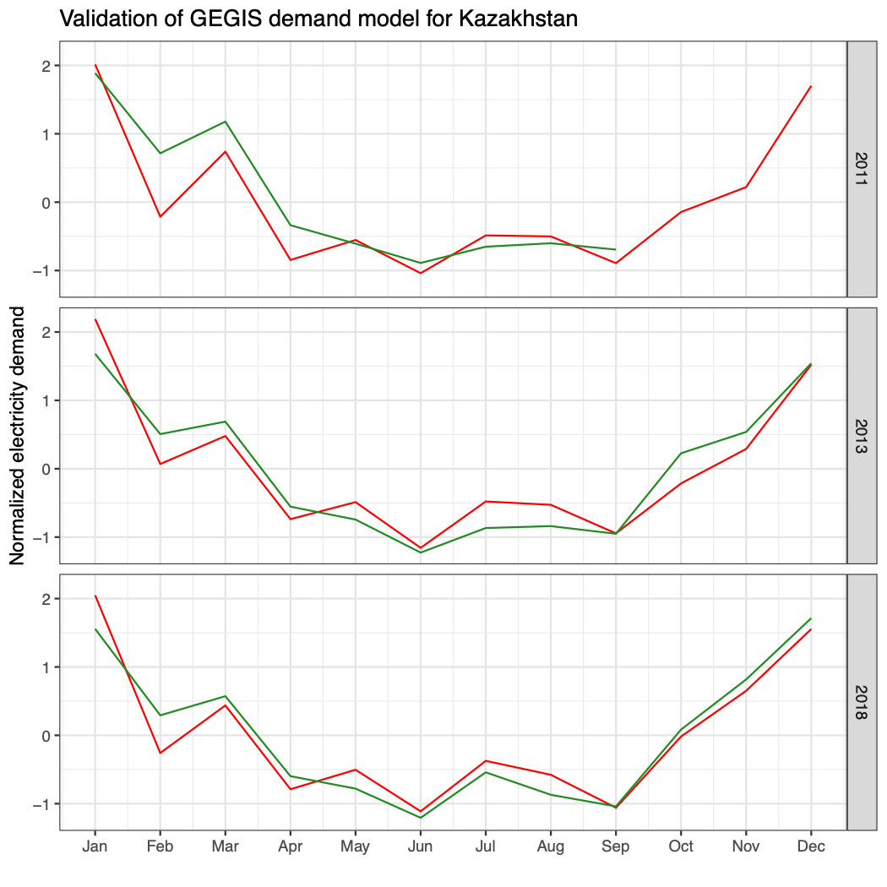
PYPSA-EARTH: MAKING THE ENERGY TRANSITION GLOBAL
measurements
model

Slide 10
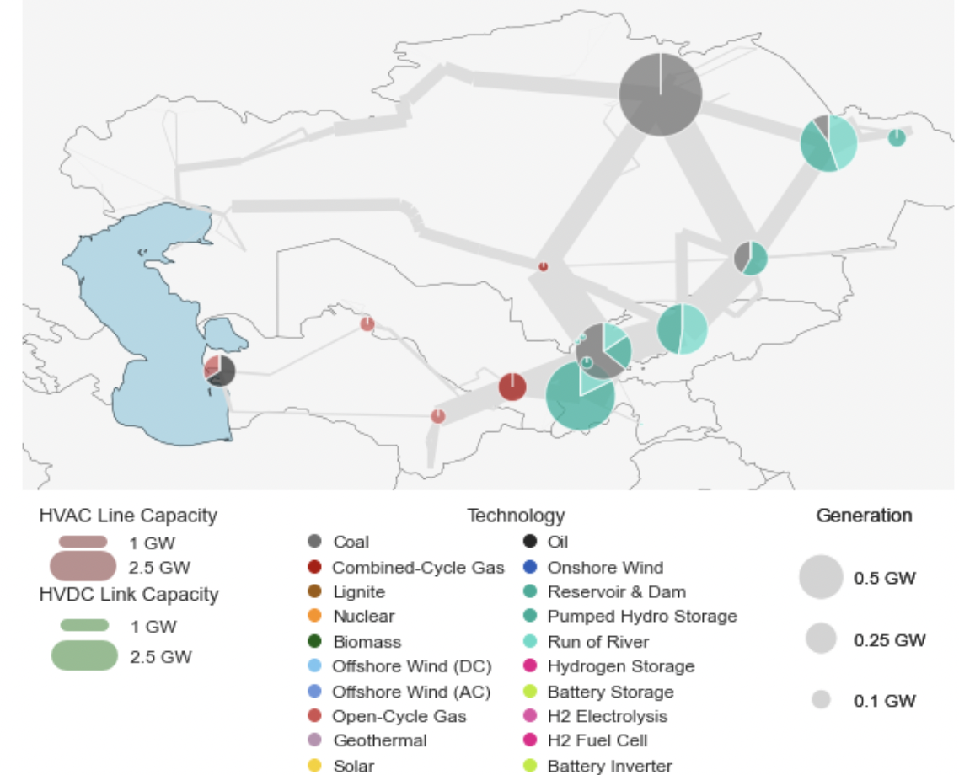
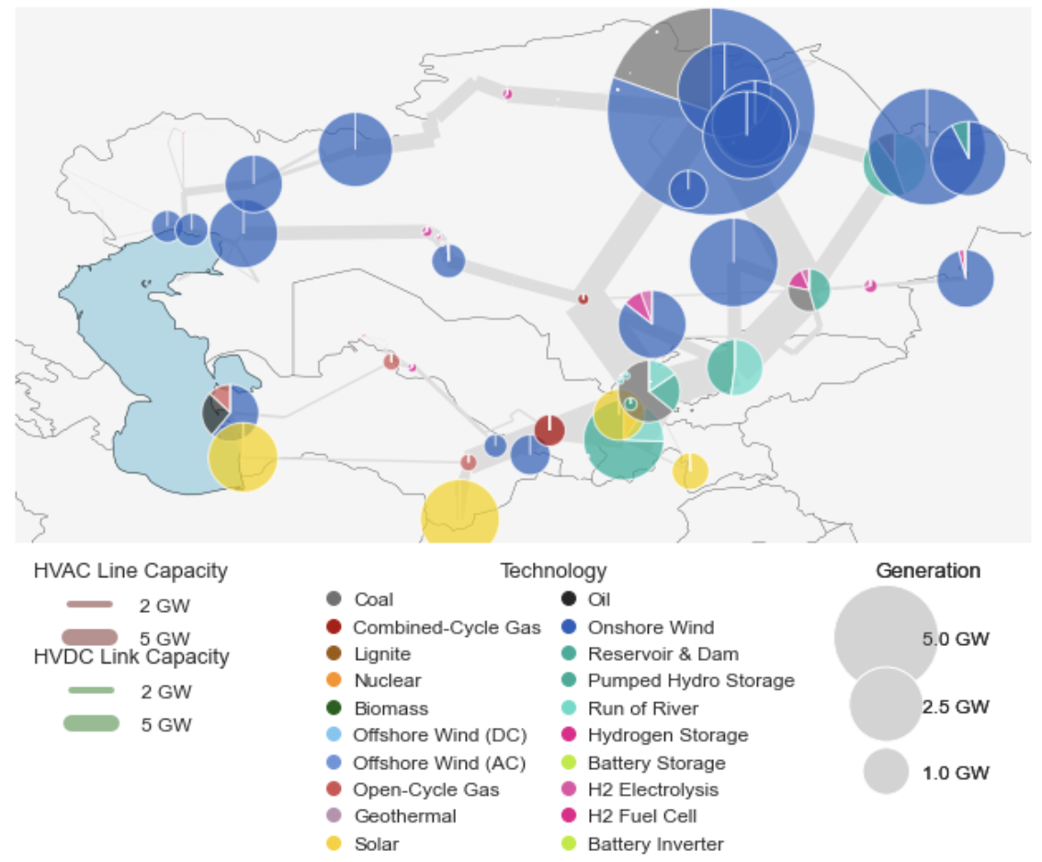
PYPSA-EARTH: MAKING THE ENERGY TRANSITION GLOBAL

Slide 11
YOU CAN CHANGE THE WORLD!
21.10.2022,
Ekaterina Fedotova (Central Asia lead PyPSA-Earth),
Maximilian Parzen (Co-director PyPSA-Earth)
Notes:
https://deepai.org/machine-learning-model/text2img

